Slide 1
www.dementiabehaviors.com
Atul Sunny Luthra MD MSc FRCPC

Slide 3
LuBAIR™ Paradigm
Expressions have a ‘Purpose’…
How caregivers interpret expressions
Expressions have a ‘Meaning’…
What the PwNCD is ‘communicating’ to caregivers

Slide 4
Sensorium
Information Processing Circuits
Motivational Circuits
Emotional Regulatory Circuits
Self Monitoring and Regulatory Circuits
Higher Cortical Intellectual Functions
(HCIF)
Thinking Functions
Behavioral Functions
Emotional Functions

Slide 5
Sensorium
(gatekeeper)

Slide 6
LuBAIR™ Paradigm
Functional Hierarchy of the Brain
S. Sensorium
i. Intellectual Functions
T. Thinking Functions
E. Emotional Functions
A. Actions or Behavioral Functions
{S.i.(T.e.a)T}
Pronounced S i T Model
Notes:
Copy of this slide needs to go as slide 5.
DONE
Should we consider changing
The ‘meaning’ caregivers attribute to expressions
To
How caregivers interpret expressions
Because the word ‘meaning’ under ‘purpose’ instead of ‘meaning’ is kind of confusing

Slide 7
What is Dementia
……….Normal Sensorium……….
Information Processing Circuits
Motivational Circuits
Emotional Regulatory Circuits
Self Monitoring and Regulatory Circuits
IMPAIRMENT

Slide 8
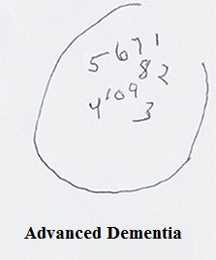
What is Dementia?
IMPAIRMENT
The Mini-Mental State Examination (MMSE)
Montreal Cognitive Assessment (MOCA)
CDT
Higher Cortical Intellectual Functions (HCIF)
Executive Functions
Visuospatial
Memory
Language Functions
Praxis
Gnosia
Insight/ Judgment

Slide 9
Brain Circuits for Normal Brain Function
Regulation of Sensorium
Information Processing Circuits
Motivational Circuits
Emotional Regulatory Circuits
Self-Monitoring & Regulatory Circuits
Notes:
Need to remove this slide from here and move it down as slide 34.
DONE

Slide 10
Approach to Classification
Impairment in Regulation of Sensorium
Disorganized Expressions
Impairment in Information Processing Circuits
Misidentification Expressions
Sensorium
Information Processing Circuits

Slide 11
Approach to Classification
Impairment in Motivational Circuits
Goal Directed Expressions
Apathy Expressions
Motor Expressions
Importuning Expressions
Motivational Circuits

Slide 12
Approach to Classification
Impairment in Emotional Regulatory Circuits
Vocal Expressions
Emotional Expressions
Fretful/Trepidation Expressions
Emotional Regulatory Circuits

Slide 13
Approach to Classification
Impairment in Self-Monitoring & Regulatory Circuits
Oppositional Expressions
Physically Responsive Expressions
Sexual Expressions
Self Monitoring and Regulatory Circuits

Slide 14
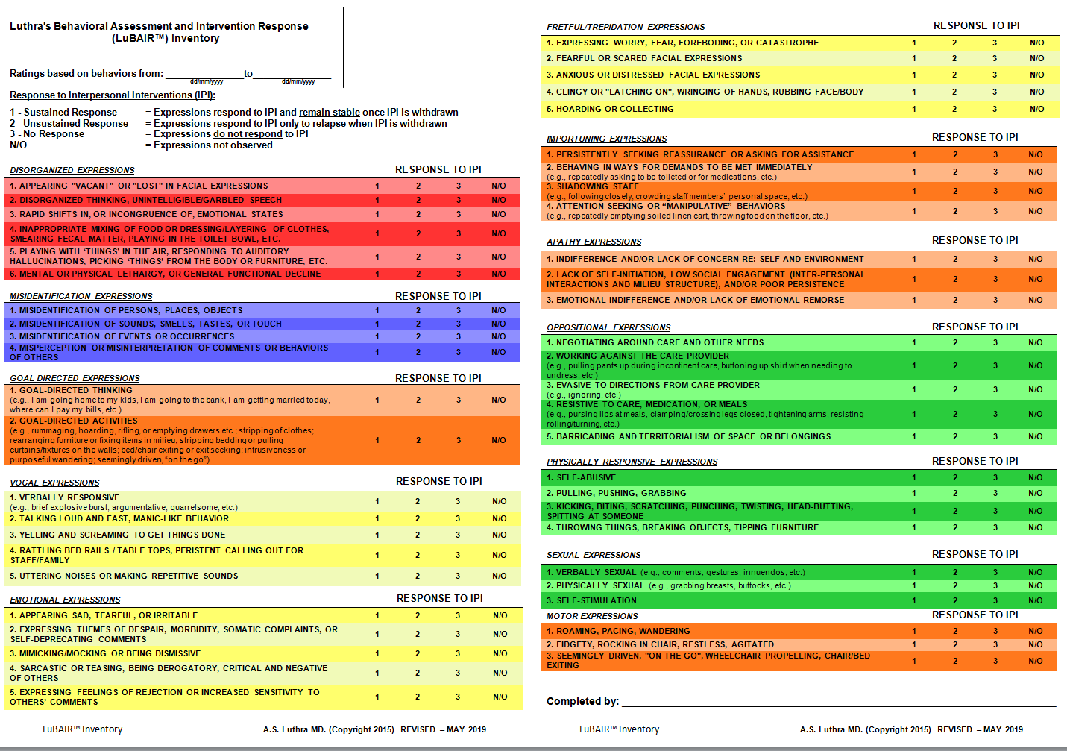
Luthra’s Behavioral Assessment and Intervention Response (LuBAIR™) Inventory

Slide 15
LuBAIR™ Inventory
Based in Impairment in Regulation of Sensorium
Disorganized Expressions
Sensorium

Slide 16
Arousal or Alertness
Sensorium
Attention
Notes:
Need a slide before this on introducing ‘sensorium’. it’s the ‘gate-keeper’ to flow of information.
SEE PREVIOUS SLIDE
NOTE: Does it make sense to tell listeners that the sensorium is the gatekeeper before they even know what it is?

Slide 17
Arousal or Alertness
Arousal or Alertness
State of wakefulness
Psychological and physiological domain
Purpose
Reaction to stimulus
Speed of information processing

Slide 18
Attention
Attention
Behavioral and cognitive processes involved in focusing on stimulus
Purpose
Determine which “chunk” of information will be processed

Slide 19
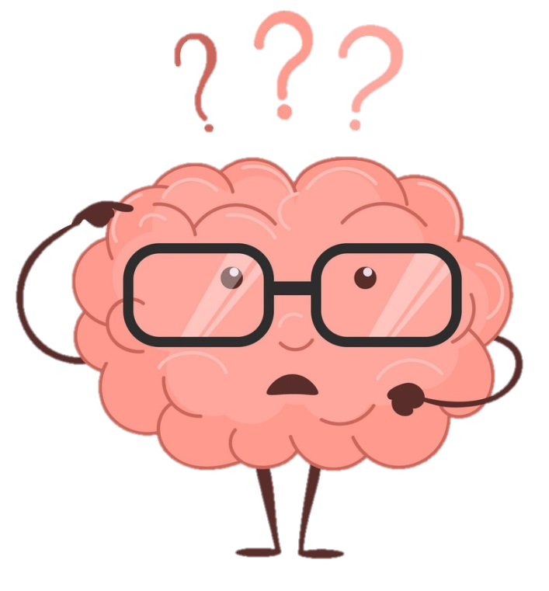
LuBAIR™ Inventory
Based in Impairment in Regulation of Sensorium
Disorganized Expressions
Impaired reaction time
Impaired processing speed
Impairment in which “chunk” of information is processed

Slide 20
LuBAIR™ Inventory
Based in Impairment in Regulation of Sensorium
Disorganized Expressions
Alertness or Arousal
Impaired reaction time and processing speed
Attentiveness
Impaired chunk of information
Information Processing Circuits
Task Performance

Slide 21
LuBAIR™ Inventory
Based in Impairment in Regulation of Sensorium
Disorganized Expressions
There is something different about Ms. Smith today.
Ms. Smith seems more confused as of late.

Slide 22
LuBAIR™ Inventory
Based in Impairment in Regulation of Sensorium
Disorganized Expressions
Purpose of Expressions
Increased “confusion” from baseline

Slide 23
LuBAIR™ Inventory
Based in Impairment in Regulation of Sensorium
Disorganized Expressions
Meaning of Expressions
“My body physiology has changed. Please help me find the cause.”

Slide 24
LuBAIR™ Inventory
Based in Impairment in Regulation of Sensorium
Disorganized Expressions
Baseline
“Giuseppe, Open you mouth, its time to brush our teeth”
“Lift your arms, time to change your shirt”
Today.
Simply looks at you, looks through you vaguely
Blank look in his eyes
1. APPEARING "VACANT" OR "LOST" IN FACIAL EXPRESSIONS

Slide 25
LuBAIR™ Inventory
Based in Impairment in Regulation of Sensorium
Disorganized Expressions
Baseline
“I need … call my wife today” “When do . shower today
Speech intelligible
Today
“wife .. Call need today” “Today shower ….. When”
Marbles in the mouth speech.
2. Disorganized Thinking or Unintelligible Speech

Slide 26
LuBAIR™ Inventory
Based in Impairment in Regulation of Sensorium
Disorganized Expressions
Baseline
“Mrs. Smith, Good Morning. Are we ready for breakfast”
Polite, courteous response: “a little, may be”
Today.
Initial response angry, loud and intense, “Why do you care, try eating this garbage food everyday”. Next sarcastic, condescending laughter “You don’t need food everyday, you are fat”. Followed by becoming emotional, weepy, remorseful and profusely apologizing.
3. RAPID SHIFTS IN, OR INCONGRUENCE OF, EMOTIONAL STATES

Slide 27
LuBAIR™ Inventory
Based in Impairment in Regulation of Sensorium
Disorganized Expressions
Baseline
Set up Raj for meals. Mix dressing in the salad. Use spoon to feed soup, able to use knife and fork to cut meat and feed self.
In the shower, Raj is handed the loofaa and is able to apply soap all over the body and step into the shower.
Today.
Putting soup in the salad, using hands to separate meat and knife/fork to cut the dessert.
Once handed the loofaa, he starts to eat it
4. INAPPROPRIATE MIXING OF FOOD OR DRESSING/LAYERING OF CLOTHES, SMEARING FECAL MATTER, PLAYING IN TOILET BOWL, ETC.

Slide 28
LuBAIR™ Inventory
Based in Impairment in Regulation of Sensorium
Disorganized Expressions
Baseline
Ms. Smith is always asleep when you are proving care to Fred, across the hall.
Mr. Cheng always clings to the nurse and shadowing the med cart all evening
Today
You hear Ms. Smith talking, you peak in to see her having a dialogue and busy directing ‘someone’ to open the closet and fetch her clothes
Mr. Cheng is roaming at the other end of the hall, away from the nurse and the med cart, picking ‘stuff’ off the floor and putting in his pocket all evening
5. PLAYING WITH ‘THINGS’ IN THE AIR, RESPONDING TO AUDITORY HALLUCINATIONS, PICKING ‘THINGS’ FROM BODY OR FURNITURE, ETC.

Slide 29
LuBAIR™ Inventory
Based in Impairment in Regulation of Sensorium
Disorganized Expressions
Baseline
Alert, upright/midline and roaming the unit all evening
Functional swallow, fecal Continence, pivot transfer
Today
Drowsy, leaning to the right and sitting on the couch all evening
Pocketing food, fecal incontinence and mechanical transfer
6. MENTAL OR PHYSICAL LETHARGY, OR GENERAL FUNCTIONAL DECLINE

Slide 30
LuBAIR™ Inventory
Based in Impairment of Information Processing Circuits
Misidentification Expressions
Information Processing Circuits

Slide 31
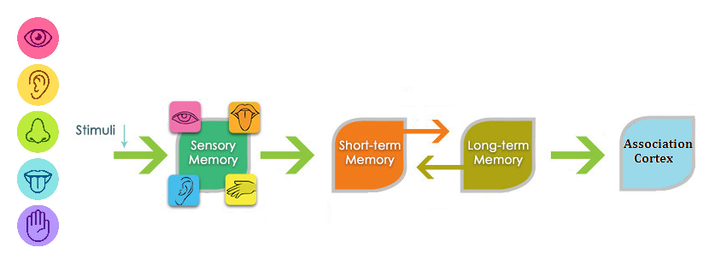
LuBAIR™ Inventory
Based in Impairment of Information Processing Circuits
Misidentification Expressions

Slide 32
LuBAIR™ Inventory
Based in Impairment of Information Processing Circuits
Misidentification Expressions
Encoding
Schema Identification <……………….> Long Term Memories
Pattern Recognition <……………….> Long Term Memories
Working Memory
Pairing of New with Old
Inner World Order (Mental Images)

Slide 33
LuBAIR™ Inventory
Based in Impairment of Information Processing Circuits
Misidentification Expressions
Breakdown in pairing of ‘old’ and ‘new’ information
Information is of ‘great’ personal importance to PwD
‘Altered’ sense of relatedness between PwD and their environment

Slide 34
LuBAIR™ Inventory
Based in Impairment of Information Processing Circuits
Misidentification Expressions
Purpose of Expressions
An alternative approach to assess for psychosis

Slide 35
LuBAIR™ Inventory
Based in Impairment of Information Processing Circuits
Misidentification Expressions
Meaning of Expressions
“Please help me – my thinking and perception is NOT based in reality”

Slide 36
LuBAIR™ Inventory
Based in Impairment of Information Processing Circuits
Misidentification Expressions
Persons
Labelling another resident as their “wife”.
(H/O a loving, functional married life)
Labelling “wife” as an Imposter
(Distrusting, adversarial and contentious married life)
1. MISIDENTIFICATION OF PERSONS, PLACES, OBJECTS

Slide 37
LuBAIR™ Inventory
Based in Impairment of Information Processing Circuits
Misidentification Expressions
Places
“What are these people doing in my home. Get them out of here or I will hurt them”
“They need to pay rent , can’t live for free”
Immigrant, brought over and supported extended family renting homes
Very passionate but fair as a landlord
1. MISIDENTIFICATION OF PERSONS, PLACES, OBJECTS

Slide 38
LuBAIR™ Inventory
Based in Impairment of Information Processing Circuits
Misidentification Expressions
Objects
“See those people (faces) in the tree, they watch me”
“See the goats behind the bushes, keep stealing them”
Farmer by trade
Long standing conflicts with the neighbor
1. MISIDENTIFICATION OF PERSONS, PLACES, OBJECTS

Slide 39
LuBAIR™ Inventory
Based in Impairment of Information Processing Circuits
Misidentification Expressions
Sounds
“Do you hear the water gushing, I am drowning”
“I am not leaving my bed”
Lost everything in house flooding a defining moment
Faulty Air vents with ribbons attached
2. MISIDENTIFICATION OF SOUNDS, SMELLS, TASTES, OR TOUCH

Slide 40
LuBAIR™ Inventory
Based in Impairment of Information Processing Circuits
Misidentification Expressions
Sounds
“The tanks are rolling in, we’re under attack”
Korean war veteran, armory division with combat experience
Once a week cleaning staff would bring electric machines
2. MISIDENTIFICATION OF SOUNDS, SMELLS, TASTES, OR TOUCH

Slide 41
LuBAIR™ Inventory
Based in Impairment of Information Processing Circuits
Misidentification Expressions
Olfactory
“Every one evacuate, building is on fire”
Episodic occurrence in the morning
Lost everything in a house fire
Toast preparation at breakfast
2. MISIDENTIFICATION OF SOUNDS, SMELLS, TASTES, OR TOUCH

Slide 42
LuBAIR™ Inventory
Based in Impairment of Information Processing Circuits
Misidentification Expressions
Olfactory
“Call the plumbing company, there is sewage leak”
Episodic occurrence in the evening
Lived through a septic tank overflow
Ethnic food for dinner (Indian or Asian)
2. MISIDENTIFICATION OF SOUNDS, SMELLS, TASTES, OR TOUCH

Slide 43
LuBAIR™ Inventory
Based in Impairment of Information Processing Circuits
Misidentification Expressions
Gustatory
Stopped eating. All food laced with ‘arsenic’
Worked as a spy during cold war
‘Chip on the shoulder’ personality
2. MISIDENTIFICATION OF SOUNDS, SMELLS, TASTES, OR TOUCH

Slide 44
LuBAIR™ Inventory
Based in Impairment of Information Processing Circuits
Misidentification Expressions
Tactile
“The nurse twisted my wrist, beat me up” pointing to all the bruises on her arms and legs.
Orphaned young and regularly strapped by step-father
2. MISIDENTIFICATION OF SOUNDS, SMELLS, TASTES, OR TOUCH
Notes:
Need to add another bullet. Male RN put a suppository. Accused by PwD of attemtped rape. h/o sexual trauma.
DONE

Slide 45
LuBAIR™ Inventory
Based in Impairment of Information Processing Circuits
Misidentification Expressions
Tactile
‘I was almost raped by this man”
Male RN applying cream to the excoriated perineum
Survivor of childhood trauma
2. MISIDENTIFICATION OF SOUNDS, SMELLS, TASTES, OR TOUCH

Slide 46
LuBAIR™ Inventory
Based in Impairment of Information Processing Circuits
Misidentification Expressions
Events and occurrences
“I am being evicted”
Several deaths in the LTCH rooms sanitized
h/o homelessness and frequent moves
3. MISOF EVENTS OR OCCURRENCES

Slide 47
LuBAIR™ Inventory
Based in Impairment of Information Processing Circuits
Misidentification Expressions
Comments or Actions of Others
“Why do you always yell at me. Why don’t you like me”
Raised in a loud, chaotic and abusive environment
4. MISPERCEPTION OF COMMENTS OR BEHAVIORS OF OTHERS

Slide 48
LuBAIR™ Inventory
Based in Impairment of Information Processing Circuits
Misidentification Expressions
Purpose of Expressions
An alternative approach to assess for psychosis

Slide 49
LuBAIR™ Inventory
Based in Impairment of Information Processing Circuits
Misidentification Expressions
Meaning of Expressions
“Please help me – my thinking is NOT based in reality”

Slide 50
LuBAIR™ Inventory
Based in Impairment of Motivational Circuits
Goal Directed Expressions
Apathy Expressions
Motor Expressions
Importuning Expressions

Slide 51
LuBAIR™ Inventory
Based in Impairment of Motivational Circuits
Need
Preserved Motivational Circuits needed to:
Detect State of discrepancy between
Internal Physiological or Psychological state, and The external state of the Milieu, to
Identify a Need

Slide 52
LuBAIR™ Inventory
Based in Impairment of Motivational Circuits
The Process
Needs thoughts
Thoughts goals Goals
Goals ‘drives’ or ‘motivation’
‘Motivation’ need
Results in goal attainment
get represented as
lead to formation of
trigger
propels to satiate the
Notes:
Alternative
Needs get represented as thoughts
Thoughts lead to formation of goals
Goals trigger ‘drives’ or ‘motivation’
‘Motivation’ propels to satiate the need
This results in goal attainment

Slide 53
LuBAIR™ Inventory
Based in Impairment of Motivational Circuits
Goal Directed Expressions
‘Needs’ and ‘Motives’ Coexist
Needs Thoughts Goals
Release Satiation Motive

Slide 54
LuBAIR™ Inventory
Based in Impairment of Motivational Circuits
Goal Directed Expressions
Motivational Circuits
Notes:
Do we need the top line since we have a schematic of impairment of Motivational Circuits? Put the diagram first and then Goal Directed Behaviors
If we make this change, this will mean that other slides are not the same. Also, I think explicitly connecting the expressions to the type of impairment is helpful and keeps the viewer consistently connecting the ideas

Slide 55
LuBAIR™ Inventory
Based in Impairment of Motivational Circuits
Goal Directed Expressions
1. GOAL DIRECTED THINKING (e.g., I am going home to my kids, I am going to the bank, I am getting married today, where can I pay my bills, etc.)
Leads to
2. GOAL DIRECTED ACTIVITIES (e.g., rummaging, hoarding, rifling, or emptying drawers etc.; stripping of clothes; rearranging furniture or fixing items in milieu; stripping bedding or pulling curtains/fixtures on the walls; bed/chair exiting or exit seeking; intrusiveness or purposeful wandering; seemingly driven, “on the go”)
Notes:
Very crowded. Do we need this slide?
I think this helps to contextualize the 2 points that fall under this category, and underscores that they are directly linked. Also, every other group of expressions are covered individually – if this slide is eliminated, then this will be the only one that doesn’t.

Slide 56
LuBAIR™ Inventory
Based in Impairment of Motivational Circuits
Goal Directed Expressions
Impairment in MC. High Motivational Drives
Heightened detection of discrepancy between self and milieu
Persistent and repetitive Appears determined
High degree of ‘unrest’.
Staff playing ‘catch-up’

Slide 57
LuBAIR™ Inventory
Based in Impairment of Motivational Circuits
Goal Directed Expressions
Purpose of Expressions
Presence of “busy beaver” states

Slide 58
LuBAIR™ Inventory
Based in Impairment of Motivational Circuits
Goal Directed Expressions
Meaning of Expressions
“Please help me belong...”
(Family, Faith, Community Profession or Life’s Work, Ethnicity)

Slide 59
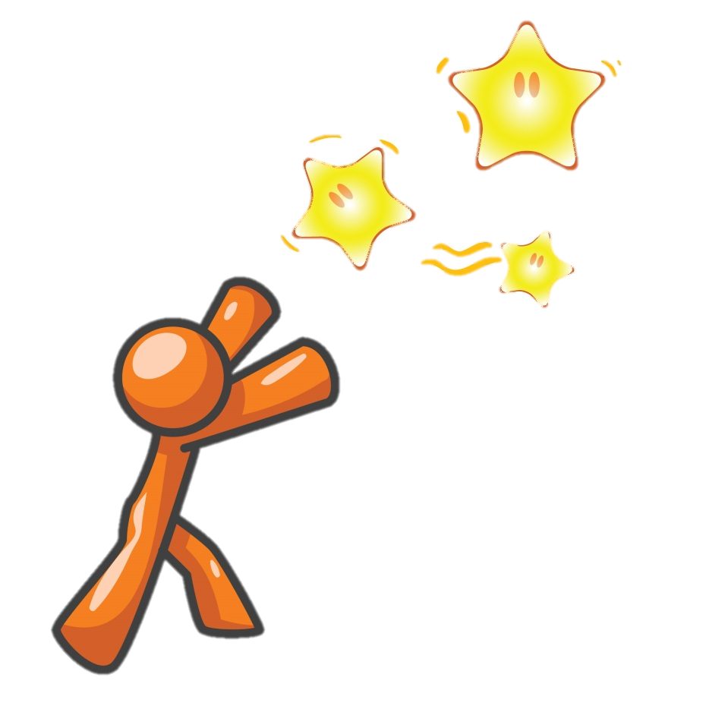
LuBAIR™ Inventory
Based in Impairment of Motivational Circuits
Goal Directed Expressions
(Goal Directed) Thought
“My husband will be home by 4, I need to go home and make dinner”
(Goal Directed) Action
Intrusiveness into nursing station, pacing,
exit-seeking, trying the doors, becoming increasingly
distressed and inconsolable.
(Belongingness to Family)
Notes:
GDT ‘I need to go home to feed the kids; they are alone and waiting for me…. GDA. Intrussives into the nursing station, Pacing the floor, trying the doors, exit seeking

Slide 60
LuBAIR™ Inventory
Based in Impairment of Motivational Circuits
Goal Directed Expressions
(Goal Directed) Thought”
“I am late for the appointment with Father Carruthers”
(Goal Directed) Action
Repetitive requests to call son for a ride to the church, getting angry at staff, calling them names, insulting their religion
(Belongingness to Faith)
Notes:
GDT ‘I need to go home to feed the kids; they are alone and waiting for me…. GDA. Intrussives into the nursing station, Pacing the floor, trying the doors, exit seeking

Slide 61
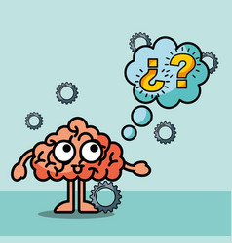
LuBAIR™ Inventory
Based in Impairment of Motivational Circuits
Goal Directed Expressions
(Goal Directed) Thought
“I need to get to the bank to pay my mortgage. I will loose my house”
(Goal Directed) Action
Asking for a phone book, looking for a phone, reaching over desk, entering the nursing station, yelling and screaming.
(Belongingness to Community)
Notes:
I need to pay the utility, gas or telephone bill….. Requesting for a phonebook, looking for a phone, reaching over nursing station for the phone

Slide 62
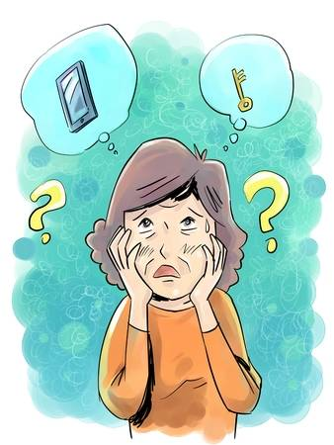
LuBAIR™ Inventory
Based in Impairment of Motivational Circuits
Goal Directed Expressions
(Belongingness to Work)
(Goal Directed) Thought
“I am late for work! Where are my keys?”
(Goal Directed) Action
Rummaging, rifling, emptying drawers, changing clothes, confrontational.

Slide 63
LuBAIR™ Inventory
Based in Impairment of Motivational Circuits
Goal Directed Expressions
(Goal Directed) Thought”
“I am going to get all of them fired”
(Goal Directed) Action
Opening seat belts, shaking residents from sleep, pushing their W/C, moving furniture, TV etc.
(Organizational Belonging)
Notes:
GDT ‘I need to go home to feed the kids; they are alone and waiting for me…. GDA. Intrussives into the nursing station, Pacing the floor, trying the doors, exit seeking

Slide 64
LuBAIR™ Inventory
Based in Impairment of Motivational Circuits
Apathy Expressions
Motivational Circuits
Notes:
Apathy Expressions go after GDB.
DONE

Slide 65
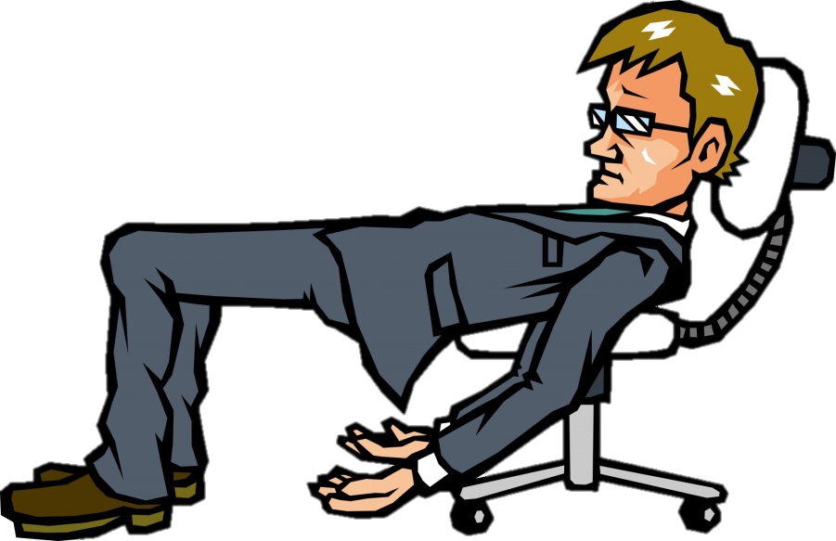
LuBAIR™ Inventory
Based in Impairment of Motivational Circuits
Apathy Expressions
Impairment in MC. Low or absent Motivational Drive
No detection of discrepancy between self and milieu
NO recognition of any Need
Lack of Insight of the same

Slide 66
LuBAIR™ Inventory
Based in Impairment of Motivational Circuits
Apathy Expressions
Purpose of Expressions
Presence of “lazy” states

Slide 67
LuBAIR™ Inventory
Based in Impairment of Motivational Circuits
Apathy Expressions
Meaning of Expressions
“Please help me – I do not recognize my deficits”

Slide 68
LuBAIR™ Inventory
Based in Impairment of Motivational Circuits
Apathy Expressions
1. INDIFFERENCE AND/OR LACK OF CONCERN RE: SELF AND ENVIRONMENT
Lack of ‘insight’ into their Absence of…
Care for self (not showing a need to change clothes or bath)

Slide 69
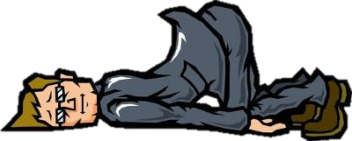
LuBAIR™ Inventory
Based in Impairment of Motivational Circuits
Apathy Expressions
2. LACK OF SELF-INITIATION, LOW SOCIAL ENGAGEMENT (INTER-PERSONAL INTERACTIONS & MILIEU STRUCTURE), AND/OR POOR PERSISTENCE
Lack of ‘insight’ into Presence of…
Poor initiation and persistence
Wife’s repetitive Cueing and set-up for shower
No response “fizzled” response

Slide 70
LuBAIR™ Inventory
Based in Impairment of Motivational Circuits
Apathy Expressions
After days and weeks of trying…..
Wife Response. Angry, frustrated, emotional and distraught in her expressions of ‘burn out’.
Individual’s Response. Presence of Emotional Indifference
No Insight Not showing ………… Concern
3. EMOTIONAL INDIFFERENCE AND/OR LACK OF EMOTIONAL REMORSE

Slide 71
LuBAIR™ Inventory
Based in Impairment of Motivational Circuits
Apathy Expressions
Conflict further escalates…….
Wife’s Response. At times, yelling and screaming, pushing and shoving. Reaching out to kids, neighbours
Individual Response. No Emotional Remorse (even a smirk)
No Insight Not showing ……… Remorse
3. EMOTIONAL INDIFFERENCE AND/OR LACK OF EMOTIONAL REMORSE

Slide 72
LuBAIR™ Inventory
Based in Impairment of Motivational Circuits
Apathy Expressions
1. INDIFFERENCE AND/OR LACK OF CONCERN RE: SELF AND ENVIRONMENT
Lack of ‘insight’ into their Absence of…
Care for milieu (squalor syndrome)

Slide 73
LuBAIR™ Inventory
Based in Impairment of Motivational Circuits
Apathy Expressions
How is it Different From Depression?
Insight into lack of care for self or others – make excuses
Insight into poor initiation/persistence….. Procrastinate
Excessive ‘Sense of Responsibility’ and ‘Guilt’

Slide 74
LuBAIR™ Inventory
Based in Impairment of Motivational Circuits
Importuning Expressions
Motivational Circuits
Notes:
Need to have Apathy Behaviors after GDB. Then Motor Behaviors and finally would be Importuning Behaviors.
DONE

Slide 75
LuBAIR™ Inventory
Based in Impairment of Motivational Circuits
Importuning Expressions
Preserved to Heightened Motivational Drive
Normal to Heightened detection of Need
Expressions of ‘Need ’ congruent with severity of dementia
(Overt/Obvious) (Occult/Hidden) (Ambiguous/Innocuous)

Slide 76
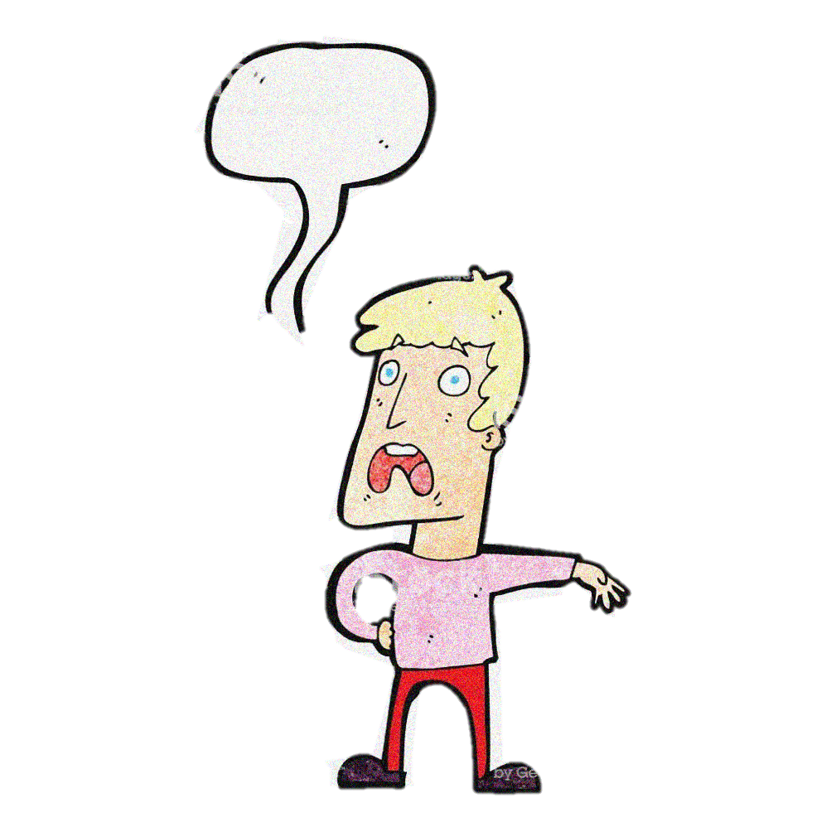
LuBAIR™ Inventory
Based in Impairment of Motivational Circuits
Importuning Expressions
Early Dementia (Obvious/Overt)
“I have to go pee”
“I am hungry”
“My tummy hurts”
!

Slide 77
LuBAIR™ Inventory
Based in Impairment of Motivational Circuits
Importuning Expressions
Middle Dementia (Occult / Hidden)
Crowding around the nursing station
Repeatedly ringing call bell or calling for family
Shadowing staff during medication pass

Slide 78
LuBAIR™ Inventory
Based in Impairment of Motivational Circuits
Importuning Expressions
Advanced Dementia (Ambiguous/Innocuous)
Repeatedly lying down on the floor
Rummaging through garbage and bringing it to PSW
Repeatedly removing incontinent product, handing it to PSWs

Slide 79
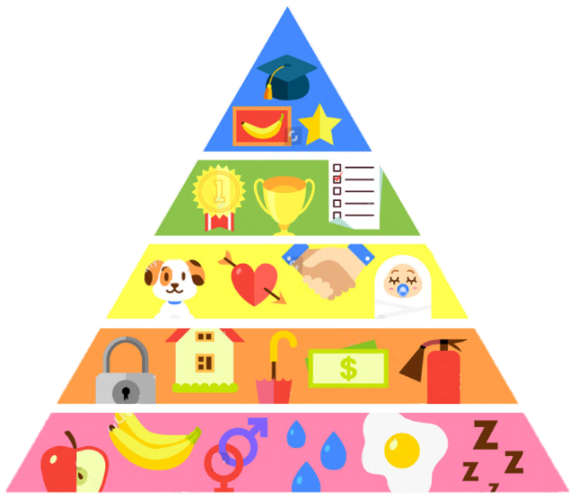
LuBAIR™ Inventory
Based in Impairment of Motivational Circuits
Importuning Expressions
Purpose of Expressions
Presence of unmet ‘basic’ needs

Slide 80
LuBAIR™ Inventory
Based in Impairment of Motivational Circuits
Importuning Expressions
Meaning of Expressions
“Please help me identify my specific innate physiological needs”
(hunger/thirst)
(voiding/defecating)
(fatigue/need to rest)
(pain/discomfort)
(mental/social stimulation)
Pleasure needs
(need for intimacy)
(sexual needs)
Notes:
ORIGINAL

Slide 81
LuBAIR™ Inventory
Based in Impairment of Motivational Circuits
Motor Expressions
Motivational Circuits

Slide 82
LuBAIR™ Inventory
Based in Impairment of Motivational Circuits
Motor Expressions
“Agitation”
Mental Health Definition ---- Symptom
Cohen-Mansfield Definition ---- Syndrome
Most Ubiquitous. Least Helpful

Slide 83
LuBAIR™ Inventory
Based in Impairment of Motivational Circuits
Motor Expressions
Governed by two factors:
Frequency of motor activity
Amplitude of motor activity
Both on a continuum of low to high
Contextual to Milieu its Happening In

Slide 84
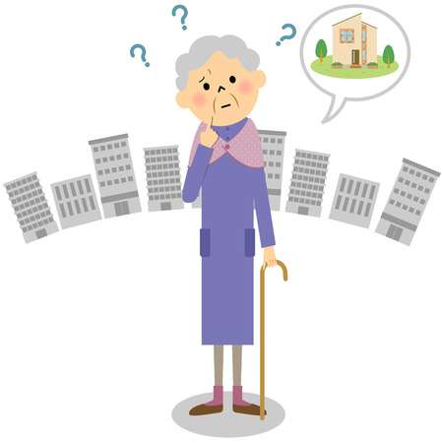
LuBAIR™ Inventory
Based in Impairment of Motivational Circuits
Motor Expressions
“Wandering” Behaviors
‘Purposeful’
‘Purposeless’

Slide 85
LuBAIR™ Inventory
Based in Impairment of Motivational Circuits
Motor Expressions
Does ‘Wandering’ Behavioral Expression appear
‘Purposeful’
or
‘Purposeless’
This is important information!
Please pass it on to the team!

Slide 86
LuBAIR™ Inventory
Based in Impairment of Motivational Circuits
Motor Expressions
Purpose of Expressions
Existence of an ‘unsettled state’

Slide 87
LuBAIR™ Inventory
Based in Impairment of Motivational Circuits
Motor Expressions
Meaning of Expressions
“Please help me – I don’t understand my reasons for being unsettled”

Slide 88
LuBAIR™ Inventory
Based in Impairment of Motivational Circuits
Motor Expressions
If it appears ‘Purposeful’
“I require fulfillment of belongingness needs”, or
“I require fulfillment of innate physiological needs”

Slide 89
LuBAIR™ Inventory
Based in Impairment of Motivational Circuits
Motor Expressions
If it appears ‘Purposeless’
“I may be afraid”, or
“I may be worrying or thinking too much”

Slide 90
BREAK
Notes:
Ideally, this break should occur at around 12 noon at the latest.
1 hour lunch

Slide 91
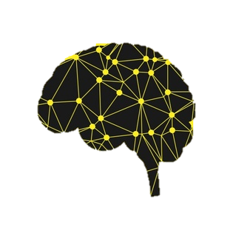
LuBAIR™ Inventory
Based in Impairment of Emotional Regulatory Circuits
Vocal Expressions
Emotional Expressions
Fretful/Trepidation Expressions

Slide 92
LuBAIR™ Inventory
Based in Impairment of Emotional Regulatory Circuits
Mood and Emotions
Two discrete Psychological Constructs
Specific definitions for both
Cannot be used interchangeably

Slide 93
LuBAIR™ Inventory
Based in Impairment of Emotional Regulatory Circuits
Emotions
Arise in context of a specific situation (Extrinsic or Intrinsic)
Experienced as “whole body phenomenon”
Has “control precedence” (Interrupts our consciousness)
Capacity to modifying / changing contextual situation
Parkinson et al. (1996)

Slide 94
LuBAIR™ Inventory
Based in Impairment of Emotional Regulatory Circuits
Mood
Persistent, long lasting and chronic
Diffuse, tied to cognitions rather than ‘Situations’
Lack “control precedence”
Lack capacity to modifying / change context
Clore, Schwarz and Conway (1994)

Slide 95
LuBAIR™ Inventory
Based in Impairment of Emotional Regulatory Circuits
Emotions and Mood
Persistence of the an emotion for a specified duration is ‘mood’
Requires subjective recall
Preserved Cognitive abilities

Slide 96
LuBAIR™ Inventory
Based in Impairment of Emotional Regulatory Circuits
Emotions and Mood
STM is severely impaired in Advanced NCD (>12)
Reliability of Recall of ‘mood and related symptoms’ questionable
Validity and reliability of diagnosis of ‘depression’ needs to be challenged in Advanced NCD

Slide 97
LuBAIR™ Inventory
Based in Impairment of Emotional Regulatory Circuits
Emotions in Advanced NCD
Emotional Comprehension preserved
Emotional Expressivity is decreased (Joy and Pleasure)
Emotional Expressivity Heightened
(Melancholy, Fear, Discontentment and Anger)
Need to work with Emotions, Not Mood

Slide 98
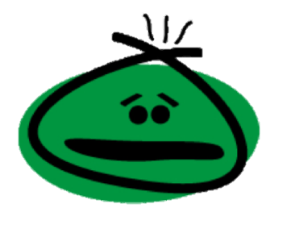
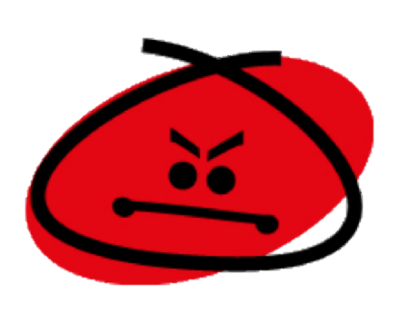
LuBAIR™ Inventory
Based in Impairment of Emotional Regulatory Circuits
Five Primary Emotions:
Joy or Happiness
Discontentment
Fear
Anger
Sadness or Melancholy
Notes:
Need a slide of sigmoid curve; discontentment at the bottom and anger at the top. Need another slide of bell curve; joy at the left end and discontentment / anger at the right end. Another slide of two intersecting circles; one has melancholy an the other is discontentment
DONE

Slide 99
LuBAIR™ Inventory
Based in Impairment of Emotional Regulatory Circuits
Anger
Discontentment
Notes:
Need a slide of sigmoid curve; discontentment at the bottom and anger at the top.

Slide 100
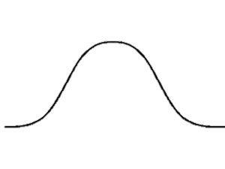
LuBAIR™ Inventory
Based in Impairment of Emotional Regulatory Circuits
Anger
Joy or Happiness
Discontentment
Notes:
Need another slide of bell curve; joy at the left end and discontentment / anger at the right end.

Slide 101
LuBAIR™ Inventory
Based in Impairment of Emotional Regulatory Circuits
Sadness or Melancholy
Discontentment
Notes:
Another slide of two intersecting circles; one has melancholy an the other is discontentment

Slide 102
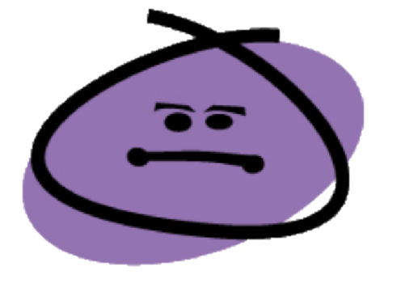
LuBAIR™ Inventory
Based in Impairment of Emotional Regulatory Circuits
Combination of emotions = secondary emotions
Optimism
Love
Awe
Disappointment
Remorse/Guilt
Contempt

Slide 103
Emotional Regulatory Circuits
LuBAIR™ Inventory
Based in Impairment of Emotional Regulatory Circuits
Vocal Expressions

Slide 104
LuBAIR™ Inventory
Based in Impairment of Emotional Regulatory Circuits
Vocal Expressions
Represents two primary emotions:
Anger
&
Joy
Notes:
Need one slide after this which shows the relationship between joy and anger. Also a slide of relationship between discontentment and anger and melancholy and discontentment

Slide 105
LuBAIR™ Inventory
Based in Impairment of Emotional Regulatory Circuits
Vocal Expressions
Generation of Emotions (Anger and Joy)
and
Regulation of Emotions (Anger and Joy)
Impaired

Slide 106
LuBAIR™ Inventory
Based in Impairment of Emotional Regulatory Circuits
Vocal Expressions
The responses are:
Increased in amplitude
Prolonged in duration
Slow to extinguish
‘Out-of-proportion’

Slide 107
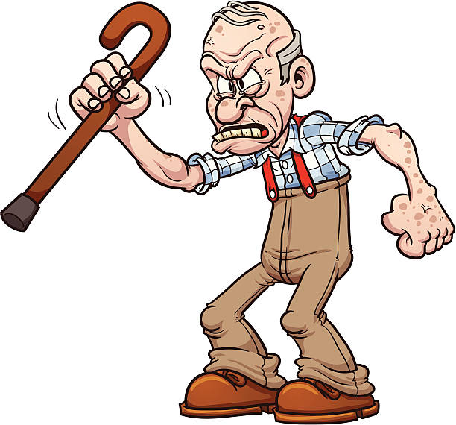
LuBAIR™ Inventory
Based in Impairment of Emotional Regulatory Circuits
Vocal Expressions
1. VERBALLY RESPONSIVE (e.g., brief explosive burst, argumentative, quarrelsome, etc.)

Slide 108
LuBAIR™ Inventory
Based in Impairment of Emotional Regulatory Circuits
Vocal Expressions
Continuum of Emotion of Anger
Brief Explosive Outbursts

Slide 109
LuBAIR™ Inventory
Based in Impairment of Emotional Regulatory Circuits
Vocal Expressions
Continuum of Emotion of Anger
Argumentative or Quarrelsome

Slide 110
LuBAIR™ Inventory
Based in Impairment of Emotional Regulatory Circuits
Vocal Expressions
Continuum of Emotion of Anger
Dysphoric Syndrome
Emotional symptoms (Irritable, Angry, Mood Swings)
Cognitive Symptoms (Projecting blame and distrust)
Behavioral Symptoms (Intense, loud, Agitated, distracted)

Slide 111
LuBAIR™ Inventory
Based in Impairment of Emotional Regulatory Circuits
Vocal Expressions
Continuum of Emotion of Anger
Destructive Syndromes
Shredding Briefs, Towels, Pillows
Picking or Scratching skin, Pulling hair, Biting cuticles/nails

Slide 112
LuBAIR™ Inventory
Based in Impairment of Emotional Regulatory Circuits
Vocal Expressions
Continuum of Emotion of Anger
Primal Scream
Blood curdling, repetitive noise making

Slide 113
LuBAIR™ Inventory
Based in Impairment of Emotional Regulatory Circuits
Vocal Expressions
5. UTTERING NOISES OR MAKING REPETITIVE SOUNDS
Notes:
AUDIO
Click the image ONCE to play it (a second click will stop it)

Slide 114
LuBAIR™ Inventory
Based in Impairment of Emotional Regulatory Circuits
Vocal Expressions
Continuum of Emotion of Joy
Effusive ………….> Elated …………..> Euphoric

Slide 115
LuBAIR™ Inventory
Based in Impairment of Emotional Regulatory Circuits
Vocal Expressions
2. TALKING LOUD AND FAST, MANIC-LIKE BEHAVIOR
Full video found at https://www.youtube.com/watch?v=ExKCcndqK5c
Notes:
VIDEO
Click the video ONCE to play it (a second click will stop it)

Slide 116
LuBAIR™ Inventory
Based in Impairment of Emotional Regulatory Circuits
Vocal Expressions

Slide 117
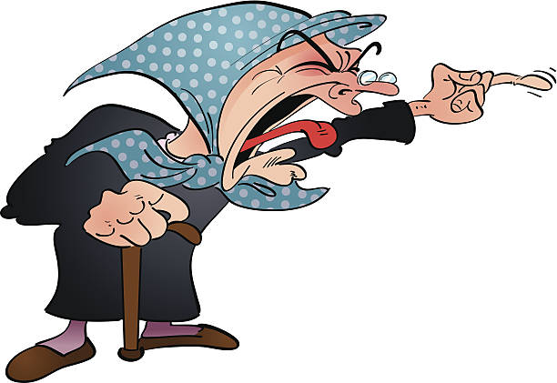
LuBAIR™ Inventory
Based in Impairment of Emotional Regulatory Circuits
Vocal Expressions
3. YELLING AND SCREAMING TO GET THINGS DONE

Slide 118
LuBAIR™ Inventory
Based in Impairment of Emotional Regulatory Circuits
Vocal Expressions
4. RATTLING BED RAILS/TABLE TOPS, PERISTENT CALLING OUT FOR STAFF/FAMILY

Slide 119
LuBAIR™ Inventory
Based in Impairment of Emotional Regulatory Circuits
Vocal Expressions
Purpose of Expressions
Unintended ‘Out-of-proportion’ emotional responses

Slide 120
LuBAIR™ Inventory
Based in Impairment of Emotional Regulatory Circuits
Vocal Expressions
Meaning of Expressions (Based in Anger)
“Please appreciate…….I am in a defensive mode”
“I’m warning you to stop/back off”
(Brief Explosive Outbursts)
“Please appreciate…..I am in aggressive mode”
Quarrelsome…..Dysphoric….Destructive
Notes:
Need two slides. One for emotions of anger and the other for joy. Next slide. Meaning of behaviors based in joy “Please help me control my emotions”
DONE
NOTE: This is not a well-known idiom and may be especially confusing for non-native English speakers.
Old version said

Slide 121
LuBAIR™ Inventory
Based in Impairment of Emotional Regulatory Circuits
Vocal Expressions
Meaning of Expressions (Based in Joy)
“Please help me to control my emotions”

Slide 122
Emotional Regulatory Circuits
LuBAIR™ Inventory
Based in Impairment of Emotional Regulatory Circuits
Emotional Expressions

Slide 123
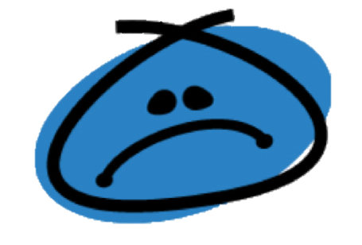
LuBAIR™ Inventory
Based in Impairment of Emotional Regulatory Circuits
Emotional Expressions
Represents two primary emotions:
Melancholy &
Discontentment

Slide 124
LuBAIR™ Inventory
Based in Impairment of Emotional Regulatory Circuits
Emotional Expressions
Sadness or Melancholy
Discontentment
Notes:
Is this good here?

Slide 125
LuBAIR™ Inventory
Based in Impairment of Emotional Regulatory Circuits
Emotional Expressions
Melancholy Discontentment
1. APPEARING SAD, TEARFUL, OR IRRITABLE

Slide 126
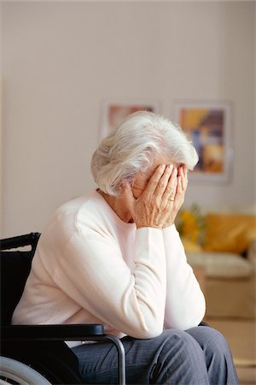
LuBAIR™ Inventory
Based in Impairment of Emotional Regulatory Circuits
Emotional Expressions
Melancholy
2. EXPRESSING THEMES OF DESPAIR, MORBIDITY, SOMATIC COMPLAINTS, OR SELF-DEPRICATING COMMENTS

Slide 127
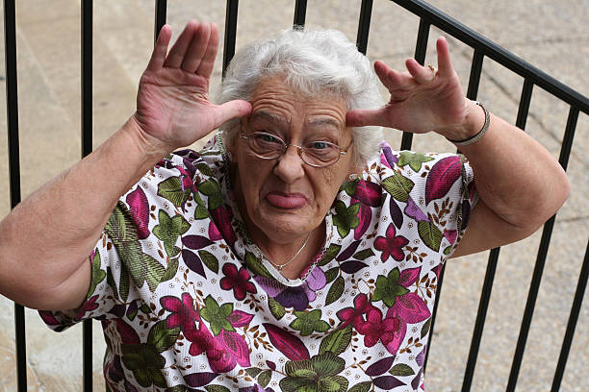
LuBAIR™ Inventory
Based in Impairment of Emotional Regulatory Circuits
Emotional Expressions
Discontentment
3. MIMICKING/MOCKING OR BEING DISMISSIVE

Slide 128
LuBAIR™ Inventory
Based in Impairment of Emotional Regulatory Circuits
Emotional Expressions
Discontentment
4. SARCASTIC OR TEASING, BEING DEROGATORY, CRITICAL AND NEGATIVE OF OTHERS

Slide 129
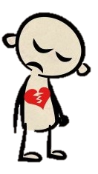
LuBAIR™ Inventory
Based in Impairment of Emotional Regulatory Circuits
Emotional Expressions
Melancholy
5. EXPRESSING FEELINGS OF REJECTION OR INCREASED SENSITIVITY TO OTHERS’ COMMENTS

Slide 130
LuBAIR™ Inventory
Based in Impairment of Emotional Regulatory Circuits
Emotional Expressions
Humans are innately averse to pain; emotional or physical
Protection from pain becomes primary defense mechanism
Does not change regardless of stage of dementia
Likely heightened

Slide 131
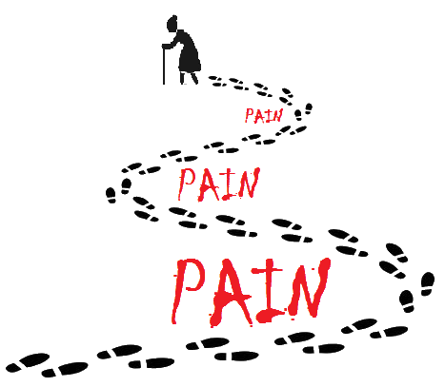
LuBAIR™ Inventory
Based in Impairment of Emotional Regulatory Circuits
Emotional Expressions
Two approaches to dealing with pain:
Coping with pain
&
Avoidance of pain

Slide 132
LuBAIR™ Inventory
Based in Impairment of Emotional Regulatory Circuits
Emotional Expressions
Coping with Pain (Melancholy)
‘Catharsis’ of pain - crying and talking
Measured ‘decompression’
Observer’s perspective: suffering
Individual’s perspective: relief from suffering

Slide 133
LuBAIR™ Inventory
Based in Impairment of Emotional Regulatory Circuits
Emotional Expressions
Avoidance of Pain (Discontentment)
“I feel good by putting you down” (verbal)
Pro-active shut down of communication
(non-verbal)
Creates barriers or distance with others
Protect exposure to ‘hurt’
Prevent experiencing of ‘pain’

Slide 134
LuBAIR™ Inventory
Based in Impairment of Emotional Regulatory Circuits
Emotional Expressions
Purpose of Expressions (Melancholy)
Presence of painful states ……….‘coping’ with pain
Notes:
Two slides. Purpose of Measure for Meloncholy. Awareness of ‘coping’ with pain. Purpose of measure for discontentment. Awareness of ‘avoidance’ of pain

Slide 135
LuBAIR™ Inventory
Based in Impairment of Emotional Regulatory Circuits
Emotional Expressions
Meaning of Expressions (Melancholy)
“Please help me in my catharsis”
Notes:
Two slides. Meaning of the Expression based in melancholy. I am not surffering (this does not make sense to me – they *are* suffering otherwise why would they be sad? They are trying not to suffer – “I’m trying to relieve my suffering” makes a lot more sense); please help me in releasing my emotions. Meaning of the Expression based in discontentment. Please don’t take me for a ‘jerk’; I am simply trying to protect myself from ‘pain’.

Slide 136
LuBAIR™ Inventory
Based in Impairment of Emotional Regulatory Circuits
Emotional Expressions
Purpose of Expressions (Discontentment)
Presence of painful states – ‘avoidance’ of pain
Notes:
Two slides. Purpose of Measure for Meloncholy. Awareness of ‘coping’ with pain. Purpose of measure for discontentment. Awareness of ‘avoidance’ of pain

Slide 137
LuBAIR™ Inventory
Based in Impairment of Emotional Regulatory Circuits
Emotional Expressions
Meaning of Expressions (Discontentment)
“Please don’t take me for a ‘jerk’ – I am simply trying to protect myself from pain”
Notes:
Two slides. Meaning of the Expression based in melancholy. I am not surffering; please help me in releasing my emotions. Meaning of the Expression based in discontentment. Please don’t take me for a ‘jerk’; I am simply trying to protect myself from ‘pain’.

Slide 138
Emotional Regulatory Circuits
LuBAIR™ Inventory
Based in Impairment of Emotional Regulatory Circuits
Fretful/Trepidation Expressions

Slide 139
LuBAIR™ Inventory
Based in Impairment of Emotional Regulatory Circuits
Fretful/Trepidation Expressions
Represents the primary emotion of:
FEAR

Slide 140
LuBAIR™ Inventory
Based in Impairment of Emotional Regulatory Circuits
Fretful/Trepidation Expressions
Attachment
Bowlby and Ainsworth
Bonding between mom and infant
Valid for all ‘attachments’ throughout life (marital, family, work)
Remains valid through all stages of dementia
Notes:
Remains valid through all stages of dementia; early, middle and late. Next slide. Different types of attachments with four bullets.
Different types (secure, anxious, avoidant disorganized)

Slide 141
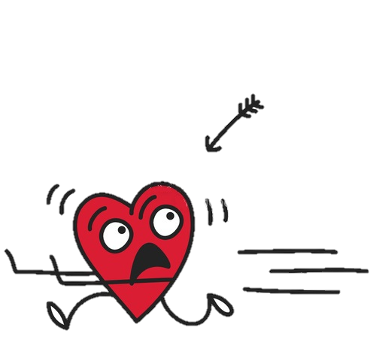
LuBAIR™ Inventory
Based in Impairment of Emotional Regulatory Circuits
Fretful/Trepidation Expressions
Attachment (Bowlby and Ainsworth):
Different types of attachments:
Secure
Anxious
Avoidant
Disorganized
Notes:
Remains valid through all stages of dementia; early, middle and late. Next slide. Different types of attachments with four bullets.
Different types (secure, anxious, avoidant disorganized)

Slide 142
LuBAIR™ Inventory
Based in Impairment of Emotional Regulatory Circuits
Fretful/Trepidation Expressions
Attachment
Stored as ‘mental images’
Create ‘Inner World Model’ (hard drive)
Pair ‘New Milieu’ ……..‘Stored attachments’
Determines response
Notes:
Not sure if we need this slide.

Slide 143
LuBAIR™ Inventory
Based in Impairment of Emotional Regulatory Circuits
Fretful/Trepidation Expressions
Advanced Dementia
Complete loss of recognition of own environment
No familiarity of new environment
Preserved early childhood memories (Birth to 8)
Turn inwards for ‘Safe’ place
Notes:
Need to change the slide. Moderate to Advanced Dementia. Complete loss of recognition of ‘own’ environment. No familiarity of new environment. Still have recognition of earlier childhood memories. Between ages of 2 to 8). Parent or sibling fixations.
CHANGED SLIDE

Slide 144
LuBAIR™ Inventory
Based in Impairment of Emotional Regulatory Circuits
Fretful/Trepidation Expressions
Advanced Dementia
If pairing with…….
‘Secure’ mental images’ ……..no symptoms
‘Anxious’, Avoidant or Disorganized’ mental images
…………Fretful/Trepidation Expressions
Parent or sibling fixation
Notes:
Not sure if we need to keep this slide.

Slide 145
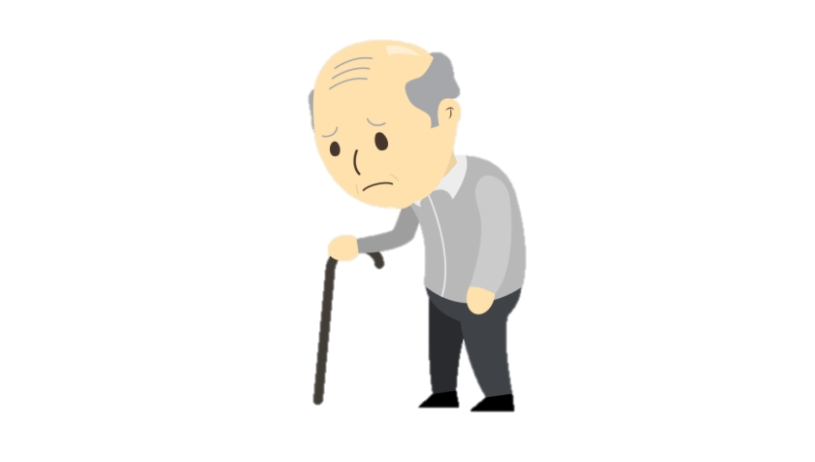
LuBAIR™ Inventory
Based in Impairment of Emotional Regulatory Circuits
Fretful/Trepidation Expressions
1. EXPRESSING WORRY, FEAR, FOREBODING, OR CATASTROPHE

Slide 146
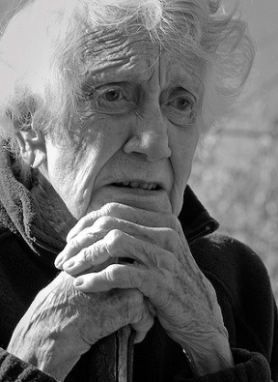
LuBAIR™ Inventory
Based in Impairment of Emotional Regulatory Circuits
Fretful/Trepidation Expressions
2. FEARFUL OR SCARED FACIAL EXPRESSIONS

Slide 147
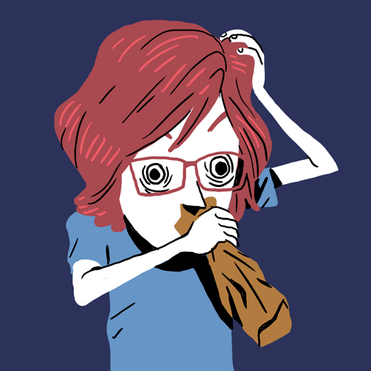
LuBAIR™ Inventory
Based in Impairment of Emotional Regulatory Circuits
Fretful/Trepidation Expressions
3. ANXIOUS OR DISTRESSED FACIAL EXPRESSIONS

Slide 148
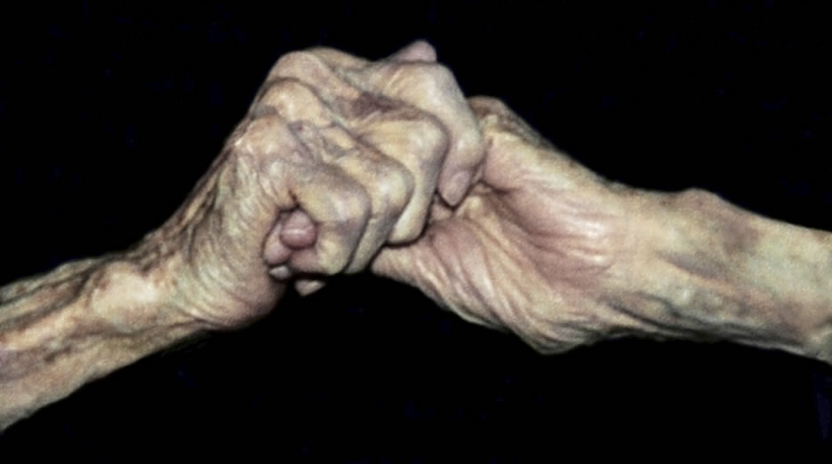
LuBAIR™ Inventory
Based in Impairment of Emotional Regulatory Circuits
Fretful/Trepidation Expressions
4. CLINGY OR "LATCHING ON", WRINGING OF HANDS, RUBBING FACE/BODY

Slide 149
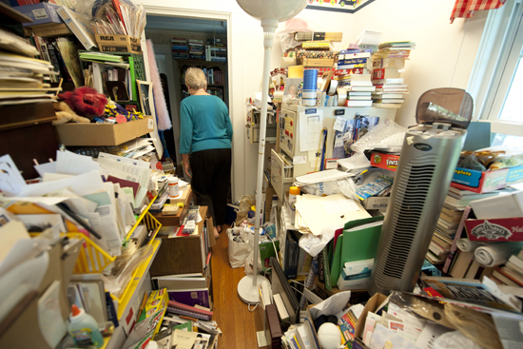
LuBAIR™ Inventory
Based in Impairment of Emotional Regulatory Circuits
Fretful/Trepidation Expressions
5. HOARDING OR COLLECTING

Slide 150
LuBAIR™ Inventory
Based in Impairment of Emotional Regulatory Circuits
Fretful/Trepidation Expressions
Purpose of Expressions
Presence of unmet ‘security’ needs

Slide 151
LuBAIR™ Inventory
Based in Impairment of Emotional Regulatory Circuits
Fretful/Trepidation Expressions
Meaning of Expressions
“Please help me feel ‘safe’
Notes:
Please help me feel ‘safe’ and ‘secure’

Slide 152
BREAK
Notes:
Ideally, this break should occur at around 2:30 at the latest.
10-15 mins break

Slide 153
LuBAIR™ Inventory
Based in Impairment of Self-Regulatory Circuits
Oppositional Expressions
Physically Responsive Expressions
Sexual Expressions

Slide 154
Self Monitoring and Regulatory Circuits
LuBAIR™ Inventory
Based in Impairment of Self-Regulatory Circuits
Oppositional Expressions

Slide 155
LuBAIR™ Inventory
Based in Impairment of Self-Regulatory Circuits
Oppositional Expressions
Basis in Developmental Psychology
Basis in parent–child interactions
Verbal and non-verbal expressions of “no” are expressions of:
Emergence of self-identity
Self-regulation
Independence

Slide 156
LuBAIR™ Inventory
Based in Impairment of Self-Regulatory Circuits
Oppositional Expressions
Role-reversal in PwD
Governed by developmental sophistication and severity of cognitive impairment
Notes:
This slide is unclear to me

Slide 157
LuBAIR™ Inventory
Based in Impairment of Self-Regulatory Circuits
Oppositional Expressions
Compliance:
Follow instruction in designated time
Non-Compliance:
Refusal to initiate or complete instructions in ‘designated time’
Basis of Oppositional Expressions

Slide 158
LuBAIR™ Inventory
Based in Impairment of Self-Regulatory Circuits
Oppositional Expressions
Early Dementia
Negotiation
Person attempts to modify the nature/conditions of the command
Passive Non-Compliance
Person does not acknowledge directions given to them

Slide 159
LuBAIR™ Inventory
Based in Impairment of Self-Regulatory Circuits
Oppositional Expressions
Moderate Dementia
Simple Non-Compliance
Person appears to acknowledge commands but refuses to comply
No associated hostility/anger

Slide 160
LuBAIR™ Inventory
Based in Impairment of Self-Regulatory Circuits
Oppositional Expressions
Advanced Dementia
Direct Defiance
Variant of non-compliance, accompanied by hostility/anger

Slide 161
LuBAIR™ Inventory
Based in Impairment of Self-Regulatory Circuits
Oppositional Expressions
1. NEGOTIATING AROUND CARE AND OTHER NEEDS
It’s time to take your medicine.
I don’t need to take all that! Just give me the red ones.
You need to take all of it.
Fine – I’ll take it if you let me leave!

Slide 162
2. WORKING AGAINST THE CARE PROVIDER (e.g., pulling pants up during incontinent care, buttoning up shirt when needing to undress, etc.)
Full video found at https://www.youtube.com/watch?v=hahvUXwTXE4
Notes:
VIDEO
Click the video ONCE to play it (a second click will stop it)

Slide 163
LuBAIR™ Inventory
Based in Impairment of Self-Regulatory Circuits
Oppositional Expressions
3. EVASIVE TO DIRECTIONS FROM CARE PROVIDER (e.g., ignoring, etc.)

Slide 164
LuBAIR™ Inventory
Based in Impairment of Self-Regulatory Circuits
Oppositional Expressions
4. RESISTIVE TO CARE, MEDICATION, OR MEALS (e.g., pursing lips at meals, clamping/crossing legs closed, tightening arms, resisting rolling/turning, etc.)
Full video found at https://www.youtube.com/watch?v=sl3Dc1kERto
Notes:
VIDEO
Click the video ONCE to play it (a second click will stop it)

Slide 165
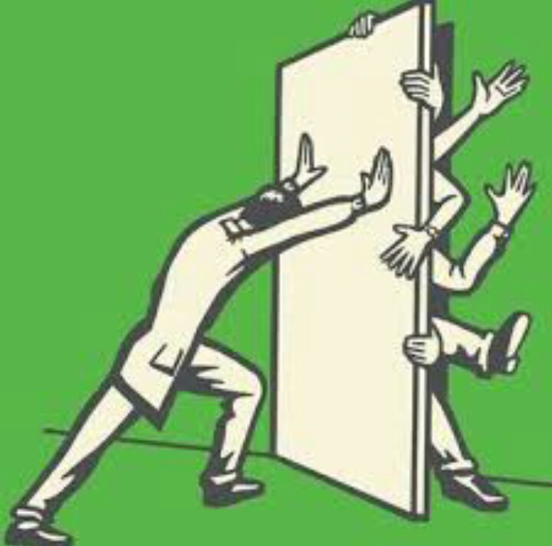
LuBAIR™ Inventory
Based in Impairment of Self-Regulatory Circuits
Oppositional Expressions
5. BARRICADING AND TERRITORIALISM OF SPACE OR BELONGINGS

Slide 166
LuBAIR™ Inventory
Based in Impairment of Self-Regulatory Circuits
Oppositional Expressions
Purpose of Expressions
Attempts to preserve dignity, autonomy, and self-regulation
Notes:
Preserved sense of ‘autonomy’ and ‘self-regulation’
NOTE:
If this is how the caregiver is interpreting the expression, doesn’t the current phrasing make more sense?

Slide 167
LuBAIR™ Inventory
Based in Impairment of Self-Regulatory Circuits
Oppositional Expressions
Meaning of Expressions
“Please help support my independence”
Notes:
Please help me support my ‘independence’

Slide 168
LuBAIR™ Inventory
Based in Impairment of Self-Regulatory Circuits
Oppositional Expressions
Approach to Care
Validate the PwD’s autonomy/independence – assure them that they have retained their dignity/identity
Offer 2 choices in such a way that it makes the PwD feel like they are the decision-maker
It is ok to be gentle but firm
Notes:
NOTE: This slide was blank – I populated it with the information that was in the duo-tang folder

Slide 169
Self Monitoring and Regulatory Circuits
LuBAIR™ Inventory
Based in Impairment of Self-Regulatory Circuits
Physically Responsive Expressions

Slide 170
LuBAIR™ Inventory
Based in Impairment of Self-Regulatory Circuits
Physically Responsive Expressions
Represents two primary emotions:
Anger &
Discontentment

Slide 171
LuBAIR™ Inventory
Based in Impairment of Self-Regulatory Circuits
Physically Responsive Expressions
Anger
Joy or Happiness
Discontentment
Notes:
Added this here due to previous slide

Slide 172
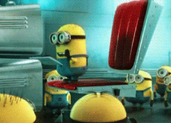
LuBAIR™ Inventory
Based in Impairment of Self-Regulatory Circuits
Physically Responsive Expressions
Classification
Instrumental Aggression
Hostile Aggression

Slide 173
LuBAIR™ Inventory
Based in Impairment of Self-Regulatory Circuits
Physically Responsive Expressions
Instrumental Aggression:
Reward-Consequence Paradigm
Individuals appreciate the difference between “right” and “wrong”
Preserved self-regulatory circuits
Criminal behavior

Slide 174
LuBAIR™ Inventory
Based in Impairment of Self-Regulatory Circuits
Physically Responsive Expressions
Hostile Aggression:
Frustration-Aggression Paradigm
Relationship between “frustration and aggression”
Perceived impediment in goal-attainment and ‘negative’ emotions
Impaired self-regulatory circuits

Slide 175
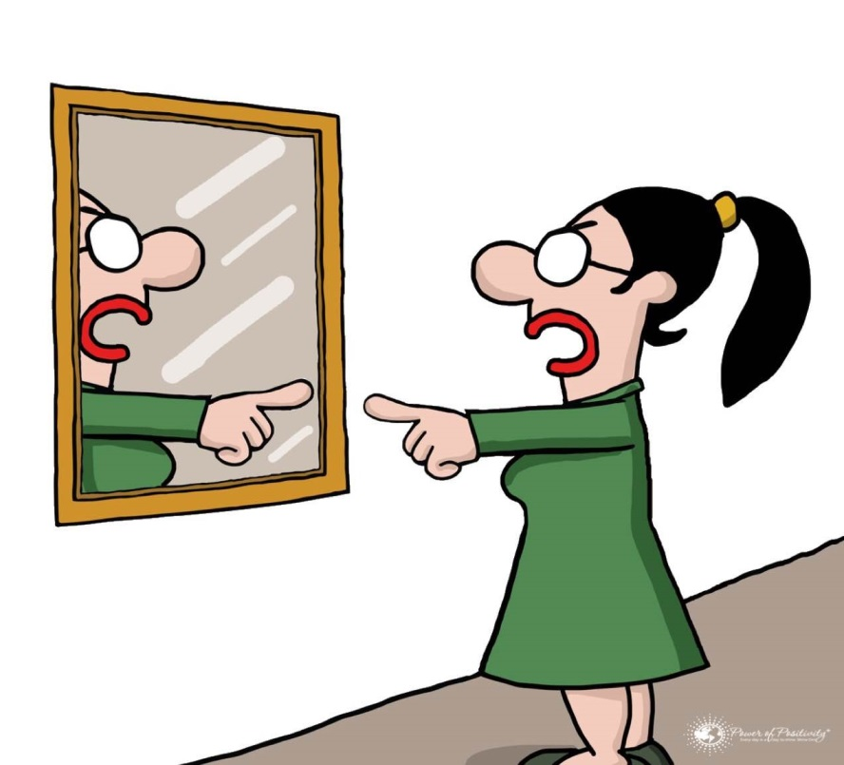
LuBAIR™ Inventory
Based in Impairment of Self-Regulatory Circuits
Physically Responsive Expressions
1. SELF-ABUSIVE

Slide 176
LuBAIR™ Inventory
Based in Impairment of Self-Regulatory Circuits
Physically Responsive Expressions
2. PULLING, PUSHING, GRABBING

Slide 177
LuBAIR™ Inventory
Based in Impairment of Self-Regulatory Circuits
Physically Responsive Expressions
3. KICKING, BITING, SCRATCHING, PUNCHING, TWISTING, HEAD BUTTING, SPITTING AT SOMEONE

Slide 178
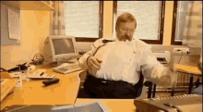
LuBAIR™ Inventory
Based in Impairment of Self-Regulatory Circuits
Physically Responsive Expressions
4. THROWING THINGS, BREAKING OBJECTS, TIPPING FURNITURE

Slide 179
LuBAIR™ Inventory
Based in Impairment of Self-Regulatory Circuits
Physically Responsive Expressions
Purpose of Expressions
‘Goal attainment’ is being impeded
Notes:
THIS WHOLE SECTION NEEDS TO BE REVIEWED

Slide 180
LuBAIR™ Inventory
Based in Impairment of Self-Regulatory Circuits
Physically Responsive Expressions
Meaning of Expressions
“Please help me identify and meet my needs”

Slide 181
LuBAIR™ Inventory
Based in Impairment of Self-Regulatory Circuits
Physically Responsive Expressions
Approach to Care
It depends…
Which ‘need’ is being impeded?
Innate physiological needs
Security needs
Belongingness needs

Slide 182
LuBAIR™ Inventory
Based in Impairment of Self-Regulatory Circuits
Physically Responsive Expressions
Approach to Care
It depends…
Which ‘need’ is being impeded?
Need to avoid or cope with pain
Lack of recognition of a need

Slide 183
LuBAIR™ Inventory
Based in Impairment of Self-Regulatory Circuits
Physically Responsive Expressions
Approach to Care
Identify and understand the behavioral expressions
Determine the ‘impeded need’ which is triggering the expressions
Care Plan accordingly
Notes:
101

Slide 184
Self Monitoring and Regulatory Circuits
LuBAIR™ Inventory
Based in Impairment of Self-Regulatory Circuits
Sexual Expressions

Slide 185
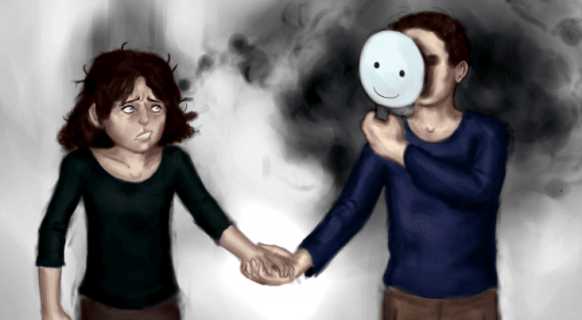
LuBAIR™ Inventory
Based in Impairment of Self-Regulatory Circuits
Sexual Expressions
The basis of these expressions can be multi-faceted:
Over-identification of Facial Visual Stimulus (Misidentification expressions)

Slide 186
LuBAIR™ Inventory
Based in Impairment of Self-Regulatory Circuits
Sexual Expressions
The basis of these expressions can be multi-faceted:
Increased drive to satiate innate physiological needs of sexuality
(goal-directed expressions)
Preserved drive for innate need for intimacy
(importuning expressions)

Slide 187
LuBAIR™ Inventory
Based in Impairment of Self-Regulatory Circuits
Sexual Expressions
The basis of these expressions can be multi-faceted:
Based in emotions of discontentment (misogynistic)
Based in satiating security needs

Slide 188
LuBAIR™ Inventory
Based in Impairment of Self-Regulatory Circuits
Sexual Expressions
The basis of these expressions can be multi-faceted:
Staff’s interpretation

Slide 189
LuBAIR™ Inventory
Based in Impairment of Self-Regulatory Circuits
Sexual Expressions
1. VERBALLY SEXUAL (e.g., comments, gestures, innuendos, etc.)

Slide 190
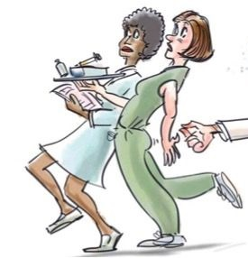
LuBAIR™ Inventory
Based in Impairment of Self-Regulatory Circuits
Sexual Expressions
2. PHYSICALLY SEXUAL (e.g., grabbing breasts, buttocks, etc.)

Slide 191
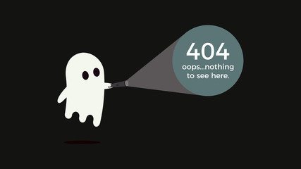
LuBAIR™ Inventory
Based in Impairment of Self-Regulatory Circuits
Sexual Expressions
3. SELF STIMULATION

Slide 192
LuBAIR™ Inventory
Based in Impairment of Self-Regulatory Circuits
Sexual Expressions
Purpose of Expressions
Don’t rush to ‘judge’ and ‘label’
Notes:
It used to say “Do not judge”
But this doesn’t make sense as the “caregiver’s interpretation of the expressions”

Slide 193
LuBAIR™ Inventory
Based in Impairment of Self-Regulatory Circuits
Sexual Expressions
Meaning of Expressions
“Please make an effort to understand my reasons”
Notes:
This is my meaning. The original said:
Based in Impairment in IPC
Over-Identification of Facial Visual Stimulus
Attribution Error
Based in Impairment in MC
Increased Drive to Satiation of IPN
Preserved Drives to INI
Based in Impairment of ERC
Emotions of Discontentment (Misogyny)
Emotions of Fear (Secure Base)

Slide 194
LuBAIR™ Inventory
Based in Impairment of Self-Regulatory Circuits
Sexual Expressions
Approach to Care
De-stigmatize
Educate staff and family
Determine the basis for expressions
Care Plan accordingly
Notes:
Original said
Individualized care plan tailored to the principles identified above

Slide 195
THANK YOU!

