Slide 1
Approach to Understanding the ‘Meaning’ of Behaviors in NCD (Luthra’s Behavioral Assessment and Intervention Response Paradigm) LuBAIR™ Paradigm
Atul Sunny Luthra MD MSc FRCPC
Clinical Associate Professor
McMaster University
Research Scientist
Schlegel’s Research Institute in Aging

Slide 2
Approach to Understanding the ‘Meaning’ of Behaviors in NCD
‘
Agitation
Symptom versus Syndrome

Slide 3
Approach to Understanding the ‘Meaning’ of Behaviors in NCD
Agitation as a Symptom

Slide 4
Approach to Understanding the ‘Meaning’ of Behaviors in NCD
Definition of a Symptom (Kaplan and Sadock. 1995)
‘Severe anxiety with motor restlessness’

Slide 5
Approach to Understanding the ‘Meaning’ of Behaviors in NCD
Depressive Episode
Insomnia, loss of appetite, feeling hopeless and guilt, thoughts of suicide, anhedonia, poor concentration and agitation
Manic Episode
Irritable, angry, quarrelsome, reduced need to sleep, grandiose and agitation
Psychotic Episode
Delusions, hallucinations, mood instability and lability, insomnia and agitation

Slide 6
Approach to Understanding the ‘Meaning’ of Behaviors in NCD
Anxiety Episode
Fearful and worrisome thoughts, autonomic arousal and hypervigilance, restless, fidgety and agitation
Delirious Episode
Distractibility, disorganized thinking, increase disorientation, delusions and hallucination, and agitation
Innate Physiological Needs
Nervousness, sweating, irritability, restlessness and agitation

Slide 7
Terminology and Conceptual Models
‘
Agitation (or Aggression) in Dementia
Biological Model
Continuum of Agitation into Aggression

Slide 8
Biological Model
Continuum of Agitation into Aggression (Fabio et al 1996 and Bédard et al., 1997)
Circumstantial Episode
Agitation or Aggression
Confusion
Out of Control
Anxiety to Panic

Slide 9
Approach to Understanding the ‘Meaning’ of Behaviors in NCD
Problem Behaviors, Disruptive Behaviors, Disturbing Behaviors
Cross-Referenced with
Agitation or Aggression
In Dementia

Slide 10
Approach to Understanding the ‘Meaning’ of Behaviors in NCD
Agitation as a Syndrome

Slide 11
Terminology and Definitions
Agitation as a Syndrome
Cohen-Mansfield (1986, 1995)
“an inappropriate verbal, vocal or motor activity that is not judged by an outsider to result directly from the needs or confusion of the individual”.

Slide 12
Approach to Understanding the ‘Meaning’ of Behaviors in NCD
Cohen-Mansfield (2003).
‘if any of the following constructs (psychosis, individual’s emotional state, unmet needs or delirium) can be used to describe agitation, then the behavior is not labeled as ‘Agitation in Dementia’.

Slide 13
Meaning of Behaviors in NCD LuBAIR™ Paradigm
Diagnosis of BPSD or BD in NCD
Is One of
Exclusion
www.dementiabehaviors.com

Slide 14
Meaning of Behaviors in NCD LuBAIR™ Paradigm
To rule in BPSD or BD……..Need to Rule out:
Organic Mental Disorders
Mood, Anxiety and Psychotic Disorders
Physiological and Environmental Determinants
www.dementiabehaviors.com

Slide 15
Meaning of Behaviors in NCD LuBAIR™ Paradigm
If any of the above are deemed contributory to
presence of symptoms,
then those symptoms cannot be labelled BPSD or BD
www.dementiabehaviors.com

Slide 16
Meaning of Behaviors in NCD LuBAIR™ Paradigm
Diagnostic and Statistical Manual III to V
(American Psychiatric Association)
Adopted Cohen-Mansfield Constructs to define
BPSD or Behavioral Disturbances (BD)

Slide 17
Meaning of Behaviors in NCD LuBAIR™ Paradigm
Conceptualizing Behaviors as ‘Symptom’ or ‘Syndrome’
Mere presence viewed as ‘disruptive’
Negative connotations
Purely from Caregivers or Health Professional’s point of view

Slide 18
Conceptualizing Behaviors as ‘Symptom’ or ‘Syndrome’
Psychosocial Model (Algase et. el., 1995 and Kovacs et. El., 2005)
‘Reasons’ for presence of ‘Behaviors’
‘Identify’ the ‘Reasons’ for their presence
‘Identify’ the ‘Problem’; not label ‘Behaviors’ as ‘Problem’
May represent ‘unmet needs’
Single ‘unmet need’ -----→ Cascade of ‘unmet needs’
Notes:
Called “INTO aggression” in paper, not IN
Called Needs Based Dementia Compromised Behaviors in paper, not the one above

Slide 19
Consequences of Needs-Driven, Dementia-Compromised Behaviors (C-NDB) (Algase et. al., 1996 and Kovach et al., 2005)
Psychosocial Model
Background
factors
Proximal
factors
Primary NDB
Personal Factors
Care Factors
Contextual
factors
Primary
Needs
Unmet
Needs
Secondary
Need
Secondary
NDB
Primary
NDB
Notes:
Kovach et al., 2005

Slide 20
Conceptualizing Behaviors as ‘Symptom’ or ‘Syndrome’
Conceptualize Behavioral Expressions as Meaningful
Pro-Active approach to identify Reasons or Meaning
Reduce use of medications targeted at Behavioral Expressions

Slide 21
Conceptualizing Behaviors as ‘Symptom’ or ‘Syndrome’
Disconnect Between
Frontline staff applying definition of Symptom to label BE
Clinical training promoting definition of Syndrome to label BE

Slide 22
Conceptualizing Behaviors as ‘Symptom’ or ‘Syndrome’
Arrives P.I.E.C.E.S. (Leclaire et. El., 1997-2003)
Approach to assessing Dementia
Approach to determine Severity Dementia
Approach to assessing BE

Slide 23
Conceptualizing Behaviors as ‘Symptom’ or ‘Syndrome’
P.I.E.C.E.S for Severity
I---Intellectual ( Cognitive screen and testing)
C---Capacity ( Functional Evaluations- BDL, IADL, Social and Occupational)

Slide 24
Conceptualizing Behaviors as ‘Symptom’ or ‘Syndrome’
P.I.E.C.E.S for BE
P –Physical (Medical and Physiological)
E—Emotional (Mood, Anxiety and Psychotic Illnesses)
E---Environmental (Milieu)
S– Social (Inter-Personal) Revised S– Self (person carrying the disease)

Slide 25
Meaning of Behaviors in NCD LuBAIR™ Paradigm
How do we Approach Assessment of BE
To R/O Delirium, Mood, Anxiety and Psychotic D/O and Innate Physiological needs and Environmental Antecedents
Patient must be able to Engage in Valid and Reliable Clinical Examination
Obtain History
Mental State Examination
Necessary Physical Examination
Person Must have Preserved Memory (Intellectual Function)
Use DSM-V Criteria

Slide 26
Meaning of Behaviors in NCD LuBAIR™ Paradigm
Herein Lies the Challenge
Prevalence of BE highest in advanced NCD
MMSE less than 12
Reliability and Validity of Clinical Assessment
??? In Patient with MMSE of less than 12 ????

Slide 27
Meaning of Behaviors in NCD LuBAIR™ Paradigm
Psychometric Tools Available
Confusion Assessment Methodology (CAM) – Delirium
Only valid in Non-Cognitively Impaired Individuals
CAM-ICU version. For non-verbal, ventilated Individuals
No Established Validity in Advanced Dementia
Require Reliable and Valid Patient Engagement

Slide 28
Psychometric Tools Available
Cornell Depression Scale -- Depression
Alexopoulas et. Al., 1988.
“ The Cornell scale is a quantitative measure of depression. Although, its
original scores correlate with the presence of depressive syndromes classified
by RDC, the Cornell scale is NOT designed for use as a diagnostic instrument”
Establish Severity: Once clinical diagnosis made
Requires reliable and Valid Patient Engagement

Slide 29
Psychometric Tools
Neuro-Psychiatric Inventory (Cummings et. Al., 1994 and 1997)
Used for Anxiety and Psychotic Disorders
“Inability to discriminate amongst different disorders”
“Validity and Reliability of sub-scales in advanced NCD, when clinical examination becomes increasingly unreliable, needs questioning”

Slide 30
Disconnect Between
‘Symptom’ or ‘Syndrome’ to label BE
True Even Today

Slide 31
Meaning of Behaviors in NCD LuBAIR™ Paradigm
Paradigm Shift from
‘Diagnostic Labelling’ of ‘Syndrome’ of ‘Agitation’ (Spezialle 2008)
To
‘ Understanding the Meaning’

Slide 32
Meaning of Behaviors in NCD LuBAIR™ Paradigm
BE in NCD
‘Mode of Communication’
“What is being communicate through their Behaviors”
Understanding the Meaning

Slide 33
Meaning of Behaviors in NCD LuBAIR™ Paradigm
Available Framework
P.I.E.C.E.S.™------------- Concept of ‘Self’
GPA™ --------------------- ‘Personhood’
‘State or Fact of being of an Individual or Having Individual Characteristics and Feelings’

Slide 34
Meaning of Behaviors in NCD LuBAIR™ Paradigm
This is where my Journey Began (2012)
Two Terms ‘Personhood’ and ‘Meaning’
Personhood-----Bio-Psycho-Social being of a Person

Slide 35
Meaning of Behaviors in NCD LuBAIR™ Paradigm
Dichotomy of Models --- ‘Biological’ and ‘Psychosocial’
Bio-Psycho-Social (BPS) Model.
Yet to be Established
No Established Framework to Understand ‘Meaning’

Slide 36
Break

Slide 37
Meaning of Behaviors in NCD LuBAIR™ Paradigm
BPS Model
Biological Factors
Stage of the Disease (with or w/o mental illness)
Inherent Circadian Rhythms
Innate Physiological Needs
Personal Factors (Psychological)
Pre-morbid personality and psychological defense mechanisms
Acquired Coping Strategies
Environmental factors (Social)
Milieu Structures
Interpersonal Interactions

Slide 38
Meaning of Behaviors in NCD LuBAIR™ Paradigm
Biological Factors
Notes:
- Cognitive and noncognitive

Slide 39
Meaning of Behaviors in NCD LuBAIR™ Paradigm
Biological Factors
Stage of the Disease
Cognitive Changes
Non-Cognitive Changes

Slide 40
Meaning of Behaviors in NCD LuBAIR™ Paradigm
Biological Factors
Stage of the Disease (SOD)
Cognitive Changes
Mild
Moderate
Advanced
Notes:
- Cognitive and noncognitive

Slide 41
Meaning of Behaviors in NCD LuBAIR™ Paradigm
Biological Factors
Stage of the Disease (SOD)
Non-Cognitive changes
Mood symptoms
Anxiety symptoms
Psychotic symptoms
Behaviors
Notes:
- Cognitive and noncognitive

Slide 42
Biological Factors
Stage of the Disease – Non-Cognitive
Mood Symptoms
-- Prodromal Symptoms
-- Mild-to-moderate (Psychological symptoms)
-- Advanced (Motivational symptoms)
Notes:
- Cognitive and noncognitive

Slide 43
Biological Factors
Stage of the Disease (SOD)-Non-Cognitive
Anxiety Symptoms
-- Adjustment disorder (with anxiety Sx)
At the time of diagnosis
-- Mild-to-Moderate
Newly diagnosed GAD
-- Severe (Advanced)
Anxiety symptoms in the absence of any measurable cognitive schema
Notes:
- Cognitive and noncognitive

Slide 44
Model of Illness
Biological Factors
Stage of the Disease (SOD) - Non-Cognitive
Psychotic Symptoms
Mild-to-Early Moderate
Non-bizarre, well systematized delusions
Moderate
Delusional misidentification syndromes (DIS)
Hallucinations
Advanced
Conspicuous absence
Notes:
- Cognitive and noncognitive

Slide 45
Model of Illness Biological Factors
Stage of the Disease (SOD) -- Non-Cognitive
Behaviors
No correlates between ‘specific behavioral sets’ and ‘specific regions’ in the brain (Rosen et al 2002)
No correlates between ‘specific cognitive deficits’ and ‘specific regions’ in the brain (Nun Study 2013)

Slide 46
Biological Facotrs
Stage of the Disease (SOD) -- Non-Cognitive
Behaviors
Severity of ‘cognitive deficits’ correlated with severity of ‘neuro-pathological’ findings in the brain; Not Behaviors (Frederic and Cummings, (2002)
Correlation between PAC Score and incidence of behaviors (Forstl’’, 1993)
PAC Score. Summation score of P (physical disability), A (apathy) and C (communication failure)
(lower brain weight, higher cortical tangle density, greater neuronal loss in Hippocampus and Nucleus of Maynert)
higher incidence of BPSD

Slide 47
Biological Factors
Stage of the Disease (SOD) -- With Mental Illness
Risk factor for developing dementia
Shape behaviors in dementia
Notes:
- Cognitive and noncognitive

Slide 48
Biological Factors
Stage of Disease (SOD)
Progressive Process
Dynamic Impact on Cognitive and Non-Cognitive Symptoms
Changing Phenotypic Manifestation of Symptoms

Slide 49
Model of Illness Biological Factors
Inherent Circadian Rhythms
Innately Internal, Self-Governing Rhythms
Light (Blue Wavelength) at dusk and dawn) is the main ‘Timer’ (Zeitberger)
Homeostasis of ALL Hormones and Neurotransmitters
Regulation, and Synchronization of, Body Organs and Bodily Functions

Slide 50
Model of Illness
Biological Factors
Inherent Circadian Rhythms (ICR)
Sleep rhythms
Sensorium (Level of arousal and attention)
Cognition (Motor performance, cognitive speed, reaction time and memory)
Emotional states

Slide 51
Model of Illness
Bi-Directional Relationship Between
Disruption of CR, and
Neuro-Pathogenesis of Cognitive disorders
Protein Synthesis Pathways
Neuro-Inflammatory Processes
Mitochondrial Oxidative Pathways
Cerebral Hypo-Perfusion
Metabolic Dys-Funtions (Glucose-Ketosis)
Dynamic and Progressive

Slide 52
Model of Illness
Biological Factors
Innate Physiological Needs (IPN)
Fatigue → Need to rest
Hunger and thirst → Need to satiate
Bladder and bowels → Need to void / defecate
Pain and discomfort → Need for relief (without medications)
Sexuality and satiation of the same
Need for mental and social stimulation (including innate need for intimacy )

Slide 53
Model of Illness
Biological Factors
Relationship between CR and IPN
Disrupted sleep rhythms:
→ decreased wakefulness
→ increased need to sleep
→ decreased need for nutrition & hydration mental & social stimulation

Slide 54
Model of illness Model
Biological Factors
Relationship between CR and IPN
Fecal impaction / inadequate bladder emptying:
→ Increased pain & discomfort
→ Increased arousal
→ Decreased need to rest
→ Sleep rhythm disturbances

Slide 55
Model of illness Model
Bi-Directional Relationship Amongst
Neuro-Pathogenesis of Cognitive Impairment
Inherent Circadian Rhythms
Innate Physiological Needs
Dynamic and Progressive Relationship

Slide 56
Model of Illness
Personal Factors
(Psychological Contributors)

Slide 57
Model of Illness
Personal Factors (Psychological)
Personality Model (McCrae & John, 1992)
Neuroticism (emotional instability)
Extraversion vs. Introversion
Conscientiousness (rigidity vs. flexibility)
Agreeability vs. Aggression
Openness to experience

Slide 58
Model of Illness
Personal Factors (Psychological)
Ego defense mechanisms
Neurotic defenses (intellectualization, reaction formation, dissociation, displacement, and repression).
Mature defenses (humor, sublimation, altruism, suppression) .
Immature defenses (fantasy, projection, acting out).
Pathological defenses (psychotic denial and delusional projection).

Slide 59
Model of Illness
Personal Factors (Psychological)
Acquired Coping Strategies (Weiten et al. 2009)
Appraisal or adaptive cognitive focused
(denial, minimizing, rationalizing, etc.)
Emotional focused (principles of emotional regulation)
(managing hostile emotions, meditating, relaxation techniques)
Problem focused (solution driven)

Slide 60
Model of Illness
Personal Factors
Innate and constitutional
Genetically determined
Specific ‘personality’ ‘ego-defenses’ --→ Coping Strategy
Determine vulnerability to mental illness and Cognitive Imp.

Slide 61
Model of Illness Personal Factors
Neuro-pathological decline (SOD) affects all ‘Personal Factors’
Personality structure
Associated Ego-defense mechanisms.
-- Acquired Coping Mechanisms.
Change with progression of Cognitive Impairment

Slide 62
Model of Illness
Environmental Factors

Slide 63
Model of Illness
Environmental Factors
Milieu Structure (MS)
Static
Structural layout
Lighting fixtures
Flooring
Type of furniture
Walls décor

Slide 64
Model of Illness Environmental Factors
Milieu Structure (MS)
Dynamic
Amount of lighting
Movement of furniture
Opening/closing of doors
Clutter and cleanliness
Music and TV programming

Slide 65
Model of Illness
Environmental Factors
Inter-Personal Interactions
Random
Changing resident population and individual resident behaviors
Staff changes at shift times
Movement of and Activities of cleaning staff
Kitchen staff and food cart activities
Visiting family members and their activities on the unit.

Slide 66
Model of Illness Environmental Factors
Interpersonal Interactions
Structured
TR lead activities
OT lead activities
Chaplain lead activities
Volunteer lead activities

Slide 67
Model of Illness
Environmental Factors
Relationship between MS and IPI
Changes in MS
→ Increased behaviors
→ Decreased behaviors
Changes in IPI
→ Scheduled activities at shift change
→ Changing patient population

Slide 68
Model of Illness
Biological Factors
Personal Factors
Environmental factors
Congruent changes with disease progression
Fluid and Dynamic

Slide 69
Bio-psycho-social (BPS) Model
Dynamic Model
Input Stage
Processing Stage
Output Stage

Slide 70
BPS Model
Input Stage
Internal Factors:
Inherent Circadian Rhythm (CR)
Innate Physiological Needs (PN)
External Factors:
Milieu Structure (MS) (Static and Dynamic)
Inter-Personal Interactions (IPI) (Random and Structured)

Slide 71
BPS Model
2. Processing Stage
Stage of Disease (with or w/o mental illness)
Personal Factors
Dynamic with disease progression
Notes:
- In the SCRB model

Slide 72
BPS Model
2. Processing Stage
Ecological Model of Aging (Lawton 1974)
Competence = biological & personal factors
Demands from environmental factors
NCD ===➔ Reduced Competence Demands
Notes:
- In the SCRB model

Slide 73
BPS Model
3. Output Stage
Quality ((Individual behavioral characteristics)
Frequency
Duration
Severity

Slide 74
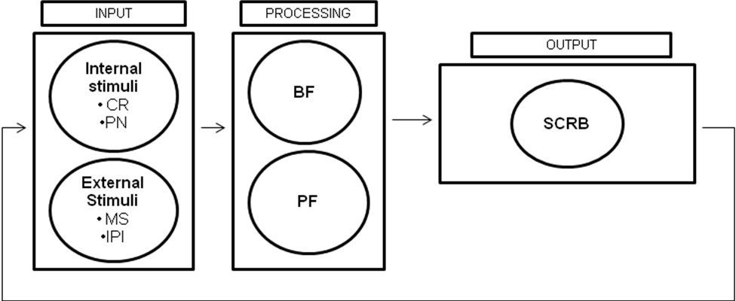
New Model →New Terminology (Stage Congruent Responsive Behaviors)
SODOD
Notes:
Description of this figure:
Figure 1 describes how biological, personal, and environmental factors of a person with dementia dynamically interact to result in a behavior. An internal (CR or PN) or external (MS or IPI) are inputted either separately or together, resulting in impaired processing through biological factors (i.e. the stage of the disease) and personal factors (i.e. coping mechanisms), resulting in an output of stage congruent responsive behaviors.

Slide 75
Understanding Behaviors
Quality and Severity of Behavioral Expressions (BE)
SOD and PF.
Frequency and Duration of BE
Internal Factors: ICR and IPN
External Factors: MS and IPI
Diurnal variation during course of each day
Variation over days and weeks
Stage Congruent Behaviors Expressions

Slide 76
Proposed Classification System

Slide 77
Proposed Classification System
Criteria proposed by Davis et al. (1997)
Identification of the target population,
Construction of items into categories
Definition of the purpose of the measure, and
Specification of the psychological construct of the category

Slide 78
Proposed Classification System
Identification of the target population
Advanced major neurocognitive disorder
Incapable of engaging in a valid and reliable clinical interview

Slide 79
Proposed Classification System
Construction of items into categories
Clustering of ‘alike’ or ‘similar’ behavioral symptoms into discrete categories.
Each category titled to adequately represent the symptoms collected therein

Slide 80
Proposed Classification System
Definition of the purpose of the measure
Each Behavioral Category represents a specific “purpose”
‘Purpose’……. Caregivers interpretation of BE
Each Behavioral Category represents a specific “meaning”
‘Meaning’………PwNCD communicating through BE

Slide 81
Proposed Classification System
Specification of the construct of the category
Identification of specific theoretical constructs which justify the formation of each behavioral category.
Each identified theoretical construct has been validated and accepted in existing psychology literature.

Slide 82
Meaning of Behaviors in NCD LuBAIR™ Paradigm
Psychological Theories Used to Classify BE in NCD
Theories on Regulation of Sensorium
Theories on Information Processing Cascades
Theories on Motivation
Theories on Regulation of Emotions
Theories on Compliance and Aggression
www.dementiabehaviors.com

Slide 83
Meaning of Behaviors in NCD LuBAIR™ Paradigm
Neuro-Circuitry of Brain
Information Processing Pathways (SenF and HCIF)
Motivational Circuits (ThiF)
Emotional Regulatory Circuits (EmoF)
Self Monitoring and Regulatory Circuits (BehF)
www.dementiabehaviors.com

Slide 84
Meaning of Behaviors in NCD LuBAIR™ Paradigm
Behavioral Categories
BE due to Impairment of Regulation of Sensorium
Disorganized Expressions
BE due to Impairment of Information Processing Cascade
Mis-Identification Expressions
www.dementiabehaviors.com

Slide 85
Meaning of Behaviors in NCD LuBAIR™ Paradigm
BE due to Impairment of Motivational Circuits
Goal Directed Expressions
Apathy Expressions
Motor Expressions
Importuning Expressions
www.dementiabehaviors.com

Slide 86
Meaning of Behaviors in NCD LuBAIR™ Paradigm
BE due to Impairment of Emotional Regulatory Circuits
Emotional Expressions
Vocal Expressions
Fretful/Trepidated Expression
www.dementiabehaviors.com

Slide 87
Meaning of Behaviors in NCD LuBAIR™ Paradigm
BE due to Impairment in Self-Monitoring and Regulatory Circuits
Oppositional Expressions
Physical Expressions
Sexual Expressions
www.dementiabehaviors.com

Slide 88
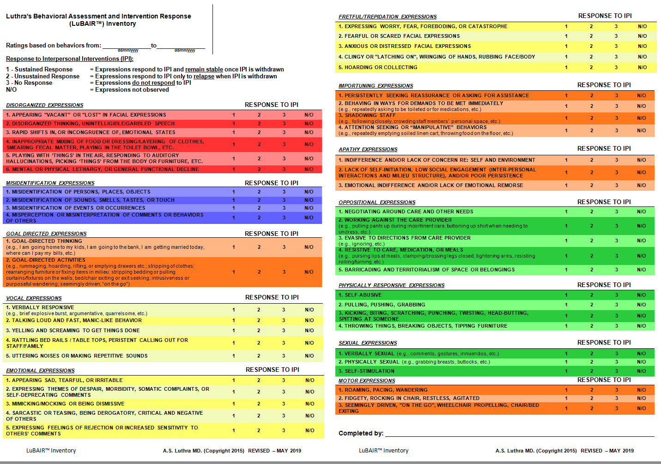
Luthra’s Behavioral Assessment and Intervention Response (LuBAIR™) Inventory

Slide 90
Meaning of Behaviors in NCD LuBAIR™ Paradigm
Next Steps……………
Future Direction……….

Slide 91
Meaning of Behaviors in NCD LuBAIR™ Paradigm
Neuro-Circuitry of Brain
Information Processing Pathways (SenF and HCIF)
Motivational Circuits (ThiF)
Emotional Regulatory Circuits (EmoF)
Self Monitoring and Regulatory Circuits (BehF)
www.dementiabehaviors.com

Slide 92
Meaning of Behaviors in NCD LuBAIR™ Paradigm
Psychological Theories Used to Classify BE in NCD
Theories on Regulation of Sensorium
Theories on Information Processing Cascades
Theories on Motivation
Theories on Regulation of Emotions
Theories on Compliance and Aggression
www.dementiabehaviors.com

Slide 93
Meaning of Behaviors in NCD LuBAIR™ Paradigm
Behavioral Categories
BE due to Impairment of Regulation of Sensorium
Disorganized Expressions
BE due to Impairment of Information Processing Cascade
Mis-Identification Expressions
www.dementiabehaviors.com

Slide 94
Meaning of Behaviors in NCD LuBAIR™ Paradigm
BE due to Impairment of Motivational Circuits
Goal Directed Expressions
Apathy Expressions
Motor Expressions
Importuning Expressions
www.dementiabehaviors.com

Slide 95
Meaning of Behaviors in NCD LuBAIR™ Paradigm
BE due to Impairment of Emotional Regulatory Circuits
Emotional Expressions
Vocal Expressions
Fretful/Trepidated Expression
www.dementiabehaviors.com

Slide 96
Meaning of Behaviors in NCD LuBAIR™ Paradigm
BE Due to Impairment Self Monitoring and Regulatory Circuits
Oppositional Expressions
Physical Expressions
Sexual Expressions

Slide 97
Meaning of Behaviors in NCD LuBAIR™ Paradigm
Accepting them as ‘Normal’
‘Normalized’ for the ‘Personhood’.
As a means of ‘Communication’ by Pwd.
From the point of view of caregivers
From the point of view of PwD
www.dementiabehaviors.com

Slide 98
Meaning of Behaviors in NCD LuBAIR™ Paradigm
Expressions have a ‘Purpose’…
How caregivers interpret expressions
Expressions have a ‘Meaning’…
What the PwD is ‘communicating’ to caregivers
www.dementiabehaviors.com

