Slide 1
Section # 17. Based in Impairment of Self-regulatory circuits.
Sexual Expressions.

Slide 2
Self Monitoring and Regulatory Circuits
LuBAIR™ Inventory
Based in Impairment of Self-Regulatory Circuits
Sexual Expressions

Slide 3
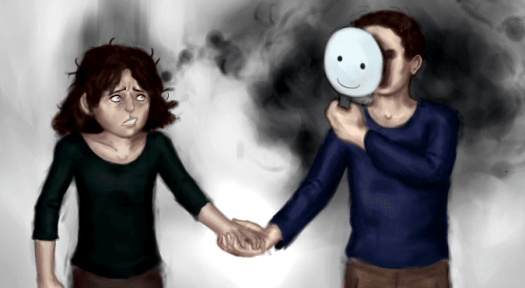
LuBAIR™ Inventory
Based in Impairment of Self-Regulatory Circuits
Sexual Expressions
The basis of these expressions can be multi-faceted:
Over-identification of Facial Visual Stimulus (Misidentification expressions)

Slide 4
LuBAIR™ Inventory
Based in Impairment of Self-Regulatory Circuits
Sexual Expressions
The basis of these expressions can be multi-faceted:
Increased drive to satiate innate physiological needs of sexuality
(goal-directed expressions)
Preserved drive for innate need for intimacy
(importuning expressions)

Slide 5
LuBAIR™ Inventory
Based in Impairment of Self-Regulatory Circuits
Sexual Expressions
The basis of these expressions can be multi-faceted:
Based in emotions of discontentment (misogynistic)
Based in satiating security needs

Slide 6
LuBAIR™ Inventory
Based in Impairment of Self-Regulatory Circuits
Sexual Expressions
The basis of these expressions can be multi-faceted:
Staff’s interpretation

Slide 7
LuBAIR™ Inventory
Based in Impairment of Self-Regulatory Circuits
Sexual Expressions
1. VERBALLY SEXUAL (e.g., comments, gestures, innuendos, etc.)

Slide 8
LuBAIR™ Inventory
Based in Impairment of Self-Regulatory Circuits
Sexual Expressions
2. PHYSICALLY SEXUAL (e.g., grabbing breasts, buttocks, etc.)

Slide 9
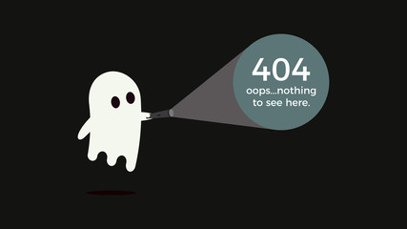
LuBAIR™ Inventory
Based in Impairment of Self-Regulatory Circuits
Sexual Expressions
3. SELF STIMULATION

Slide 10
LuBAIR™ Inventory
Based in Impairment of Self-Regulatory Circuits
Sexual Expressions
Purpose of Expressions
Don’t rush to ‘label’
Notes:
It used to say “Do not judge”
But this doesn’t make sense as the “caregiver’s interpretation of the expressions”

Slide 11
LuBAIR™ Inventory
Based in Impairment of Self-Regulatory Circuits
Sexual Expressions
Meaning of Expressions
“Please understand my reasons”
Notes:
This is my meaning. The original said:
Based in Impairment in IPC
Over-Identification of Facial Visual Stimulus
Attribution Error
Based in Impairment in MC
Increased Drive to Satiation of IPN
Preserved Drives to INI
Based in Impairment of ERC
Emotions of Discontentment (Misogyny)
Emotions of Fear (Secure Base)

Slide 12
LuBAIR™ Inventory
Based in Impairment of Self-Regulatory Circuits
Sexual Expressions
Approach to Care
De-stigmatize
Educate staff and family
Determine the basis for expressions
Care Plan accordingly
Notes:
Original said
Individualized care plan tailored to the principles identified above

Slide 13
THANK YOU!

