Slide 1
Section # 16. Based in Impairment of Self-regulatory circuits.
Physically Responsive Expressions.

Slide 2
Self Monitoring and Regulatory Circuits
LuBAIR™ Inventory
Based in Impairment of Self-Regulatory Circuits
Physically Responsive Expressions

Slide 3
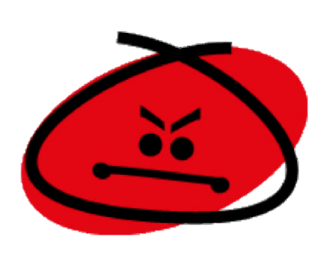
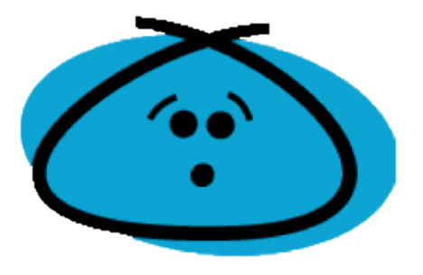
LuBAIR™ Inventory
Based in Impairment of Self-Regulatory Circuits
Physically Responsive Expressions
Represents two primary emotions:
Anger &
Discontentment

Slide 4
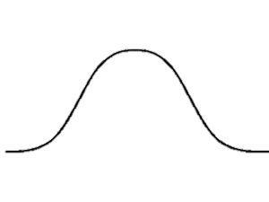
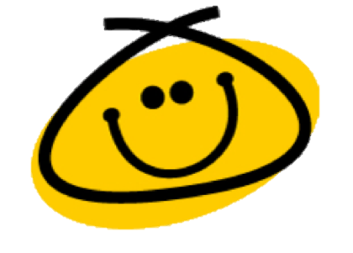
LuBAIR™ Inventory
Based in Impairment of Self-Regulatory Circuits
Physically Responsive Expressions
Anger
Joy or Happiness
Discontentment
Notes:
Added this here due to previous slide

Slide 5
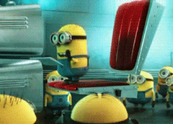
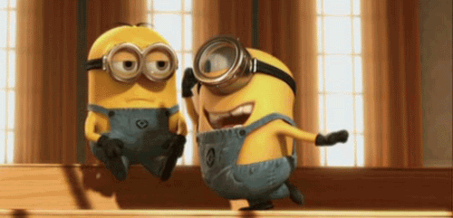
LuBAIR™ Inventory
Based in Impairment of Self-Regulatory Circuits
Physically Responsive Expressions
Classification
Instrumental Aggression
Hostile Aggression

Slide 6
LuBAIR™ Inventory
Based in Impairment of Self-Regulatory Circuits
Physically Responsive Expressions
Instrumental Aggression:
Reward-Consequence Paradigm
Individuals appreciate the difference between “right” and “wrong”
Preserved self-regulatory circuits
Criminal behavior

Slide 7
LuBAIR™ Inventory
Based in Impairment of Self-Regulatory Circuits
Physically Responsive Expressions
Hostile Aggression:
Frustration-Aggression Paradigm
Relationship between “frustration and aggression”
Perceived impediment in goal-attainment and ‘negative’ emotions
Impaired self-regulatory circuits

Slide 8
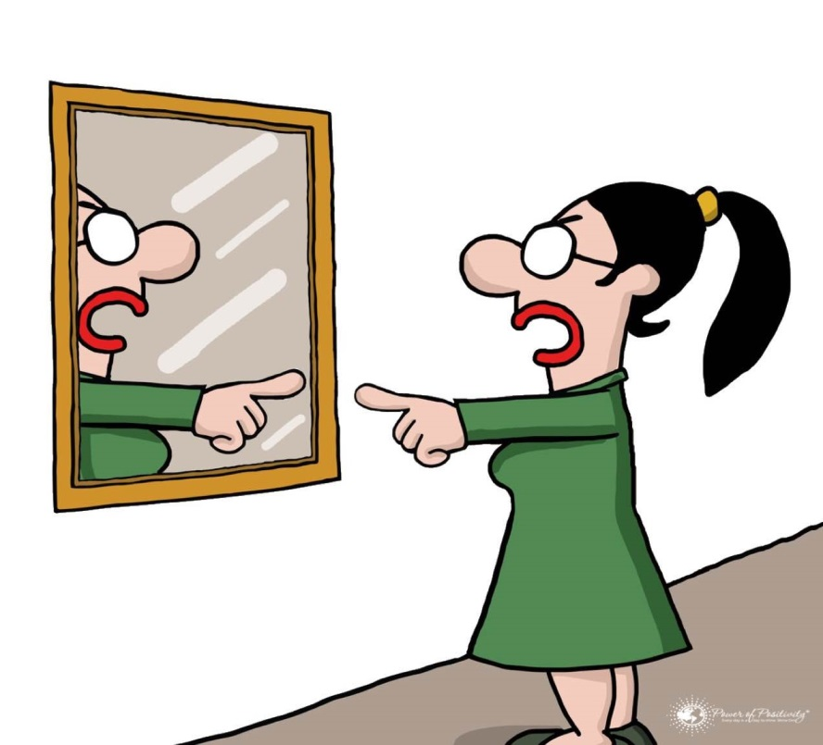
LuBAIR™ Inventory
Based in Impairment of Self-Regulatory Circuits
Physically Responsive Expressions
1. SELF-ABUSIVE

Slide 9
LuBAIR™ Inventory
Based in Impairment of Self-Regulatory Circuits
Physically Responsive Expressions
2. PULLING, PUSHING, GRABBING

Slide 10
LuBAIR™ Inventory
Based in Impairment of Self-Regulatory Circuits
Physically Responsive Expressions
3. KICKING, BITING, SCRATCHING, PUNCHING, TWISTING, HEAD BUTTING, SPITTING AT SOMEONE

Slide 11
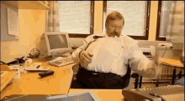
LuBAIR™ Inventory
Based in Impairment of Self-Regulatory Circuits
Physically Responsive Expressions
4. THROWING THINGS, BREAKING OBJECTS, TIPPING FURNITURE

Slide 12
LuBAIR™ Inventory
Based in Impairment of Self-Regulatory Circuits
Physically Responsive Expressions
Purpose of Expressions
‘Goal attainment’ is being impeded
Notes:
THIS WHOLE SECTION NEEDS TO BE REVIEWED

Slide 13
LuBAIR™ Inventory
Based in Impairment of Self-Regulatory Circuits
Physically Responsive Expressions
Meaning of Expressions
“Please help me identify and meet my needs”

Slide 14
LuBAIR™ Inventory
Based in Impairment of Self-Regulatory Circuits
Physically Responsive Expressions
Approach to Care
It depends…
Which ‘need’ is being impeded?
Innate physiological needs
Security needs
Belongingness needs

Slide 15
LuBAIR™ Inventory
Based in Impairment of Self-Regulatory Circuits
Physically Responsive Expressions
Approach to Care
It depends…
Which ‘need’ is being impeded?
Need to avoid or cope with pain
Lack of recognition of a need

Slide 16
LuBAIR™ Inventory
Based in Impairment of Self-Regulatory Circuits
Physically Responsive Expressions
Approach to Care
Identify and understand the behavioral expressions
Determine the ‘impeded need’ which is triggering the expressions
Care Plan accordingly
Notes:
101

