Slide 1
Section # 9 Based in Impairment of Motivational circuits.
Motor Expressions.

Slide 2
LuBAIR™ Inventory
Based in Impairment of Motivational Circuits
Motor Expressions
Motivational Circuits

Slide 3
LuBAIR™ Inventory
Based in Impairment of Motivational Circuits
Motor Expressions
Alternative Terminology
“Agitation”
Mental Health Definition ---- Symptom
Cohen-Mansfield Definition ---- Syndrome

Slide 4
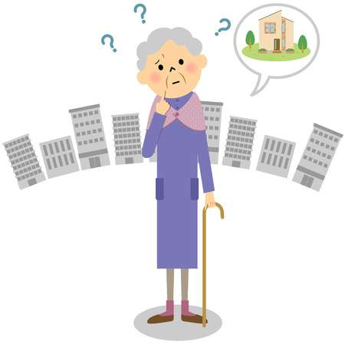
LuBAIR™ Inventory
Based in Impairment of Motivational Circuits
Motor Expressions
Alternative Terminology
“Wandering” Behaviors
‘Purposeful’ in nature
‘Purposeless’ in nature

Slide 5
LuBAIR™ Inventory
Based in Impairment of Motivational Circuits
Motor Expressions
Regardless of the ‘label’, governed by two factors:
Frequency of motor activity
Amplitude of motor activity
Both on a continuum of low to high

Slide 6
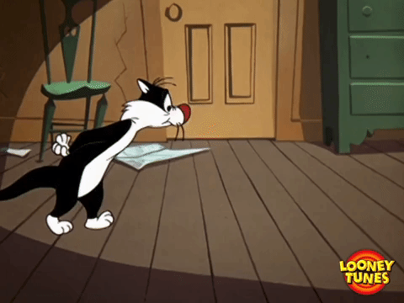
LuBAIR™ Inventory
Based in Impairment of Motivational Circuits
Motor Expressions
1. ROAMING, PACING, WANDERING

Slide 7
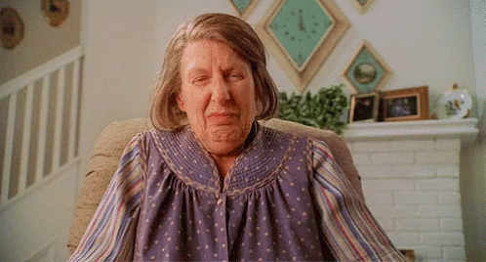
LuBAIR™ Inventory
Based in Impairment of Motivational Circuits
Motor Expressions
2. FIDGETY, ROCKING IN CHAIR, RESTLESS, AGITATED

Slide 8
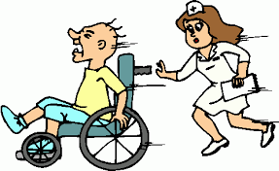
LuBAIR™ Inventory
Based in Impairment of Motivational Circuits
Motor Expressions
3. SEEMINGLY DRIVEN, "ON THE GO", WHEELCHAIR PROPELLING, CHAIR/BED EXITING

Slide 9
LuBAIR™ Inventory
Based in Impairment of Motivational Circuits
Motor Expressions
Purpose of Expressions
Existence of an ‘unsettled state’

Slide 10
LuBAIR™ Inventory
Based in Impairment of Motivational Circuits
Motor Expressions
Meaning of Expressions
“Please help me – I don’t understand my reasons for being unsettled”

Slide 11
LuBAIR™ Inventory
Based in Impairment of Motivational Circuits
Motor Expressions
Approach to Care
It depends…
Does the behavioral expression appear to be:
‘Purposeful’
or
‘Purposeless’
This is important information!
Please pass it on to the team!

Slide 12
LuBAIR™ Inventory
Based in Impairment of Motivational Circuits
Motor Expressions
Approach to Care
If it appears to be
“I require fulfillment of belongingness needs”, or
“I require fulfillment of innate physiological needs”
(Goal-Directed or Importuning Expressions)
Care Plan accordingly
‘purposeful’:

Slide 13
LuBAIR™ Inventory
Based in Impairment of Motivational Circuits
Motor Expressions
Approach to Care
If it appears to be
“I may be afraid”, or
“I may be worrying or thinking too much”
(Fretful/Trepidation or Emotional Expressions)
Care Plan accordingly
‘purposeless’:

