Slide 1
Section # 10 Based in Impairment of Motivational circuits.
Importuning Expressions.

Slide 2
LuBAIR™ Inventory
Based in Impairment of Motivational Circuits
Importuning Expressions
Motivational Circuits
Notes:
Need to have Apathy Behaviors after GDB. Then Motor Behaviors and finally would be Importuning Behaviors.
DONE

Slide 3
LuBAIR™ Inventory
Based in Impairment of Motivational Circuits
Importuning Expressions
‘Needs’ and ‘Motives’ Coexist
Needs Thoughts Goals
Release Satiation Motive

Slide 4
LuBAIR™ Inventory
Based in Impairment of Motivational Circuits
Importuning Expressions
RN worked on her feet all day - PwD family shows up with KFC for supper
Discrepancy between RN’s internal physiological state (not eaten all day) and smell of food

Slide 5
LuBAIR™ Inventory
Based in Impairment of Motivational Circuits
Importuning Expressions
I have not eaten all day
Needs Thoughts Goals
Release Satiation Motive
HUNGER
I need to get some food
I feel full
I’m taking a break
Notes:
Identification of need: HUNGER
Thought: “I have not eaten all day”
Goal: “I need to get some food”
Motive/Drive (Action): “I am going on a break to eat” change to ‘I am taking a break’
Need ‘satiated’: Tummy full

Slide 6
LuBAIR™ Inventory
Based in Impairment of Motivational Circuits
Importuning Expressions
Motivational Circuits
Notes:
Need to have Apathy Behaviors after GDB. Then Motor Behaviors and finally would be Importuning Behaviors.
DONE

Slide 7
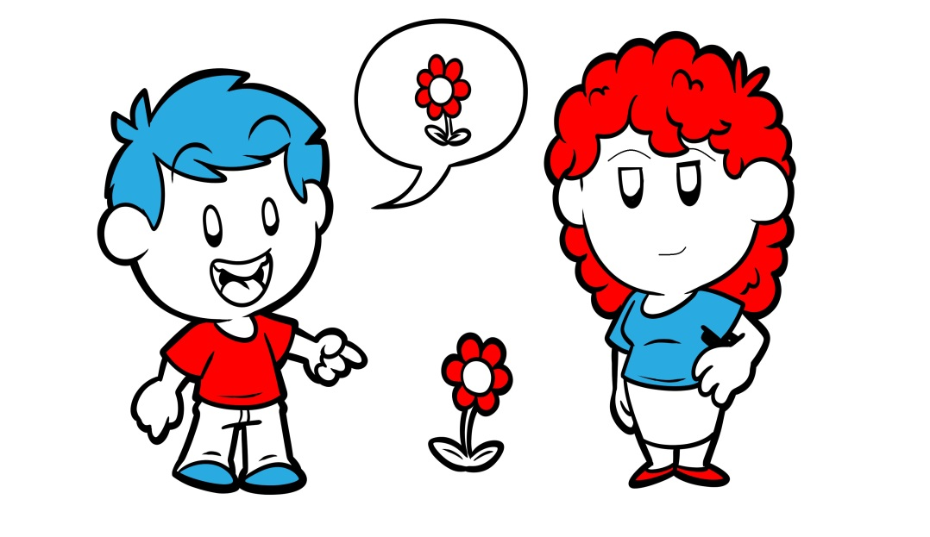
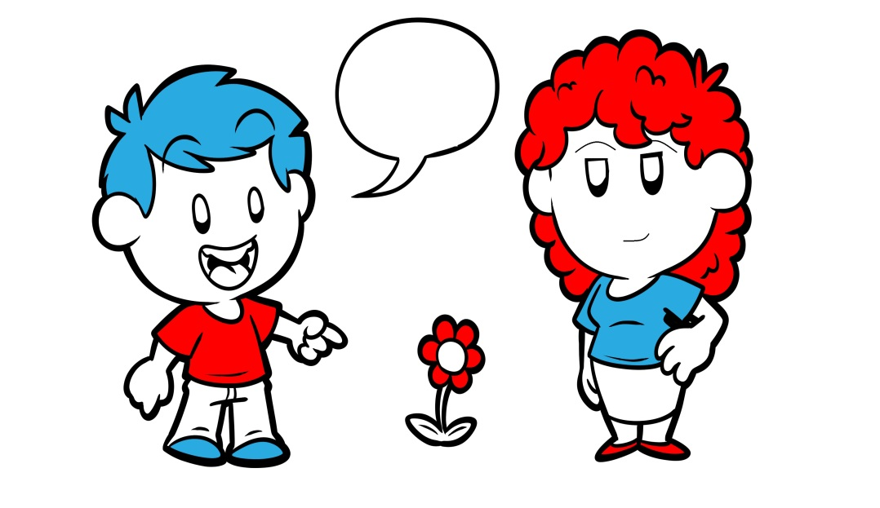
LuBAIR™ Inventory
Based in Impairment of Motivational Circuits
Importuning Expressions
Expressions of ‘requests’ congruent with severity of dementia
Overt / obvious
Occult / hidden
Ambiguous/innocuous

Slide 8
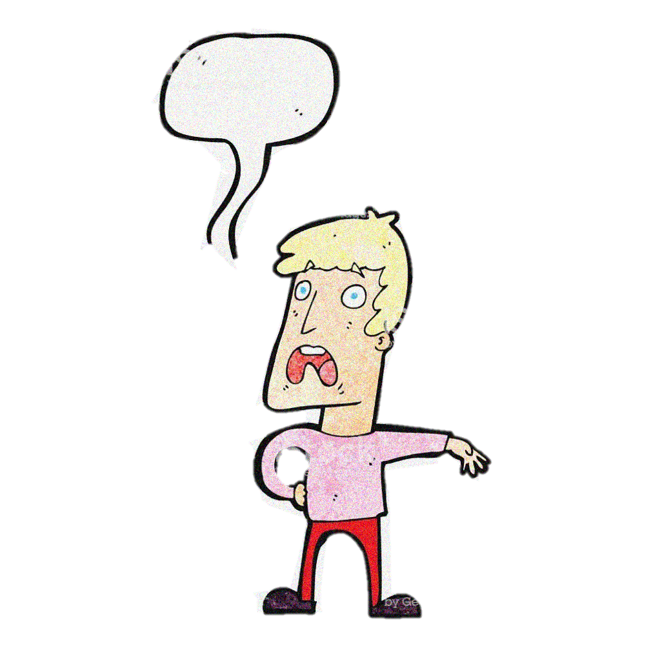
LuBAIR™ Inventory
Based in Impairment of Motivational Circuits
Importuning Expressions
Overt / obvious ---- Early Dementia
“I have to go pee”
“I am hungry”
“My tummy hurts”
!

Slide 9
LuBAIR™ Inventory
Based in Impairment of Motivational Circuits
Importuning Expressions
Occult / hidden ---- Middle Dementia
Crowding staff spaces
Repeatedly ringing call bell or calling for family
Shadowing staff during medication pass

Slide 10
LuBAIR™ Inventory
Based in Impairment of Motivational Circuits
Importuning Expressions
Ambiguous/innocuous -- Advanced Dementia
Repeatedly lying down on the floor
Rummaging through garbage and bringing it to PSW
Repeatedly removing incontinent product or shirt and handing it to PSWs

Slide 11
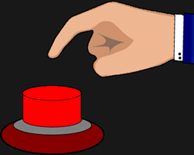
LuBAIR™ Inventory
Based in Impairment of Motivational Circuits
Importuning Expressions
1. PERSISTENTLY SEEKING REASSURANCE OR ASKING FOR ASSISTANCE

Slide 12
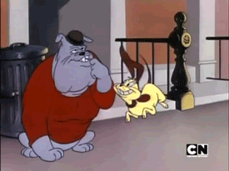
LuBAIR™ Inventory
Based in Impairment of Motivational Circuits
Importuning Expressions
2. BEHAVING IN WAYS FOR DEMANDS TO BE MET IMMEDIATELY (e.g., repeatedly asking to be toileted or for medications, etc.)

Slide 13
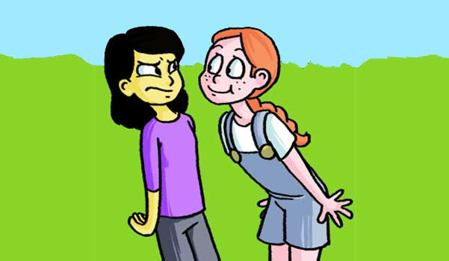
LuBAIR™ Inventory
Based in Impairment of Motivational Circuits
Importuning Expressions
3. SHADOWING STAFF (e.g., following closely, crowding staff members’ personal space, etc.)

Slide 14
LuBAIR™ Inventory
Based in Impairment of Motivational Circuits
Importuning Expressions
4. ATTENTION SEEKING OR “MANIPULATIVE” BEHAVIORS (e.g., repeatedly emptying soiled linen cart, throwing food on the floor, etc.)

Slide 15
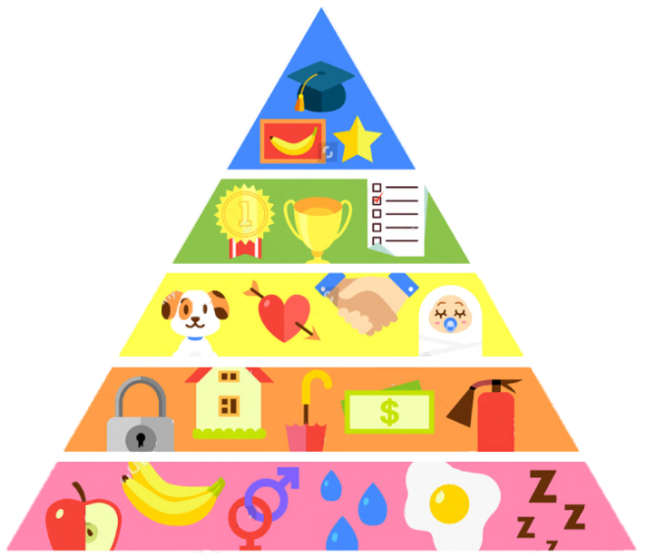
LuBAIR™ Inventory
Based in Impairment of Motivational Circuits
Importuning Expressions
Purpose of Expressions
Presence of unmet ‘basic’ needs

Slide 16
LuBAIR™ Inventory
Based in Impairment of Motivational Circuits
Importuning Expressions
Meaning of Expressions
“Please help me identify my specific innate physiological needs”
(hunger/thirst)
(voiding/defecating)
(fatigue/need to rest)
(pain/discomfort)
(mental/social stimulation)
Pleasure needs
(need for intimacy)
(sexual needs)
Notes:
ORIGINAL

Slide 17
LuBAIR™ Inventory
Based in Impairment of Motivational Circuits
Importuning Expressions
Approach to Care
Appreciate most ‘requests’ will be ‘hidden’ or ‘unclear’
Same ‘expression’ may represent different ‘needs’ at different times
Notes:
Font size is very small and there are a lot of words – can we put this over 2 slides or reduce the # of words?
Break it up into 2 slides

Slide 18
LuBAIR™ Inventory
Based in Impairment of Motivational Circuits
Importuning Expressions
Approach to Care
Involve family members in:
Daily habits and routines: while working and after retirement
Systematic approach to ‘pair’ each ‘expression’ with specific ‘need’ for different times of the day
Notes:
Font size is very small and there are a lot of words – can we put this over 2 slides or reduce the # of words?
Break it up into 2 slides

