Slide 1
Section # 7 Based in Impairment of Motivational circuits.
Goal directed expressions.

Slide 2
LuBAIR™ Inventory
Based in Impairment of Motivational Circuits
Goal Directed Expressions
Apathy Expressions
Motor Expressions
Importuning Expressions
Notes:
NOTE: Changed from:
Goal Directed Behaviors
Importuning Behaviors
Apathy Behaviors
Motor Behaviors
To expressions
Also, changed the order to be in the same order as they are presented

Slide 3
LuBAIR™ Inventory
Based in Impairment of Motivational Circuits
Definition
‘Drives’ or ‘Motivation’
Derived from Greek word ‘movere’: meaning ‘to move’
Motivation is…
Persistent voluntary effort
Directed at satiation of ‘needs’
Leads to ‘goal attainment’

Slide 4
LuBAIR™ Inventory
Based in Impairment of Motivational Circuits
Needs
An internal physiological or psychological state of an individual
The external state of the ‘milieu’, and…
The ‘state’ of discrepancy between the two
Identification of a ‘need’

Slide 5
LuBAIR™ Inventory
Based in Impairment of Motivational Circuits
The Process
Needs thoughts
Thoughts goals
Goals ‘drives’ or ‘motivation’
‘Motivation’ need
Results in goal attainment
get represented as
lead to formation of
trigger
propels to satiate the
Notes:
Alternative
Needs get represented as thoughts
Thoughts lead to formation of goals
Goals trigger ‘drives’ or ‘motivation’
‘Motivation’ propels to satiate the need
This results in goal attainment

Slide 6
LuBAIR™ Inventory
Based in Impairment of Motivational Circuits
Goal Directed Expressions
‘Needs’ and ‘Motives’ Coexist
Needs Thoughts Goals
Release Satiation Motive

Slide 7
LuBAIR™ Inventory
Based in Impairment of Motivational Circuits
Goal Directed Expressions
Negotiations with God over a desired outcome failed - questioning ‘faith’
Patient with life threatening illness, not expected to survive, lives on! Family attributes this to their “unwavering faith’ in God
Discrepancy between ‘my loss of faith’ and their ‘unwavering faith’
Notes:
Crowded slide. Need to change it.
Maybe we can remove this entirely? Is another example necessary?

Slide 8
LuBAIR™ Inventory
Based in Impairment of Motivational Circuits
Goal Directed Expressions
Where do I belong?
Needs Thoughts Goals
Release Satiation Motive
Belongingness (to faith)
Need to connect with faith
I do belong
Need to visit an elder
Notes:
Identification of need: BELONGINGNESS (to my faith)
Thought: “I feel disconnected from my faith”
Goal: “I need to visit an elder” change to where do I ‘Belong’
Motive/Drive (Action): “I visit my place of worship” change to ‘Visit an ‘elder’ or place of ‘worship’
Need ‘satiated’: Feel a sense of belongingness to my faith change to ‘I do belong’

Slide 9
LuBAIR™ Inventory
Based in Impairment of Motivational Circuits
Goal Directed Expressions
Motivational Circuits
Notes:
Do we need the top line since we have a schematic of impairment of Motivational Circuits? Put the diagram first and then Goal Directed Behaviors
If we make this change, this will mean that other slides are not the same. Also, I think explicitly connecting the expressions to the type of impairment is helpful and keeps the viewer consistently connecting the ideas

Slide 10
LuBAIR™ Inventory
Based in Impairment of Motivational Circuits
Goal Directed Expressions
1. GOAL DIRECTED THINKING (e.g., I am going home to my kids, I am going to the bank, I am getting married today, where can I pay my bills, etc.)
Leads to
2. GOAL DIRECTED ACTIVITIES (e.g., rummaging, hoarding, rifling, or emptying drawers etc.; stripping of clothes; rearranging furniture or fixing items in milieu; stripping bedding or pulling curtains/fixtures on the walls; bed/chair exiting or exit seeking; intrusiveness or purposeful wandering; seemingly driven, “on the go”)
Notes:
Very crowded. Do we need this slide?
I think this helps to contextualize the 2 points that fall under this category, and underscores that they are directly linked. Also, every other group of expressions are covered individually – if this slide is eliminated, then this will be the only one that doesn’t.

Slide 11
Full video found at https://www.youtube.com/watch?v=VdzKXhyv_tg
Notes:
VIDEO
Click the video ONCE to play it (a second click will stop it)

Slide 12
LuBAIR™ Inventory
Based in Impairment of Motivational Circuits
Goal Directed Expressions
(Goal Directed) Thought
“I need to go home and feed the kids; they are alone and waiting for me”
(Goal Directed) Action
Intrusiveness into nursing station, pacing, exit-seeking, trying the doors, etc.
Notes:
GDT ‘I need to go home to feed the kids; they are alone and waiting for me…. GDA. Intrussives into the nursing station, Pacing the floor, trying the doors, exit seeking

Slide 13
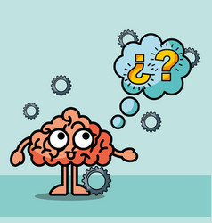
LuBAIR™ Inventory
Based in Impairment of Motivational Circuits
Goal Directed Expressions
(Goal Directed) Thought
“I need to pay my bills”
(Goal Directed) Action
Asking for a phone book, looking for a phone, reaching over nursing station
Notes:
I need to pay the utility, gas or telephone bill….. Requesting for a phonebook, looking for a phone, reaching over nursing station for the phone

Slide 14
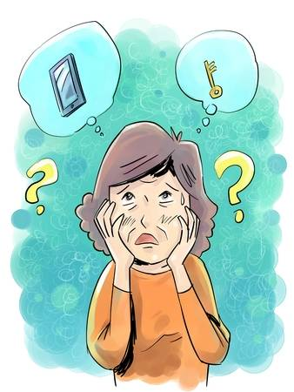
LuBAIR™ Inventory
Based in Impairment of Motivational Circuits
Goal Directed Expressions
(Goal Directed) Thought
“I am late for work! Where are my keys?”
(Goal Directed) Action
Rummaging, rifling, emptying drawers

Slide 15
LuBAIR™ Inventory
Based in Impairment of Motivational Circuits
Goal Directed Expressions
Persistent and repetitive (over shifts/days)
Appears determined
High degree of ‘unrest’ on the unit
Staff playing ‘catch-up’

Slide 16
LuBAIR™ Inventory
Based in Impairment of Motivational Circuits
Goal Directed Expressions
Purpose of Expressions
Presence of “busy beaver” states

Slide 17
LuBAIR™ Inventory
Based in Impairment of Motivational Circuits
Goal Directed Expressions
Meaning of Expressions
“Please help me belong...”
(Family, Faith, Profession or Life’s Work, Community, Ethnicity)

Slide 18
LuBAIR™ Inventory
Based in Impairment of Motivational Circuits
Goal Directed Expressions
Approach to Care
Define the goal for the PwD
Affirm the goal
Do not contradict
“How can I help?” - Help to facilitate the goal
Re-channelize energy to an immediate purpose

