Slide 1
Section # 5 Based in Impairment in Regulation of Sensorium.
Disorganized Expressions.

Slide 2
LuBAIR™ Inventory
Based in Impairment in Regulation of Sensorium
Disorganized Expressions
Sensorium

Slide 3
LuBAIR™ Inventory
Based in Impairment in Regulation of Sensorium
Disorganized Expressions
Impaired reaction time
Impaired processing speed
Impairment in which “chunk” of information is processed

Slide 4
LuBAIR™ Inventory
Based in Impairment in Regulation of Sensorium
Disorganized Expressions
Alertness or Arousal
Impaired reaction time and processing speed
Attentiveness
Impaired chunk of information
Information Processing Circuits
Task Performance

Slide 5
LuBAIR™ Inventory
Based in Impairment in Regulation of Sensorium
Disorganized Expressions
There is something different about Ms. Smith today.
Ms. Smith seems more confused as of late.

Slide 6
LuBAIR™ Inventory
Based in Impairment in Regulation of Sensorium
Disorganized Expressions
1. APPEARING "VACANT" OR "LOST" IN FACIAL EXPRESSIONS

Slide 7
2. DISORGANIZED THINKING, UNINTELLIGIBLE/GARBLED SPEECH
Full video found at https://www.youtube.com/watch?v=3oef68YabD0
Notes:
VIDEO
Click the video ONCE to play it (a second click will stop it)

Slide 8
LuBAIR™ Inventory
Based in Impairment in Regulation of Sensorium
Disorganized Expressions
3. RAPID SHIFTS IN, OR INCONGRUENCE OF, EMOTIONAL STATES

Slide 9
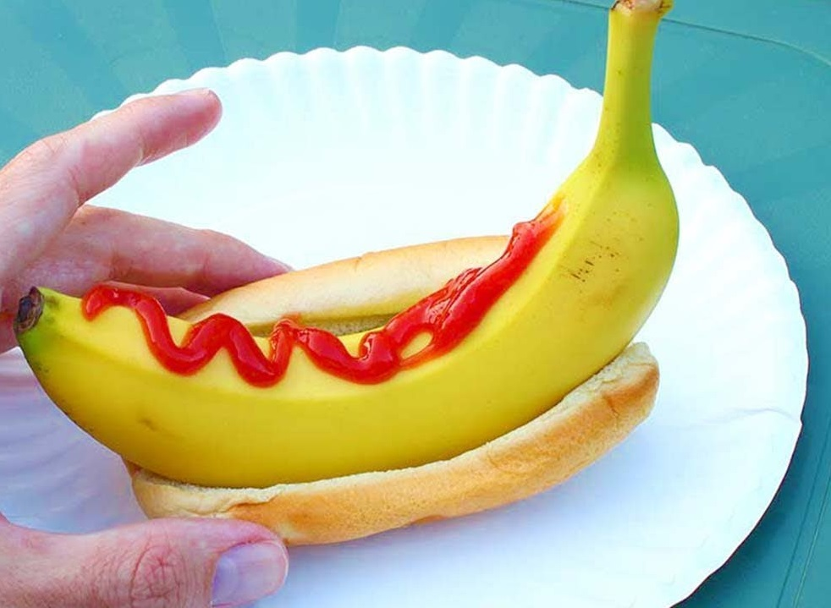
LuBAIR™ Inventory
Based in Impairment in Regulation of Sensorium
Disorganized Expressions
4. INAPPROPRIATE MIXING OF FOOD OR DRESSING/LAYERING OF CLOTHES, SMEARING FECAL MATTER, PLAYING IN TOILET BOWL, ETC.

Slide 10
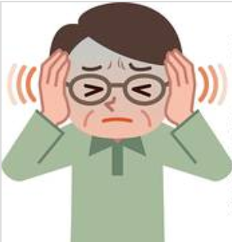
LuBAIR™ Inventory
Based in Impairment in Regulation of Sensorium
Disorganized Expressions
5. PLAYING WITH ‘THINGS’ IN THE AIR, RESPONDING TO AUDITORY HALLUCINATIONS, PICKING ‘THINGS’ FROM BODY OR FURNITURE, ETC.

Slide 11
LuBAIR™ Inventory
Based in Impairment in Regulation of Sensorium
Disorganized Expressions
6. MENTAL OR PHYSICAL LETHARGY, OR GENERAL FUNCTIONAL DECLINE
e.g., change in swallow, intake, posture, cognition, continence

Slide 12
LuBAIR™ Inventory
Based in Impairment in Regulation of Sensorium
Disorganized Expressions
Purpose of Expressions
Increased “confusion” from baseline

Slide 13
LuBAIR™ Inventory
Based in Impairment in Regulation of Sensorium
Disorganized Expressions
Meaning of Expressions
“My body physiology has changed. Please help me find the cause.”

Slide 14
LuBAIR™ Inventory
Based in Impairment in Regulation of Sensorium
Disorganized Expressions
Approach to Care
Physiological Workup
Bowel/Bladder Functions, Hearing or Vision Changes, Pain, Dentition
Circadian Rhythm Changes
Infective Workup
Metabolic Workup
Medication Optimization

