Slide 1
Section # 12 . Based in Impairment of Emotional Regulatory Circuits.
Vocal Expressions.

Slide 2
Emotional Regulatory Circuits
LuBAIR™ Inventory
Based in Impairment of Emotional Regulatory Circuits
Vocal Expressions

Slide 3
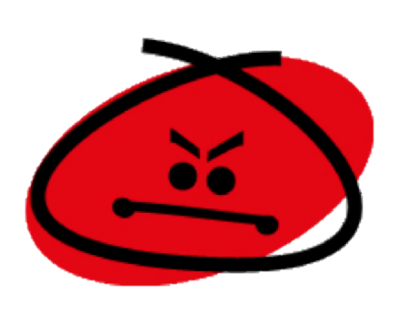
LuBAIR™ Inventory
Based in Impairment of Emotional Regulatory Circuits
Vocal Expressions
Represents two primary emotions:
Anger
&
Joy
Notes:
Need one slide after this which shows the relationship between joy and anger. Also a slide of relationship between discontentment and anger and melancholy and discontentment

Slide 4
LuBAIR™ Inventory
Based in Impairment of Emotional Regulatory Circuits
Vocal Expressions
Generation of Emotions (Anger and Joy)
and
Regulation of Emotions (Anger and Joy)
Impaired

Slide 5
LuBAIR™ Inventory
Based in Impairment of Emotional Regulatory Circuits
Vocal Expressions
PwD respond to:
Noxious or Negative triggers
Non-noxious or Neutral triggers
Ambiguous or Innocuous triggers

Slide 6
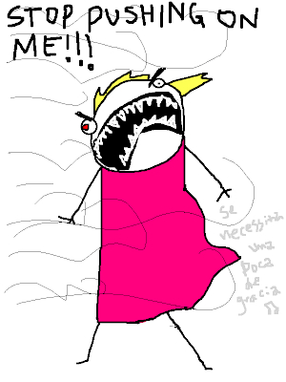
LuBAIR™ Inventory
Based in Impairment of Emotional Regulatory Circuits
Vocal Expressions
The responses are:
Increased in amplitude
Prolonged in duration
‘Out-of-proportion’

Slide 7
LuBAIR™ Inventory
Based in Impairment of Emotional Regulatory Circuits
Vocal Expressions
Continuum in Expression of Emotion - ‘Anger’
Hyper - Reactivity
Dysphoria
Argumentative
Primal Scream
Quarrelsome
Destructive Syndromes
Notes:
Need to put two streams. Hyper-reactivity (remove explosiveness) -→ Dysphoria. Now we bifurcate to Argumentative -→ Quarrelsome -→ Destructive syndromes and Dyphoria -----→ Primal Scream.
DONE
Hyper-reactivity Dysphoria
Argumentative Quarrelsome Destructive Syndromes & Dysphoria Primal Scream

Slide 8
LuBAIR™ Inventory
Based in Impairment of Emotional Regulatory Circuits
Vocal Expressions
Continuum in Expression of Emotion - ‘Joy’
Effusive Elated Euphoric

Slide 9
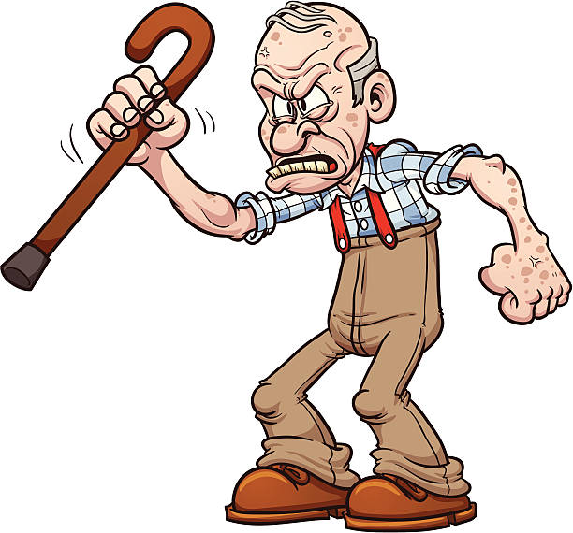
LuBAIR™ Inventory
Based in Impairment of Emotional Regulatory Circuits
Vocal Expressions
1. VERBALLY RESPONSIVE (e.g., brief explosive burst, argumentative, quarrelsome, etc.)

Slide 10
LuBAIR™ Inventory
Based in Impairment of Emotional Regulatory Circuits
Vocal Expressions
2. TALKING LOUD AND FAST, MANIC-LIKE BEHAVIOR
Full video found at https://www.youtube.com/watch?v=ExKCcndqK5c
Notes:
VIDEO
Click the video ONCE to play it (a second click will stop it)

Slide 11
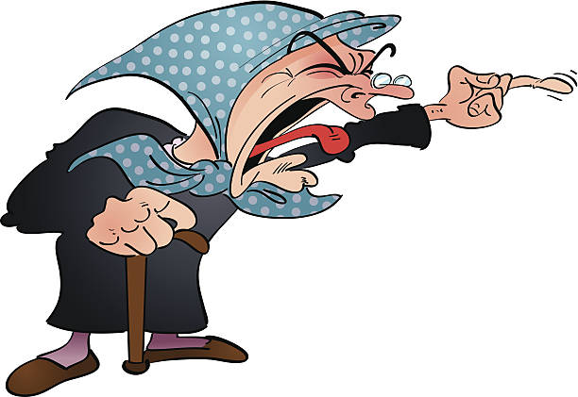
LuBAIR™ Inventory
Based in Impairment of Emotional Regulatory Circuits
Vocal Expressions
3. YELLING AND SCREAMING TO GET THINGS DONE

Slide 12
LuBAIR™ Inventory
Based in Impairment of Emotional Regulatory Circuits
Vocal Expressions
4. RATTLING BED RAILS/TABLE TOPS, PERISTENT CALLING OUT FOR STAFF/FAMILY

Slide 13
LuBAIR™ Inventory
Based in Impairment of Emotional Regulatory Circuits
Vocal Expressions
5. UTTERING NOISES OR MAKING REPETITIVE SOUNDS
Notes:
AUDIO
Click the image ONCE to play it (a second click will stop it)

Slide 14
LuBAIR™ Inventory
Based in Impairment of Emotional Regulatory Circuits
Vocal Expressions
Purpose of Expressions
‘Out-of-proportion’ emotional responses

Slide 15
LuBAIR™ Inventory
Based in Impairment of Emotional Regulatory Circuits
Vocal Expressions
Meaning of Expressions (Based in Anger)
“Please appreciate that I am in a defensive mode”
Notes:
Need two slides. One for emotions of anger and the other for joy. Next slide. Meaning of behaviors based in joy “Please help me control my emotions”
DONE
NOTE: This is not a well-known idiom and may be especially confusing for non-native English speakers.
Old version said “I’m warning you to stop/back off”

Slide 16
LuBAIR™ Inventory
Based in Impairment of Emotional Regulatory Circuits
Vocal Expressions
Approach to Care (Based in Anger)
Do not personalize these responses
Understand the defensive nature of the response
Prevent further exposure to triggers
Use ‘stop and go’ approach
Notes:
Two slides; one for anger and other for joy. For anger. Do not ‘personalize’ these ‘out of proportion’ response. Understand the ‘defensive’ nature of the responses. Prevent further exposure to triggers. Use stop and go approach. For joy. Do not ‘partake’ in these ‘out-of-proportion’ responses. Understand the ‘excitable’ nature of the responses. The last two remain the same.
DONE

Slide 17
LuBAIR™ Inventory
Based in Impairment of Emotional Regulatory Circuits
Vocal Expressions
Meaning of Expressions (Based in Joy)
“Please help me to control my emotions”

Slide 18
LuBAIR™ Inventory
Based in Impairment of Emotional Regulatory Circuits
Vocal Expressions
Approach to Care (Based in Joy)
Do not partake in ‘out-of-proportion’ responses
Understand the excitable nature of the behavior
Prevent further exposure to triggers
Use ‘stop and go’ approach
Notes:
Two slides; one for anger and other for joy. For anger. Do not ‘personalize’ these ‘out of proportion’ response. Understand the ‘defensive’ nature of the responses. Prevent further exposure to triggers. Use stop and go approach. For joy. Do not ‘partake’ in these ‘out-of-proportion’ responses. Understand the ‘excitable’ nature of the responses. The last two remain the same.

