Slide 1
Section # 14 . Based in Impairment of Emotional Regulatory Circuits.
Fretful/Trepidation Expressions.

Slide 2
Emotional Regulatory Circuits
LuBAIR™ Inventory
Based in Impairment of Emotional Regulatory Circuits
Fretful/Trepidation Expressions

Slide 3
LuBAIR™ Inventory
Based in Impairment of Emotional Regulatory Circuits
Fretful/Trepidation Expressions
‘Needs’ and ‘Motives’ Coexist
Needs Thoughts Goals
Release Satiation Motive

Slide 4
LuBAIR™ Inventory
Based in Impairment of Emotional Regulatory Circuits
Fretful/Trepidation Expressions
Lost in a foreign place, surrounded by strangers and different language - no communication feasible
Starting to get dark, and locals are carrying on with their festivities at the bar
Discrepancy between “feeling insecure” and the locals’ “at ease disposition”
Notes:
don’t like the format of this slide.
Need to change Feeling ‘Insecure’ instead of ‘afraid’.
DONE

Slide 5
LuBAIR™ Inventory
Based in Impairment of Emotional Regulatory Circuits
Fretful/Trepidation Expressions
I feel unsafe
Needs Thoughts Goals
Release Satiation Motive
SECURITY
Need to find safe place
I feel safe
Drive to a safe place
Notes:
Identification of need: SECURITY
Thought: “I am feeling unsafe”
Goal: “I need to get out of here” ‘Need to find a ‘Safe’ place.
Motive/Drive (Action): “I need to get in the car and drive away” change to ‘Drive to a ‘safe’ place
Need ‘satiated’: Feel safer in the car

Slide 6
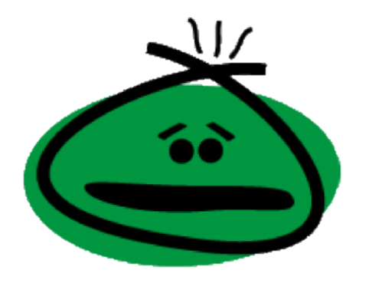
LuBAIR™ Inventory
Based in Impairment of Emotional Regulatory Circuits
Fretful/Trepidation Expressions
Represents the primary emotion of:
FEAR

Slide 7
LuBAIR™ Inventory
Based in Impairment of Emotional Regulatory Circuits
Fretful/Trepidation Expressions
Attachment:
Bowlby and Ainsworth
Bonding between mom and infant
Valid for all ‘attachments’ throughout life (marital, family, work)
Remains valid through all stages of dementia
Notes:
Remains valid through all stages of dementia; early, middle and late. Next slide. Different types of attachments with four bullets.
Different types (secure, anxious, avoidant disorganized)

Slide 8
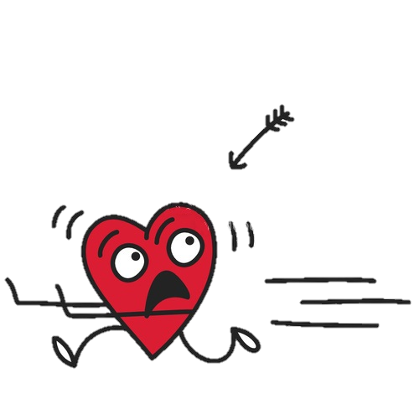
LuBAIR™ Inventory
Based in Impairment of Emotional Regulatory Circuits
Fretful/Trepidation Expressions
Attachment (Bowlby and Ainsworth):
Different types of attachments:
Secure
Anxious
Avoidant
Disorganized
Notes:
Remains valid through all stages of dementia; early, middle and late. Next slide. Different types of attachments with four bullets.
Different types (secure, anxious, avoidant disorganized)

Slide 9
LuBAIR™ Inventory
Based in Impairment of Emotional Regulatory Circuits
Fretful/Trepidation Expressions
Attachment:
Stored as ‘mental images’
Create ‘Inner World Model’ (hard drive)
Pair ‘stored attachments’ to ‘new environment’
Notes:
Not sure if we need this slide.

Slide 10
LuBAIR™ Inventory
Based in Impairment of Emotional Regulatory Circuits
Fretful/Trepidation Expressions
Moderate -> Advanced Dementia
Complete loss of recognition of own environment
No familiarity of new environment
Still have recognition of earlier childhood memories (ages 2 – 8)
Notes:
Need to change the slide. Moderate to Advanced Dementia. Complete loss of recognition of ‘own’ environment. No familiarity of new environment. Still have recognition of earlier childhood memories. Between ages of 2 to 8). Parent or sibling fixations.
CHANGED SLIDE

Slide 11
LuBAIR™ Inventory
Based in Impairment of Emotional Regulatory Circuits
Fretful/Trepidation Expressions
Advanced Dementia
Complete loss of ‘external familiarity’
PwD turns inward to ‘stored mental images’
‘Secure mental images’ -> no symptoms
‘Anxious mental images’ -> Fretful/Trepidation
Parent or sibling fixation
Notes:
Not sure if we need to keep this slide.

Slide 12
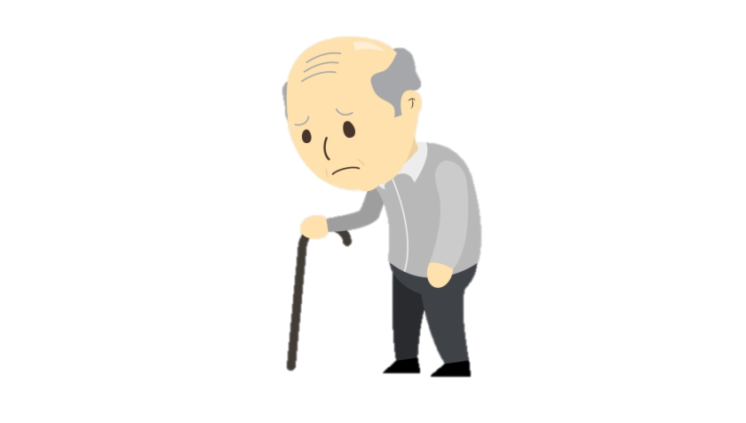
LuBAIR™ Inventory
Based in Impairment of Emotional Regulatory Circuits
Fretful/Trepidation Expressions
1. EXPRESSING WORRY, FEAR, FOREBODING, OR CATASTROPHE

Slide 13
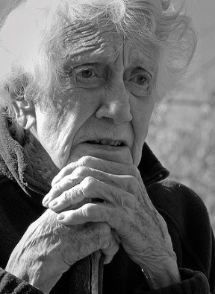
LuBAIR™ Inventory
Based in Impairment of Emotional Regulatory Circuits
Fretful/Trepidation Expressions
2. FEARFUL OR SCARED FACIAL EXPRESSIONS

Slide 14
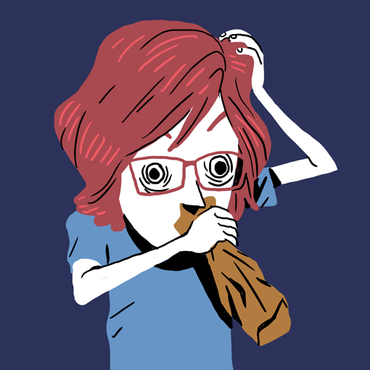
LuBAIR™ Inventory
Based in Impairment of Emotional Regulatory Circuits
Fretful/Trepidation Expressions
3. ANXIOUS OR DISTRESSED FACIAL EXPRESSIONS

Slide 15
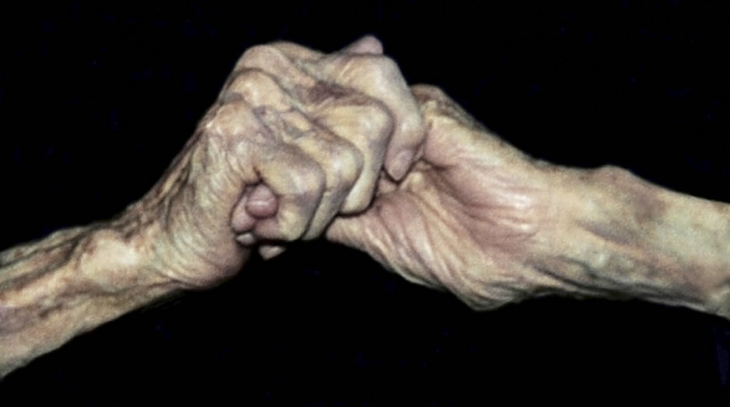
LuBAIR™ Inventory
Based in Impairment of Emotional Regulatory Circuits
Fretful/Trepidation Expressions
4. CLINGY OR "LATCHING ON", WRINGING OF HANDS, RUBBING FACE/BODY

Slide 16
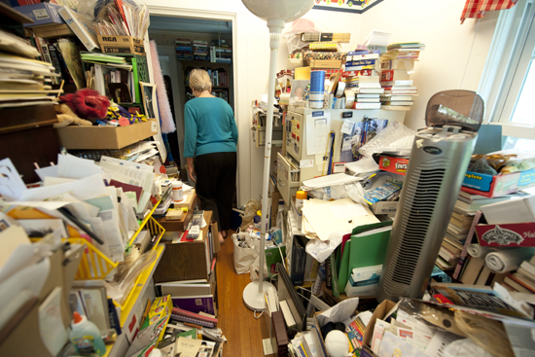
LuBAIR™ Inventory
Based in Impairment of Emotional Regulatory Circuits
Fretful/Trepidation Expressions
5. HOARDING OR COLLECTING

Slide 17
LuBAIR™ Inventory
Based in Impairment of Emotional Regulatory Circuits
Fretful/Trepidation Expressions
Purpose of Expressions
Presence of unmet ‘security’ needs

Slide 18
LuBAIR™ Inventory
Based in Impairment of Emotional Regulatory Circuits
Fretful/Trepidation Expressions
Meaning of Expressions
“Please help me feel ‘safe’”
Notes:
Please help me feel ‘safe’ and ‘secure’

Slide 19
LuBAIR™ Inventory
Based in Impairment of Emotional Regulatory Circuits
Fretful/Trepidation Expressions
Approach to Care
Help create a ‘secure base’ for the PwD
Make use of familiar things like…
Photo albums or memory windows of parents, their childhood, siblings, etc.
Music, movies, or TV shows from their era
Notes:
NOTE: On old slide it said “Approach to Care – Moderate Dementia”. However, there was no slide for advanced, so I removed the qualifier.

