Slide 1
Section # 13 . Based in Impairment of Emotional Regulatory Circuits.
Emotional expressions.

Slide 2
Emotional Regulatory Circuits
LuBAIR™ Inventory
Based in Impairment of Emotional Regulatory Circuits
Emotional Expressions

Slide 3
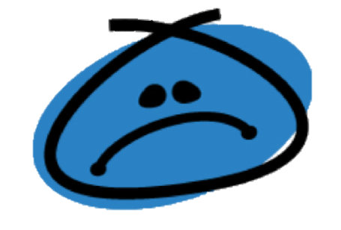
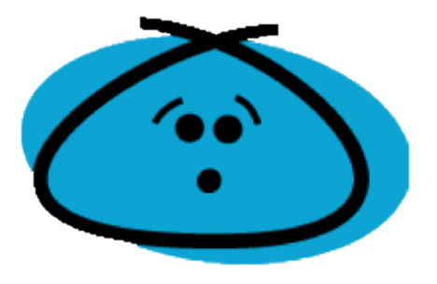
LuBAIR™ Inventory
Based in Impairment of Emotional Regulatory Circuits
Emotional Expressions
Represents two primary emotions:
Melancholy &
Discontentment

Slide 4
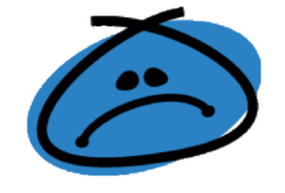
LuBAIR™ Inventory
Based in Impairment of Emotional Regulatory Circuits
Emotional Expressions
Sadness or Melancholy
Discontentment
Notes:
Is this good here?

Slide 5
LuBAIR™ Inventory
Based in Impairment of Emotional Regulatory Circuits
Emotional Expressions
Melancholy
Appearing sad, despondent, or tearful
Expression of themes of despair, morbidity, gloominess, and somatic complaints
Feeling rejected or increased sensitivity to comments from others

Slide 6
LuBAIR™ Inventory
Based in Impairment of Emotional Regulatory Circuits
Emotional Expressions
Discontentment
Low frustration tolerance, irritable, short-tempered
Mimicking or mocking and being dismissive
Sarcastic or teasing, derogatory comments, being critical and negative of others

Slide 7
LuBAIR™ Inventory
Based in Impairment of Emotional Regulatory Circuits
Emotional Expressions
Humans are innately averse to pain; emotional or physical
Protection from pain becomes primary defense mechanism
Does not change regardless of stage of dementia
Likely heightened

Slide 8
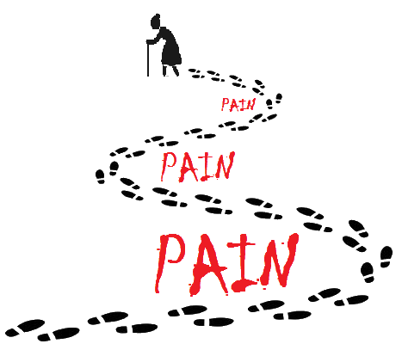
LuBAIR™ Inventory
Based in Impairment of Emotional Regulatory Circuits
Emotional Expressions
Two approaches to dealing with pain:
Coping with pain
&
Avoidance of pain

Slide 9
LuBAIR™ Inventory
Based in Impairment of Emotional Regulatory Circuits
Emotional Expressions
Coping with Pain (Melancholy)
‘Catharsis’ of pain - crying and talking
Measured ‘decompression’
Observer’s perspective: suffering
Individual’s perspective: relief from suffering

Slide 10
LuBAIR™ Inventory
Based in Impairment of Emotional Regulatory Circuits
Emotional Expressions
Avoidance of Pain (Discontentment)
“I feel good by putting you down” (verbal)
Pro-active shut down of communication
(non-verbal)
Creates barriers or distance with others
Protect exposure to ‘hurt’
Prevent experiencing of ‘pain’

Slide 11
LuBAIR™ Inventory
Based in Impairment of Emotional Regulatory Circuits
Emotional Expressions
1. APPEARING SAD, TEARFUL, OR IRRITABLE

Slide 12
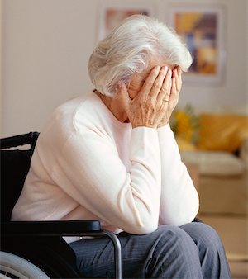
LuBAIR™ Inventory
Based in Impairment of Emotional Regulatory Circuits
Emotional Expressions
2. EXPRESSING THEMES OF DESPAIR, MORBIDITY, SOMATIC COMPLAINTS, OR SELF-DEPRICATING COMMENTS

Slide 13
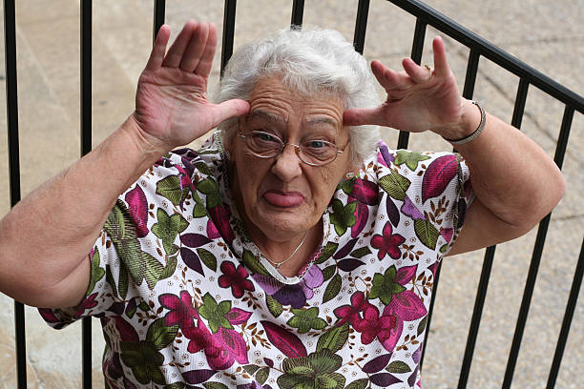
LuBAIR™ Inventory
Based in Impairment of Emotional Regulatory Circuits
Emotional Expressions
3. MIMICKING/MOCKING OR BEING DISMISSIVE

Slide 14
LuBAIR™ Inventory
Based in Impairment of Emotional Regulatory Circuits
Emotional Expressions
4. SARCASTIC OR TEASING, BEING DEROGATORY, CRITICAL AND NEGATIVE OF OTHERS

Slide 15
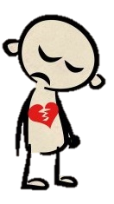
LuBAIR™ Inventory
Based in Impairment of Emotional Regulatory Circuits
Emotional Expressions
5. EXPRESSING FEELINGS OF REJECTION OR INCREASED SENSITIVITY TO OTHERS’ COMMENTS

Slide 16
LuBAIR™ Inventory
Based in Impairment of Emotional Regulatory Circuits
Emotional Expressions
Purpose of Expressions (Melancholy)
Presence of painful states – PwD is ‘coping’ with pain
Notes:
Two slides. Purpose of Measure for Meloncholy. Awareness of ‘coping’ with pain. Purpose of measure for discontentment. Awareness of ‘avoidance’ of pain

Slide 17
LuBAIR™ Inventory
Based in Impairment of Emotional Regulatory Circuits
Emotional Expressions
Meaning of Expressions (Melancholy)
“Please help me in my catharsis”
Notes:
Two slides. Meaning of the Expression based in melancholy. I am not surffering (this does not make sense to me – they *are* suffering otherwise why would they be sad? They are trying not to suffer – “I’m trying to relieve my suffering” makes a lot more sense); please help me in releasing my emotions. Meaning of the Expression based in discontentment. Please don’t take me for a ‘jerk’; I am simply trying to protect myself from ‘pain’.

Slide 18
LuBAIR™ Inventory
Based in Impairment of Emotional Regulatory Circuits
Emotional Expressions
Purpose of Expressions (Discontentment)
Presence of painful states – PwD is ‘avoiding’ pain
Notes:
Two slides. Purpose of Measure for Meloncholy. Awareness of ‘coping’ with pain. Purpose of measure for discontentment. Awareness of ‘avoidance’ of pain

Slide 19
LuBAIR™ Inventory
Based in Impairment of Emotional Regulatory Circuits
Emotional Expressions
Meaning of Expressions (Discontentment)
“Please don’t take me for a ‘jerk’ – I am simply trying to protect myself from pain”
Notes:
Two slides. Meaning of the Expression based in melancholy. I am not surffering; please help me in releasing my emotions. Meaning of the Expression based in discontentment. Please don’t take me for a ‘jerk’; I am simply trying to protect myself from ‘pain’.

Slide 20
LuBAIR™ Inventory
Based in Impairment of Emotional Regulatory Circuits
Emotional Expressions
Approach to Care
It depends…
Does the behavioral expression appear to be:
Melancholy
or
Discontentment
This is important information!
Please pass it on to the team!

Slide 21
LuBAIR™ Inventory
Based in Impairment of Emotional Regulatory Circuits
Emotional Expressions
Approach to Care
If it appears to be
Acknowledge they are hurting
Validate and accept the ‘state of catharsis’
Create a safe environment
Facilitate ‘catharsis’ through verbal and non-verbal communication
melancholy:

Slide 22
LuBAIR™ Inventory
Based in Impairment of Emotional Regulatory Circuits
Emotional Expressions
Approach to Care
If it appears to be
Understand the “contradiction” (they might seem like a jerk but they’re just protecting themselves)
Make them feel good about themselves
Use ‘reverse psychology’ (say the opposite of what would normally be said)
discontentment:

Slide 23
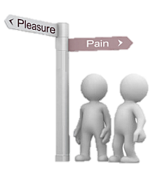
LuBAIR™ Inventory
Based in Impairment of Emotional Regulatory Circuits
Emotional Expressions
Approach to Care
Remember…
It’s NOT personal
They aren’t trying to be mean
They don’t want to suffer

