Slide 1
www.dementiabehaviors.com
Atul Sunny Luthra MD MSc FRCPC

Slide 2
Approach to Understanding the ‘Meaning’ of Behaviors in NCD: Beyond PIECES and GPA (Luthra’s Behavioral Assessment and Intervention Response Paradigm) LuBAIR™ Paradigm
Atul Sunny Luthra MD MSc FRCPC
Clinical Associate Professor
McMaster University
Research Scientist
Schlegel’s Research Institute in Aging

Slide 4
Meaning of Behaviors in NCD LuBAIR™ Paradigm
Diagnosis of BPSD or BE in NCD
Is One of
Exclusion
www.dementiabehaviors.com

Slide 5
Meaning of Behaviors in NCD LuBAIR™ Paradigm
To rule in BPSD or BE……..Need to Rule out:
Organic Mental Disorders
Mood, Anxiety and Psychotic Disorders
Physiological and Environmental Determinants
www.dementiabehaviors.com

Slide 6
Meaning of Behaviors in NCD LuBAIR™ Paradigm
If the presence of ‘behaviors’ can be accounted for by any of the above
then those ‘behaviors’ cannot be labelled BPSD or BE
www.dementiabehaviors.com

Slide 7
Meaning of Behaviors in NCD LuBAIR™ Paradigm
Diagnostic and Statistical Manual III to V
(American Psychiatric Association)
Adopted Cohen-Mansfield Constructs to define
BPSD or Behavioral Expressions (BE)

Slide 8
Meaning of Behaviors in NCD LuBAIR™ Paradigm
How do we Approach Assessment of BE
R/O Delirium, Mood, Anxiety and Psychotic D/O
Innate Physiological needs and Environmental Antecedents
Patient must be able to Engage in Valid and Reliable Clinical Examination
Obtain History
Mental State Examination
Necessary Physical Examination
Use DSM-V Criteria
Person Must have Preserved Memory (Intellectual Function)

Slide 9
Meaning of Behaviors in NCD LuBAIR™ Paradigm
Herein Lies the Challenge
Prevalence of BE highest in advanced NCD
MMSE less than 12
Reliability and Validity of Clinical Assessment
??? In Patient with MMSE of less than 12 ????

Slide 10
Meaning of Behaviors in NCD LuBAIR™ Paradigm
P.I.E.C.E.S for BE
P –Physical (Medical and Physiological)
E—Emotional (Mood, Anxiety and Psychotic Illnesses)
E---Environmental (Milieu)
S– Social (Inter-Personal) Revised S– Self (person carrying the disease)

Slide 11
Meaning of Behaviors in NCD LuBAIR™ Paradigm
Physical
Labs and Investigations
Confusion Assessment Methodology (CAM) – Delirium
Only valid in Non-Cognitively Impaired Individuals
No Established Validity in Advanced Dementia
Require Reliable and Valid Patient Engagement

Slide 12
Meaning of Behaviors in NCD LuBAIR™ Paradigm
Emotional
Cornell Depression Scale (Alexopoulas et.al. 1988)
“The Cornell scale is a quantitative measure of depression. Although, its
original scores correlate with the presence of depressive syndromes classified
by RDC, the Cornell scale is NOT designed for use as a diagnostic instrument”
Establish Severity, Once clinical diagnosis made
Requires reliable and Valid Patient Engagement

Slide 13
Meaning of Behaviors in NCD LuBAIR™ Paradigm
Emotional
Neuro-Psychiatric Inventory (Cummings et. Al., 1994 and 1997)
Used for Anxiety and Psychotic Disorders
“Inability to discriminate amongst different disorders”
“Validity and Reliability of sub-scales in advanced NCD, when clinical examination becomes increasingly unreliable, needs questioning”

Slide 14
Meaning of Behaviors in NCD LuBAIR™ Paradigm
Environmental and Social
ABC Analysis
A….. Antecedents
B ….. Behaviors
C ….. Consequences

Slide 15
Meaning of Behaviors in NCD LuBAIR™ Paradigm
Reliability and Validity of Clinical Assessment
??? In Patient with MMSE of less than 12 ????

Slide 16
Meaning of Behaviors in NCD LuBAIR™ Paradigm
Paradigm Shift from
‘Diagnostic Labelling’ of ‘Behavioral Expressions’ (Spezialle 2008)
To
‘Reason for their Presence’
‘Mode of Communication’

Slide 17
Meaning of Behaviors in NCD LuBAIR™ Paradigm
“What is being communicate through their Behaviors”
‘Understanding the Meaning’

Slide 18
Meaning of Behaviors in NCD LuBAIR™ Paradigm
Available Framework
P.I.E.C.E.S.™------------- Concept of ‘Self’
GPA™ --------------------- ‘Personhood’
‘State or Fact of being of an Individual or Having Individual Characteristics and Feelings’

Slide 19
Brain and Behavior
Body Circuits
Brain Circuits
Brain Functions
Notes:
Slide 5 from original PPT

Slide 20
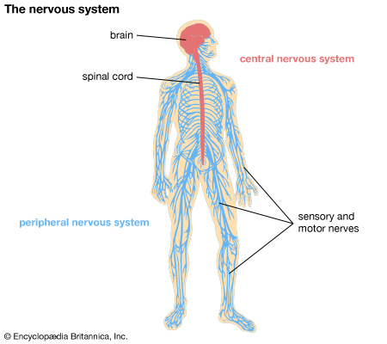
Body Circuits

Slide 21
Brain Circuits
Information Processing Circuits
Motivational Circuits
Emotional Regulatory Circuits
Self Monitoring and Regulatory Circuits

Slide 22
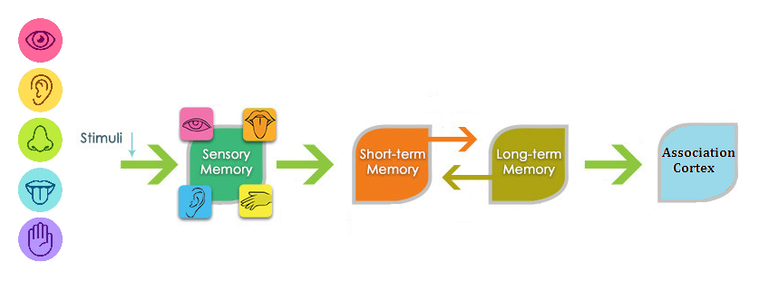
LuBAIR™ Inventory
Information Processing Circuits
Sensory and Motor Nerves
Visceral Nerves

Slide 23
Information Processing Circuits
Higher Cortical Intellectual Functions (HCIF)
Higher Cortical Intellectual Functions (HCIF)
Executive Functions
Visuospatial
Memory
Language Functions
Praxis
Gnosia
Insight/ Judgment
Notes:
Need up and down; not side by side.
DONE
This is slide 7 from original PPT

Slide 24
What is Dementia?
Information Processing Circuits
Motivational Circuits
Emotional Regulatory Circuits
Self Monitoring and Regulatory Circuits
IMPAIRMENT

Slide 25
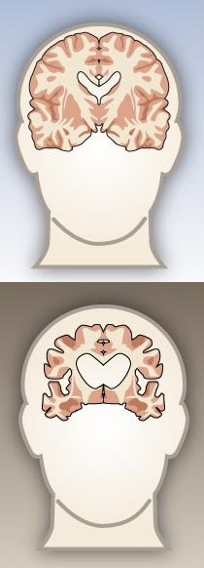
What is Dementia?
Etiology (Causes)
Protein Synthesis and Destruction
Amyloid
Syn-nucleotide
Tau
Tardau
Notes:
Break this into two or three slide; one for protein synthesis…. Vascular second. Misc third…
DONE
Need slide 8 here as slide 23 with the schematic of the lightening bolt in it.
DONE
Another slide 24 with MMSE and MOCA in it.
DONE
Break after this…….

Slide 26
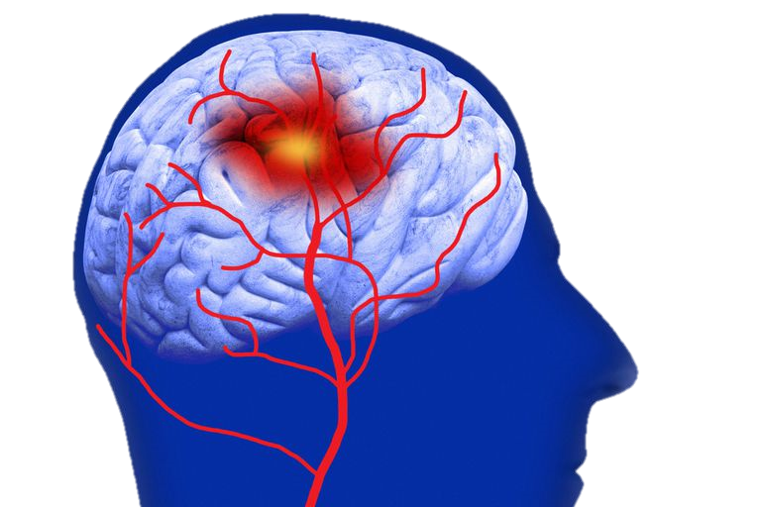
What is Dementia?
Etiology (Causes)
Vascular
Mini- and Big (Segmental) Strokes
Bleeds and Leaks
Oxygen Deprivation

Slide 27
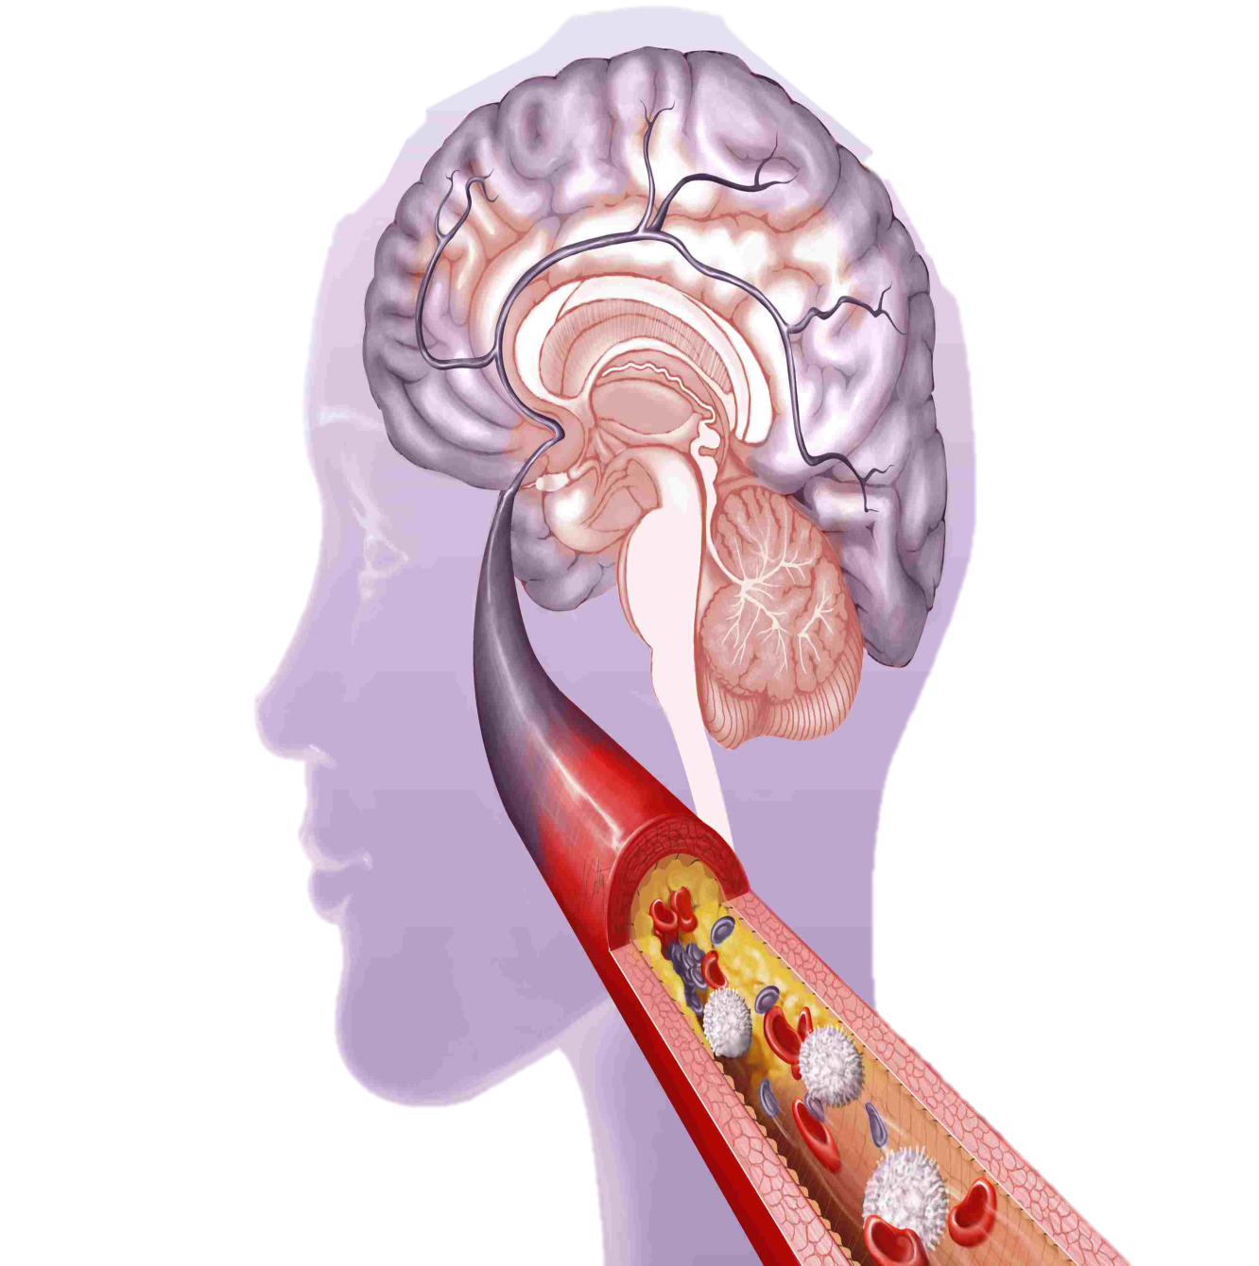
What is Dementia?
Etiology (Causes)
Miscellaneous
Trauma (HI)
Toxins (ETOH)
Deficiencies (B12)
Metabolic

Slide 28
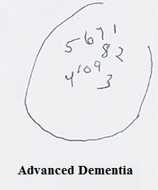
What is Dementia?
IMPAIRMENT
The Mini-Mental State Examination (MMSE)
Montreal Cognitive Assessment (MOCA)
CDT
Higher Cortical Intellectual Functions (HCIF)
Executive Functions
Visuospatial
Memory
Language Functions
Praxis
Gnosia
Insight/ Judgment

Slide 29
Brain Circuits
Information Processing Circuits
Motivational Circuits
Emotional Regulatory Circuits
Self Monitoring and Regulatory Circuits

Slide 30
Brain Functions
BRAIN FUNCTIONS
Higher Cortical Intellectual Functions (HCIF)
Thinking Functions
Emotional Functions
Behavioral Functions
Notes:
Slide 6 from original PPT

Slide 31
Motivational Circuits
Thinking Functions
Formation of Thoughts
Thoughts
Internal and External Environment
Higher Cortical Intellectual Functions
(HCIF)
Notes:
Up and down
DONE

Slide 32
LuBAIR™ Inventory
Motivational Circuits
Thinking Function
Preserved Motivational Circuits needed to:
Detect State of discrepancy between
Internal Physiological or Psychological state, and The external state of the Milieu, to
Identify a Need
Represented as Thoughts (Cognitions)

Slide 33
LuBAIR™ Inventory
Based in Impairment of Motivational Circuits
Goal Directed Expressions
‘Needs’ and ‘Motives’ Coexist
Needs Thoughts Goals
Release Satiation Motive

Slide 34
Emotional Regulatory Circuits
Emotional Functions
Generation and Regulation of Emotions
Emotions
Internal and External Environment
Motivational Circuits (Thoughts)
Higher Cortical Intellectual Functions
(HCIF)
Notes:
Up and down
DONE

Slide 35
LuBAIR™ Inventory
Origin in Limbic Circuits
Bi-Directional link b/w Limbic and Cortical circuits

Slide 36
LuBAIR™ Inventory
Emotional Regulatory Circuits
Emotional Functions
Generation of Emotions
and
Regulation of Emotions
Occurs Simultaneously

Slide 37
Self-Monitoring & Regulatory Circuits
Behavioral Functions
Regulation of Social Behaviors
(Regulation of) Behavioural Functions
Internal and External Environment
Thoughts
Emotions
Higher Cortical Intellectual Functions
(HCIF)

Slide 38
Functional Model of the Brain
Information Processing Circuits
Motivational Circuits
Emotional Regulatory Circuits
Self Monitoring and Regulatory Circuits
Higher Cortical Intellectual Functions
(HCIF)
Thinking Functions
Behavioral Functions
Emotional Functions
Notes:
Slide 6 comes after this slide.
Behaviours on this slide is ok

Slide 39
Understanding Brain and Behavior
Body Circuits
Brain Circuits
Brain Functions
Peripheral Nervous System
Information Processing Circuits
Motivational Circuits
Emotional Regulatory Circuits
Self-Monitoring & Regulatory Circuits
Central Nervous System
Higher Cortical Intellectual Functions (HCIF)
Thinking Functions
Emotional Functions
Behavioral Functions
Notes:
This slide does not belong here. Needs to go after slide 13.
DONE
we need slide 5, 6 and 7 from original presentation.
DONE

Slide 40
Sensorium
(gatekeeper)
Body Circuits
Brain Circuits
Brain Functions
Peripheral Nervous System
Information Processing Circuits
Motivational Circuits
Emotional Regulatory Circuits
Self-Monitoring & Regulatory Circuits
Central Nervous System
Higher Cortical Intellectual Functions (HCIF)
Thinking Functions
Emotional Functions
Behavioral Functions

Slide 41
Sensorium
Information Processing Circuits
Motivational Circuits
Emotional Regulatory Circuits
Self Monitoring and Regulatory Circuits
Higher Cortical Intellectual Functions
(HCIF)
Thinking Functions
Behavioral Functions
Emotional Functions

Slide 42
Arousal or Alertness
Sensorium
Attention
Notes:
Need a slide before this on introducing ‘sensorium’. it’s the ‘gate-keeper’ to flow of information.
SEE PREVIOUS SLIDE
NOTE: Does it make sense to tell listeners that the sensorium is the gatekeeper before they even know what it is?

Slide 43
Arousal or Alertness
Arousal or Alertness
State of wakefulness
Psychological and physiological domain
Purpose
Reaction to stimulus
Speed of information processing

Slide 44
Arousal or Alertness
Arousal or Alertness
State of wakefulness
Psychological and physiological domain
Purpose
Reaction to stimulus
Speed of information processing

Slide 45
Attention
Attention
Behavioral and cognitive processes involved in focusing on stimulus
Purpose
Determine which “chunk” of information will be processed

Slide 46
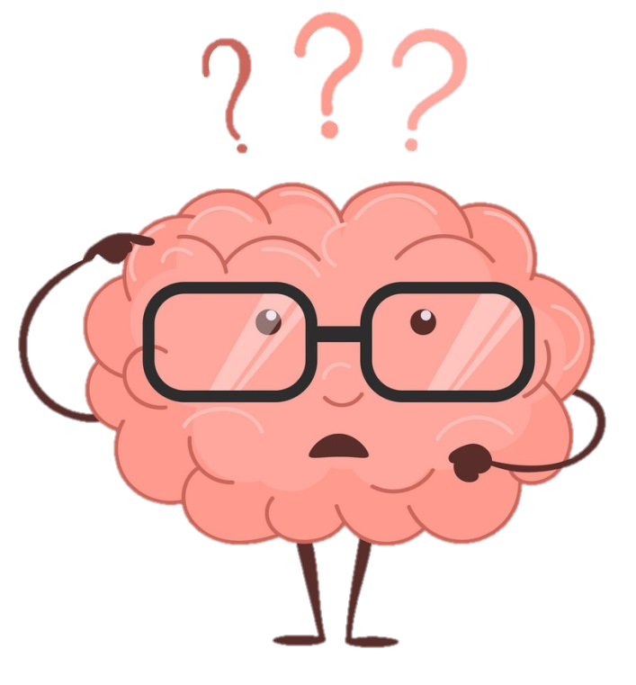
LuBAIR™ Inventory
Based in Impairment in Regulation of Sensorium
Disorganized Expressions
Impaired reaction time
Impaired processing speed
Impairment in which “chunk” of information is processed

Slide 47
LuBAIR™ Inventory
Based in Impairment in Regulation of Sensorium
Disorganized Expressions
Alertness or Arousal
Impaired reaction time and processing speed
Attentiveness
Impaired chunk of information
Information Processing Circuits
Task Performance

Slide 48
LuBAIR™ Paradigm
Functional Hierarchy of the Brain
S. Sensorium
i. Intellectual Functions
T. Thinking Functions
E. Emotional Functions
A. Actions or Behavioral Functions
{S.i.(T.e.a)T}
Pronounced S i T Model
Notes:
Copy of this slide needs to go as slide 5.
DONE
Should we consider changing
The ‘meaning’ caregivers attribute to expressions
To
How caregivers interpret expressions
Because the word ‘meaning’ under ‘purpose’ instead of ‘meaning’ is kind of confusing

Slide 49
LuBAIR™ Paradigm
Expressions have a ‘Purpose’…
How caregivers interpret expressions
Expressions have a ‘Meaning’…
What the PwNCD is ‘communicating’ to caregivers

Slide 50
Brain Circuits for Normal Brain Function
Regulation of Sensorium
Information Processing Circuits
Motivational Circuits
Emotional Regulatory Circuits
Self-Monitoring & Regulatory Circuits
Notes:
Need to remove this slide from here and move it down as slide 34.
DONE

Slide 51
Approach to Classification
Impairment in Regulation of Sensorium
Disorganized Expressions
Impairment in Information Processing Circuits
Misidentification Expressions
Sensorium
Information Processing Circuits

Slide 52
Approach to Classification
Impairment in Motivational Circuits
Goal Directed Expressions
Apathy Expressions
Motor Expressions
Importuning Expressions
Motivational Circuits

Slide 53
Approach to Classification
Impairment in Emotional Regulatory Circuits
Vocal Expressions
Emotional Expressions
Fretful/Trepidation Expressions
Emotional Regulatory Circuits

Slide 54
Approach to Classification
Impairment in Self-Monitoring & Regulatory Circuits
Oppositional Expressions
Physically Responsive Expressions
Sexual Expressions
Self Monitoring and Regulatory Circuits

Slide 55
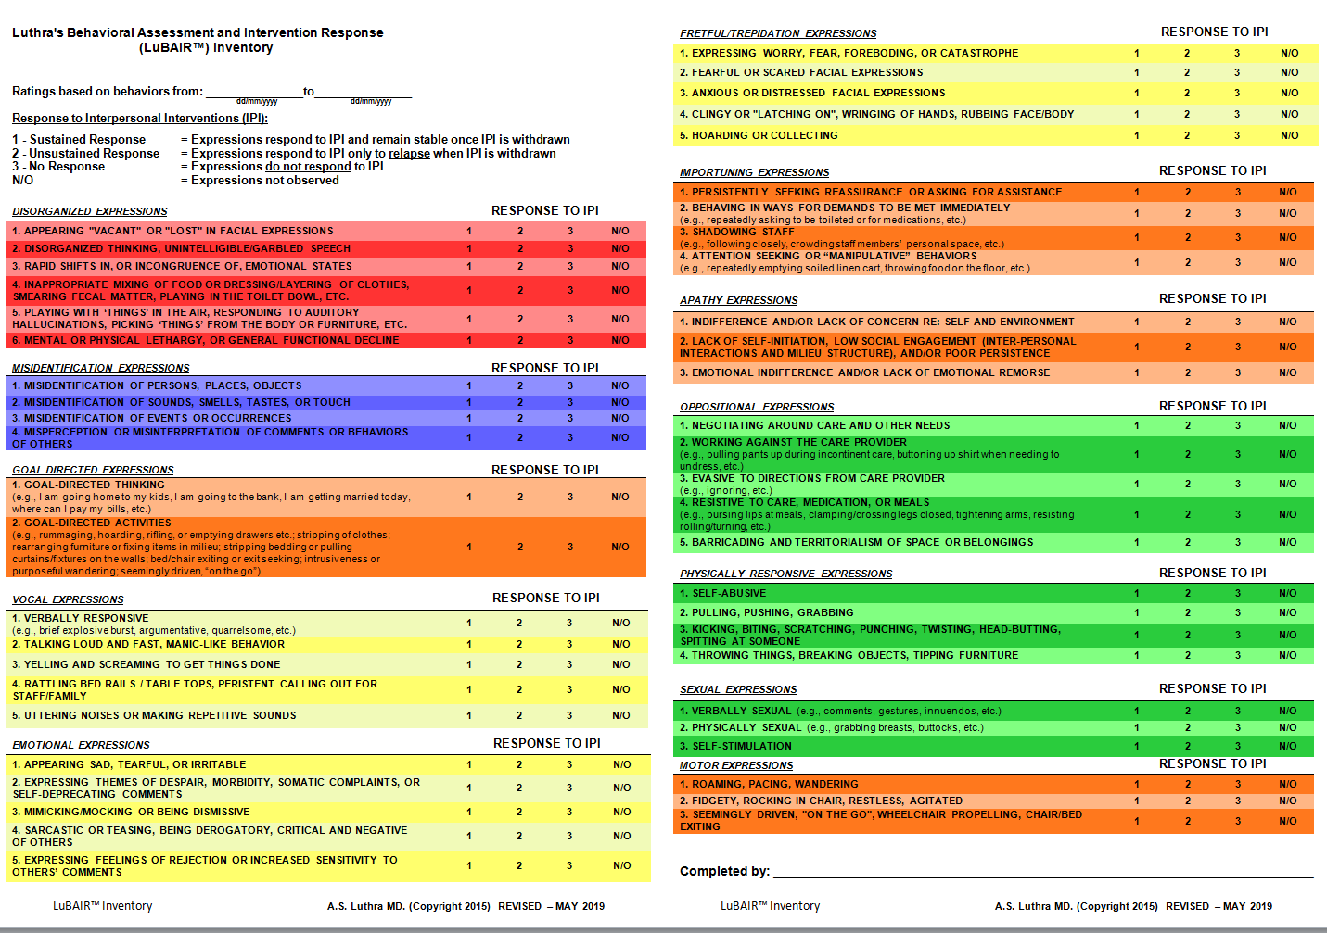
Luthra’s Behavioral Assessment and Intervention Response (LuBAIR™) Inventory

Slide 56
LuBAIR™ Inventory
Based in Impairment in Regulation of Sensorium
Disorganized Expressions
Sensorium

Slide 57
LuBAIR™ Inventory
Based in Impairment in Regulation of Sensorium
Disorganized Expressions
There is something different about Ms. Smith today.
Ms. Smith seems more confused as of late.

Slide 58
LuBAIR™ Inventory
Based in Impairment in Regulation of Sensorium
Disorganized Expressions
Purpose of Expressions
Increased “confusion” from baseline

Slide 59
LuBAIR™ Inventory
Based in Impairment in Regulation of Sensorium
Disorganized Expressions
Meaning of Expressions
“My body physiology has changed. Please help me find the cause.”

Slide 60
LuBAIR™ Inventory
Based in Impairment in Regulation of Sensorium
Disorganized Expressions
Baseline
Set up Raj for meals. Mix dressing in the salad. Use spoon to feed soup, able to use knife and fork to cut meat and feed self.
In the shower, Raj is handed the loofaa and is able to apply soap all over the body and step into the shower.
Today.
Putting soup in the salad, using hands to separate meat and knife/fork to cut the dessert.
Once handed the loofaa, he starts to eat it

Slide 61
LuBAIR™ Inventory
Based in Impairment of Information Processing Circuits
Misidentification Expressions
Information Processing Circuits

Slide 62
LuBAIR™ Inventory
Based in Impairment of Information Processing Circuits
Misidentification Expressions
Working Memory and Stored Memory
Pairing of New with Old
Inner World Order (Mental Images)

Slide 63
LuBAIR™ Inventory
Based in Impairment of Information Processing Circuits
Misidentification Expressions
Breakdown in pairing of ‘old’ and ‘new’ information
Information is of ‘great’ personal importance to PwD
‘Altered’ sense of relatedness between PwD and their environment

Slide 64
LuBAIR™ Inventory
Based in Impairment of Information Processing Circuits
Misidentification Expressions
Purpose of Expressions
An alternative approach to assess for psychosis

Slide 65
LuBAIR™ Inventory
Based in Impairment of Information Processing Circuits
Misidentification Expressions
Meaning of Expressions
“Please help me – my thinking and perception is NOT based in reality”

Slide 66
LuBAIR™ Inventory
Based in Impairment of Information Processing Circuits
Misidentification Expressions
Sounds
“Do you hear the water gushing, I am drowning”
“I am not leaving my bed”
Lost everything in house flooding a defining moment
Faulty Air vents with ribbons attached
2. MISIDENTIFICATION OF SOUNDS, SMELLS, TASTES, OR TOUCH

Slide 67
LuBAIR™ Inventory
Based in Impairment of Information Processing Circuits
Misidentification Expressions
‘I was almost raped by this man”
Male RN applying cream to the excoriated perineum
Survivor of childhood trauma

Slide 68
LuBAIR™ Inventory
Based in Impairment of Motivational Circuits
Goal Directed Expressions
Apathy Expressions
Motor Expressions
Importuning Expressions

Slide 69
LuBAIR™ Inventory
Based in Impairment of Motivational Circuits
Goal Directed Expressions
Motivational Circuits
Notes:
Do we need the top line since we have a schematic of impairment of Motivational Circuits? Put the diagram first and then Goal Directed Behaviors
If we make this change, this will mean that other slides are not the same. Also, I think explicitly connecting the expressions to the type of impairment is helpful and keeps the viewer consistently connecting the ideas

Slide 70
LuBAIR™ Inventory
Based in Impairment of Motivational Circuits
Goal Directed Expressions
1. GOAL DIRECTED THINKING (e.g., I am going home to my kids, I am going to the bank, I am getting married today, where can I pay my bills, etc.)
Leads to
2. GOAL DIRECTED ACTIVITIES (e.g., rummaging, hoarding, rifling, or emptying drawers etc.; stripping of clothes; rearranging furniture or fixing items in milieu; stripping bedding or pulling curtains/fixtures on the walls; bed/chair exiting or exit seeking; intrusiveness or purposeful wandering; seemingly driven, “on the go”)
Notes:
Very crowded. Do we need this slide?
I think this helps to contextualize the 2 points that fall under this category, and underscores that they are directly linked. Also, every other group of expressions are covered individually – if this slide is eliminated, then this will be the only one that doesn’t.

Slide 71
LuBAIR™ Inventory
Based in Impairment of Motivational Circuits
Goal Directed Expressions
Impairment in MC leads to High Motivational Drives
Heightened detection of discrepancy between self and milieu
Persistent and repetitive. Appears determined
High degree of ‘unrest’.
Staff playing ‘catch-up’

Slide 72
LuBAIR™ Inventory
Based in Impairment of Motivational Circuits
Goal Directed Expressions
Purpose of Expressions
Presence of “busy beaver” states

Slide 73
LuBAIR™ Inventory
Based in Impairment of Motivational Circuits
Goal Directed Expressions
Meaning of Expressions
“Please help me belong...”
(Family, Faith, Community Profession or Life’s Work, Ethnicity)

Slide 74
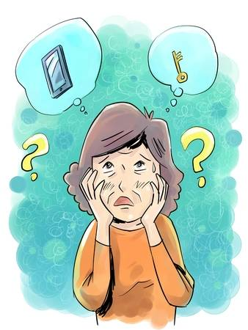
LuBAIR™ Inventory
Based in Impairment of Motivational Circuits
Goal Directed Expressions
(Belongingness to Work)
(Goal Directed) Thought
“I am late for work! Where are my keys?”
(Goal Directed) Action
Rummaging, rifling, emptying drawers, changing clothes, confrontational.

Slide 75
LuBAIR™ Inventory
Based in Impairment of Motivational Circuits
Apathy Expressions
Motivational Circuits
Notes:
Apathy Expressions go after GDB.
DONE

Slide 76
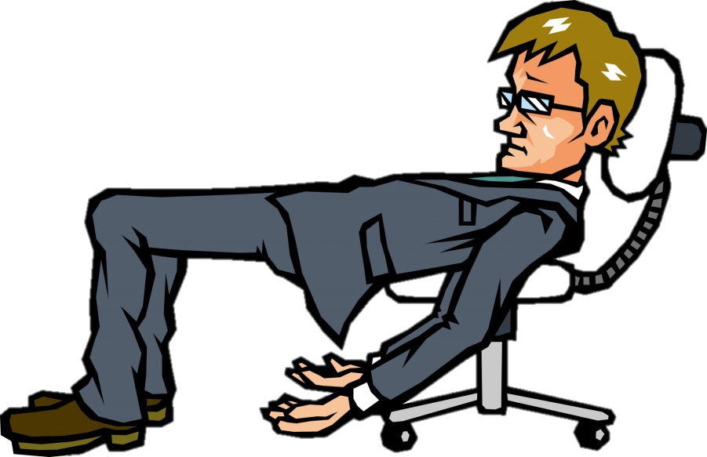
LuBAIR™ Inventory
Based in Impairment of Motivational Circuits
Apathy Expressions
Impairment in MC. Low or absent Motivational Drive
No detection of discrepancy between self and milieu
NO recognition of any Need
Lack of Insight of the same

Slide 77
LuBAIR™ Inventory
Based in Impairment of Motivational Circuits
Apathy Expressions
Purpose of Expressions
Presence of “lazy” states

Slide 78
LuBAIR™ Inventory
Based in Impairment of Motivational Circuits
Apathy Expressions
Meaning of Expressions
“Please help me – I do not recognize my deficits”

Slide 79
LuBAIR™ Inventory
Based in Impairment of Motivational Circuits
Apathy Expressions
After days and weeks of trying…..
Wife Response. Angry, frustrated, emotional and distraught in her expressions of ‘burn out’.
Individual’s Response. Presence of Emotional Indifference
No Insight Not showing ………… Concern
3. EMOTIONAL INDIFFERENCE AND/OR LACK OF EMOTIONAL REMORSE

Slide 80
LuBAIR™ Inventory
Based in Impairment of Motivational Circuits
Apathy Expressions
Conflict further escalates…….
Wife’s Response. At times, yelling and screaming, pushing and shoving. Reaching out to kids, neighbours
Individual Response. No Emotional Remorse (even a smirk)
No Insight Not showing ……… Remorse
3. EMOTIONAL INDIFFERENCE AND/OR LACK OF EMOTIONAL REMORSE

Slide 81
LuBAIR™ Inventory
Based in Impairment of Motivational Circuits
Importuning Expressions
Motivational Circuits
Notes:
Need to have Apathy Behaviors after GDB. Then Motor Behaviors and finally would be Importuning Behaviors.
DONE

Slide 82
LuBAIR™ Inventory
Based in Impairment of Motivational Circuits
Importuning Expressions
Preserved to Heightened Motivational Drive
Normal to Heightened detection of Need
Expressions of ‘Need ’ congruent with severity of dementia
(Overt/Obvious) (Occult/Hidden) (Ambiguous/Innocuous)

Slide 83
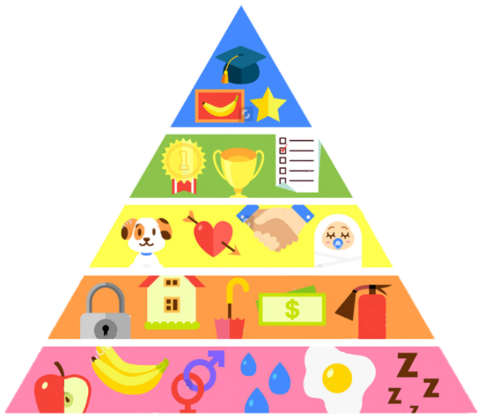
LuBAIR™ Inventory
Based in Impairment of Motivational Circuits
Importuning Expressions
Purpose of Expressions
Presence of unmet ‘basic’ needs

Slide 84
LuBAIR™ Inventory
Based in Impairment of Motivational Circuits
Importuning Expressions
Meaning of Expressions
“Please help me identify my specific innate physiological needs”
(hunger/thirst)
(voiding/defecating)
(fatigue/need to rest)
(pain/discomfort)
(mental/social stimulation)
Pleasure needs
(need for intimacy)
(sexual needs)
Notes:
ORIGINAL

Slide 85
LuBAIR™ Inventory
Based in Impairment of Motivational Circuits
Importuning Expressions
Advanced Dementia (Ambiguous/Innocuous)
Repeatedly lying down on the floor
Rummaging through garbage and bringing it to PSW
Repeatedly removing incontinent product, handing it to PSWs

Slide 86
LuBAIR™ Inventory
Based in Impairment of Motivational Circuits
Motor Expressions
Motivational Circuits

Slide 87
LuBAIR™ Inventory
Based in Impairment of Motivational Circuits
Motor Expressions
“Agitation”
Most Ubiquitous. Least Helpful

Slide 88
LuBAIR™ Inventory
Based in Impairment of Motivational Circuits
Motor Expressions
Governed by two factors:
Frequency of motor activity
Amplitude of motor activity
Both on a continuum of low to high
Contextual to Milieu its Happening In

Slide 89
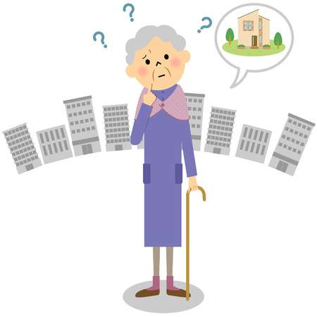
LuBAIR™ Inventory
Based in Impairment of Motivational Circuits
Motor Expressions
“Wandering” Behaviors
‘Purposeful’
‘Purposeless’

Slide 90
LuBAIR™ Inventory
Based in Impairment of Motivational Circuits
Motor Expressions
Does ‘Wandering’ Behavioral Expression appear
‘Purposeful’
or
‘Purposeless’
This is important information!
Please pass it on to the team!

Slide 91
LuBAIR™ Inventory
Based in Impairment of Motivational Circuits
Motor Expressions
Purpose of Expressions
Existence of an ‘unsettled state’

Slide 92
LuBAIR™ Inventory
Based in Impairment of Motivational Circuits
Motor Expressions
Meaning of Expressions
“Please help me – I don’t understand my reasons for being unsettled”

Slide 93
LuBAIR™ Inventory
Based in Impairment of Motivational Circuits
Motor Expressions
If it appears ‘Purposeful’
“I require fulfillment of belongingness needs”, or
“I require fulfillment of innate physiological needs”

Slide 94
LuBAIR™ Inventory
Based in Impairment of Motivational Circuits
Motor Expressions
If it appears ‘Purposeless’
“I may be afraid”, or
“I may be worrying or thinking too much”

Slide 95
BREAK
Notes:
Ideally, this break should occur at around 12 noon at the latest.
1 hour lunch

Slide 96
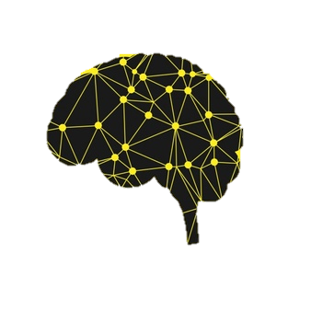
LuBAIR™ Inventory
Based in Impairment of Emotional Regulatory Circuits
Vocal Expressions
Emotional Expressions
Fretful/Trepidation Expressions

Slide 97
LuBAIR™ Inventory
Based in Impairment of Emotional Regulatory Circuits
Mood and Emotions
Two discrete Psychological Constructs
Specific definitions for both
Cannot be used interchangeably

Slide 98
LuBAIR™ Inventory
Based in Impairment of Emotional Regulatory Circuits
Emotions
Arise in context of a specific situation (Extrinsic or Intrinsic)
Experienced as “whole body phenomenon”
Has “control precedence” (Interrupts our consciousness)
Capacity to modifying / changing contextual situation
Parkinson et al. (1996)

Slide 99
LuBAIR™ Inventory
Based in Impairment of Emotional Regulatory Circuits
Mood
Persistent, long lasting and chronic
Diffuse, tied to cognitions rather than ‘Situations’
Lack “control precedence”
Lack capacity to modifying / change context
Clore, Schwarz and Conway (1994)

Slide 100
LuBAIR™ Inventory
Based in Impairment of Emotional Regulatory Circuits
Emotions and Mood
Persistence of the an emotion for a specified duration is ‘mood’
Requires subjective recall
Preserved Cognitive abilities

Slide 101
LuBAIR™ Inventory
Based in Impairment of Emotional Regulatory Circuits
Emotions and Mood
STM is severely impaired in Advanced NCD (>12)
Reliability of Recall of ‘mood and related symptoms’ questionable
Validity and reliability of diagnosis of ‘depression’ needs to be challenged in Advanced NCD

Slide 102
LuBAIR™ Inventory
Based in Impairment of Emotional Regulatory Circuits
Emotions in Advanced NCD
Emotional Comprehension preserved
Emotional Expressivity is decreased (Joy and Pleasure)
Emotional Expressivity Heightened
(Melancholy, Fear, Discontentment and Anger)
Need to work with Emotions, Not Mood

Slide 103
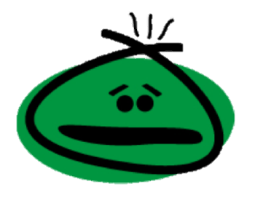
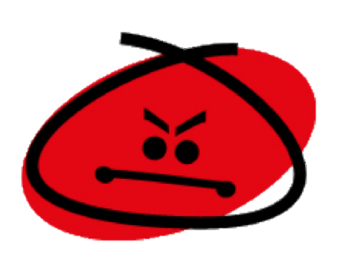
LuBAIR™ Inventory
Based in Impairment of Emotional Regulatory Circuits
Five Primary Emotions:
Joy or Happiness
Discontentment
Fear
Anger
Sadness or Melancholy
Notes:
Need a slide of sigmoid curve; discontentment at the bottom and anger at the top. Need another slide of bell curve; joy at the left end and discontentment / anger at the right end. Another slide of two intersecting circles; one has melancholy an the other is discontentment
DONE

Slide 104
LuBAIR™ Inventory
Based in Impairment of Emotional Regulatory Circuits
Vocal Expressions
Generation of Emotions
and
Regulation of Emotions
Impaired

Slide 105
LuBAIR™ Inventory
Based in Impairment of Emotional Regulatory Circuits
Vocal Expressions
The responses are:
Increased in amplitude
Prolonged in duration
Slow to extinguish
‘Out-of-proportion’

Slide 106
Emotional Regulatory Circuits
LuBAIR™ Inventory
Based in Impairment of Emotional Regulatory Circuits
Vocal Expressions

Slide 107
LuBAIR™ Inventory
Based in Impairment of Emotional Regulatory Circuits
Vocal Expressions
Represents two primary emotions:
Anger
&
Joy
Notes:
Need one slide after this which shows the relationship between joy and anger. Also a slide of relationship between discontentment and anger and melancholy and discontentment

Slide 108
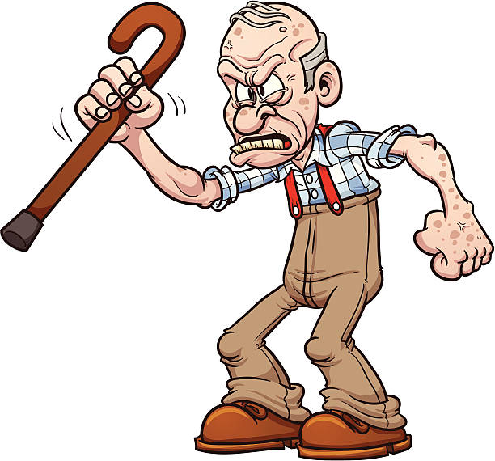
LuBAIR™ Inventory
Based in Impairment of Emotional Regulatory Circuits
Vocal Expressions
1. VERBALLY RESPONSIVE (e.g., brief explosive burst, argumentative, quarrelsome, etc.)

Slide 109
LuBAIR™ Inventory
Based in Impairment of Emotional Regulatory Circuits
Vocal Expressions
Continuum of Emotion of Anger
Brief Explosive Outbursts

Slide 110
LuBAIR™ Inventory
Based in Impairment of Emotional Regulatory Circuits
Vocal Expressions
Continuum of Emotion of Anger
Argumentative or Quarrelsome

Slide 111
LuBAIR™ Inventory
Based in Impairment of Emotional Regulatory Circuits
Vocal Expressions
Continuum of Emotion of Anger
Dysphoric Syndrome
Emotional symptoms (Irritable, Angry, Mood Swings)
Cognitive Symptoms (Projecting blame and distrust)
Behavioral Symptoms (Intense, loud, Agitated, distracted)

Slide 112
LuBAIR™ Inventory
Based in Impairment of Emotional Regulatory Circuits
Vocal Expressions
Continuum of Emotion of Anger
Destructive Syndromes
Shredding Briefs, Towels, Pillows
Picking or Scratching skin, Pulling hair, Biting cuticles/nails

Slide 113
LuBAIR™ Inventory
Based in Impairment of Emotional Regulatory Circuits
Vocal Expressions
Continuum of Emotion of Anger
Primal Scream
Blood curdling, repetitive noise making

Slide 114
LuBAIR™ Inventory
Based in Impairment of Emotional Regulatory Circuits
Vocal Expressions
5. UTTERING NOISES OR MAKING REPETITIVE SOUNDS
Notes:
AUDIO
Click the image ONCE to play it (a second click will stop it)

Slide 115
LuBAIR™ Inventory
Based in Impairment of Emotional Regulatory Circuits
Vocal Expressions
Continuum of Emotion of Joy
Effusive ………….> Elated …………..> Euphoric

Slide 116
LuBAIR™ Inventory
Based in Impairment of Emotional Regulatory Circuits
Vocal Expressions
2. TALKING LOUD AND FAST, MANIC-LIKE BEHAVIOR
Full video found at https://www.youtube.com/watch?v=ExKCcndqK5c
Notes:
VIDEO
Click the video ONCE to play it (a second click will stop it)

Slide 117
LuBAIR™ Inventory
Based in Impairment of Emotional Regulatory Circuits
Vocal Expressions

Slide 118
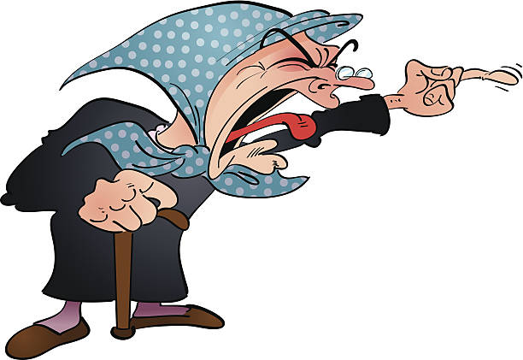
LuBAIR™ Inventory
Based in Impairment of Emotional Regulatory Circuits
Vocal Expressions
3. YELLING AND SCREAMING TO GET THINGS DONE

Slide 119
LuBAIR™ Inventory
Based in Impairment of Emotional Regulatory Circuits
Vocal Expressions
4. RATTLING BED RAILS/TABLE TOPS, PERISTENT CALLING OUT FOR STAFF/FAMILY

Slide 120
LuBAIR™ Inventory
Based in Impairment of Emotional Regulatory Circuits
Vocal Expressions
Purpose of Expressions
Unintended ‘Out-of-proportion’ emotional responses

Slide 121
LuBAIR™ Inventory
Based in Impairment of Emotional Regulatory Circuits
Vocal Expressions
Meaning of Expressions (Based in Anger)
“Please appreciate…….I am in a defensive mode”
“I’m warning you to stop/back off”
(Brief Explosive Outbursts)
“Please appreciate…..I am in aggressive mode”
Quarrelsome…..Dysphoric….Destructive
Notes:
Need two slides. One for emotions of anger and the other for joy. Next slide. Meaning of behaviors based in joy “Please help me control my emotions”
DONE
NOTE: This is not a well-known idiom and may be especially confusing for non-native English speakers.
Old version said

Slide 122
LuBAIR™ Inventory
Based in Impairment of Emotional Regulatory Circuits
Vocal Expressions
Meaning of Expressions (Based in Joy)
“Please help me to control my emotions”

Slide 123
Emotional Regulatory Circuits
LuBAIR™ Inventory
Based in Impairment of Emotional Regulatory Circuits
Emotional Expressions

Slide 124
LuBAIR™ Inventory
Based in Impairment of Emotional Regulatory Circuits
Emotional Expressions
Represents two primary emotions:
Melancholy &
Discontentment

Slide 125
LuBAIR™ Inventory
Based in Impairment of Emotional Regulatory Circuits
Emotional Expressions
Melancholy Discontentment
1. APPEARING SAD, TEARFUL, OR IRRITABLE

Slide 126
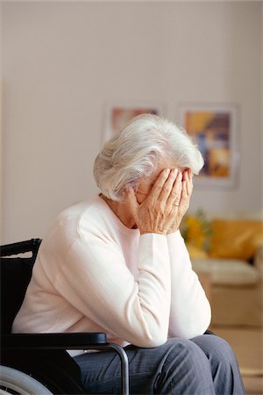
LuBAIR™ Inventory
Based in Impairment of Emotional Regulatory Circuits
Emotional Expressions
Melancholy
2. EXPRESSING THEMES OF DESPAIR, MORBIDITY, SOMATIC COMPLAINTS, OR SELF-DEPRICATING COMMENTS

Slide 127
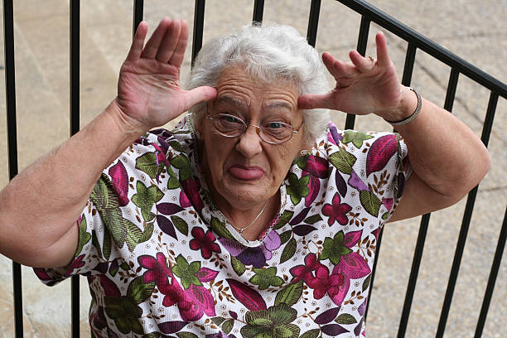
LuBAIR™ Inventory
Based in Impairment of Emotional Regulatory Circuits
Emotional Expressions
Discontentment
3. MIMICKING/MOCKING OR BEING DISMISSIVE

Slide 128
LuBAIR™ Inventory
Based in Impairment of Emotional Regulatory Circuits
Emotional Expressions
Discontentment
4. SARCASTIC OR TEASING, BEING DEROGATORY, CRITICAL AND NEGATIVE OF OTHERS

Slide 129
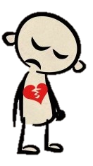
LuBAIR™ Inventory
Based in Impairment of Emotional Regulatory Circuits
Emotional Expressions
Melancholy
5. EXPRESSING FEELINGS OF REJECTION OR INCREASED SENSITIVITY TO OTHERS’ COMMENTS

Slide 130
LuBAIR™ Inventory
Based in Impairment of Emotional Regulatory Circuits
Emotional Expressions
Humans are innately averse to pain; emotional or physical
Protection from pain becomes primary defense mechanism
Does not change regardless of stage of dementia
Likely heightened in Advanced NCD

Slide 131
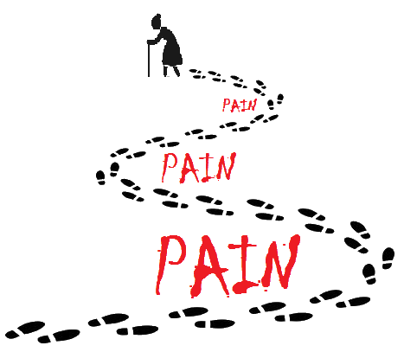
LuBAIR™ Inventory
Based in Impairment of Emotional Regulatory Circuits
Emotional Expressions
Two approaches to dealing with pain:
Coping with pain
&
Avoidance of pain

Slide 132
LuBAIR™ Inventory
Based in Impairment of Emotional Regulatory Circuits
Emotional Expressions
Coping with Pain (Melancholy)
‘Catharsis’ of pain - crying and talking
Measured ‘decompression’
Observer’s perspective: suffering
Individual’s perspective: relief from suffering

Slide 133
LuBAIR™ Inventory
Based in Impairment of Emotional Regulatory Circuits
Emotional Expressions
Avoidance of Pain (Discontentment)
“I feel good by putting you down” (verbal)
Pro-active shut down of communication
(non-verbal)
Creates barriers or distance with others
Protect exposure to ‘hurt’
Prevent experiencing of ‘pain’

Slide 134
LuBAIR™ Inventory
Based in Impairment of Emotional Regulatory Circuits
Emotional Expressions
Purpose of Expressions (Melancholy)
State of ‘measured decompression’
……….‘coping’ with pain
Notes:
Two slides. Purpose of Measure for Meloncholy. Awareness of ‘coping’ with pain. Purpose of measure for discontentment. Awareness of ‘avoidance’ of pain

Slide 135
LuBAIR™ Inventory
Based in Impairment of Emotional Regulatory Circuits
Emotional Expressions
Meaning of Expressions (Melancholy)
“Please help me in my catharsis”
Notes:
Two slides. Meaning of the Expression based in melancholy. I am not surffering (this does not make sense to me – they *are* suffering otherwise why would they be sad? They are trying not to suffer – “I’m trying to relieve my suffering” makes a lot more sense); please help me in releasing my emotions. Meaning of the Expression based in discontentment. Please don’t take me for a ‘jerk’; I am simply trying to protect myself from ‘pain’.

Slide 136
LuBAIR™ Inventory
Based in Impairment of Emotional Regulatory Circuits
Emotional Expressions
Purpose of Expressions (Discontentment)
Attempts to create barriers ……. ‘avoidance’ of pain
Notes:
Two slides. Purpose of Measure for Meloncholy. Awareness of ‘coping’ with pain. Purpose of measure for discontentment. Awareness of ‘avoidance’ of pain

Slide 137
LuBAIR™ Inventory
Based in Impairment of Emotional Regulatory Circuits
Emotional Expressions
Meaning of Expressions (Discontentment)
“Please don’t take me for a ‘jerk’ – I am simply trying to protect myself from pain”
Notes:
Two slides. Meaning of the Expression based in melancholy. I am not surffering; please help me in releasing my emotions. Meaning of the Expression based in discontentment. Please don’t take me for a ‘jerk’; I am simply trying to protect myself from ‘pain’.

Slide 138
Emotional Regulatory Circuits
LuBAIR™ Inventory
Based in Impairment of Emotional Regulatory Circuits
Fretful/Trepidation Expressions

Slide 139
LuBAIR™ Inventory
Based in Impairment of Emotional Regulatory Circuits
Fretful/Trepidation Expressions
Represents the primary emotion of:
FEAR

Slide 140
LuBAIR™ Inventory
Based in Impairment of Emotional Regulatory Circuits
Fretful/Trepidation Expressions
Attachment
Bowlby and Ainsworth
Bonding between mom and infant
Valid for all ‘attachments’ throughout life (marital, family, work)
Remains valid through all stages of dementia
Notes:
Remains valid through all stages of dementia; early, middle and late. Next slide. Different types of attachments with four bullets.
Different types (secure, anxious, avoidant disorganized)

Slide 141
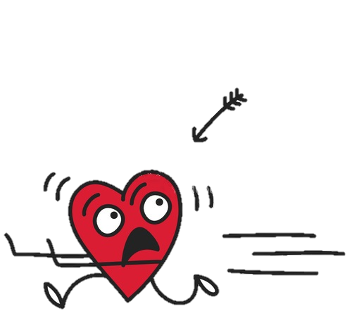
LuBAIR™ Inventory
Based in Impairment of Emotional Regulatory Circuits
Fretful/Trepidation Expressions
Attachment (Bowlby and Ainsworth):
Different types of attachments:
Secure
Anxious
Avoidant
Disorganized
Notes:
Remains valid through all stages of dementia; early, middle and late. Next slide. Different types of attachments with four bullets.
Different types (secure, anxious, avoidant disorganized)

Slide 142
LuBAIR™ Inventory
Based in Impairment of Emotional Regulatory Circuits
Fretful/Trepidation Expressions
Attachment
Stored as ‘mental images’
Create ‘Inner World Model’ (hard drive)
Pair ‘New Milieu’ ……..‘Stored attachments’
Determines response
Notes:
Not sure if we need this slide.

Slide 143
LuBAIR™ Inventory
Based in Impairment of Emotional Regulatory Circuits
Fretful/Trepidation Expressions
Advanced Dementia
Complete loss of recognition of own environment
No familiarity of new environment
Preserved early childhood memories (Birth to 8)
Turn inwards for ‘Safe’ place
Notes:
Need to change the slide. Moderate to Advanced Dementia. Complete loss of recognition of ‘own’ environment. No familiarity of new environment. Still have recognition of earlier childhood memories. Between ages of 2 to 8). Parent or sibling fixations.
CHANGED SLIDE

Slide 144
LuBAIR™ Inventory
Based in Impairment of Emotional Regulatory Circuits
Fretful/Trepidation Expressions
Advanced Dementia
If pairing with…….
‘Secure’ mental images’ ……..no symptoms
‘Anxious’, Avoidant or Disorganized’ mental images
…………Fretful/Trepidation Expressions
Parent or sibling fixation
Notes:
Not sure if we need to keep this slide.

Slide 145
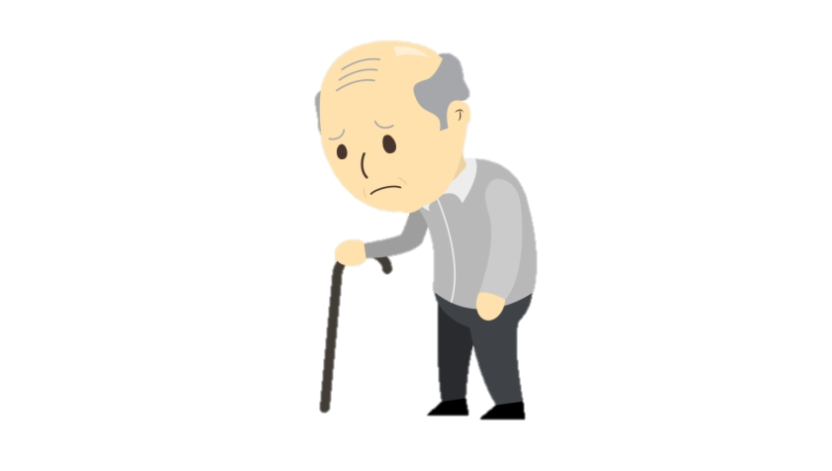
LuBAIR™ Inventory
Based in Impairment of Emotional Regulatory Circuits
Fretful/Trepidation Expressions
1. EXPRESSING WORRY, FEAR, FOREBODING, OR CATASTROPHE

Slide 146
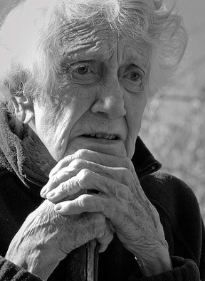
LuBAIR™ Inventory
Based in Impairment of Emotional Regulatory Circuits
Fretful/Trepidation Expressions
2. FEARFUL OR SCARED FACIAL EXPRESSIONS

Slide 147
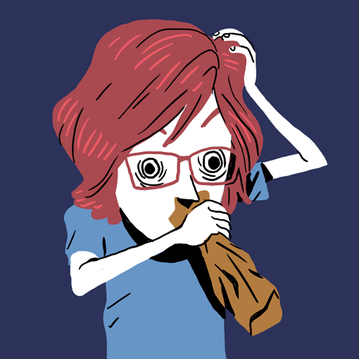
LuBAIR™ Inventory
Based in Impairment of Emotional Regulatory Circuits
Fretful/Trepidation Expressions
3. ANXIOUS OR DISTRESSED FACIAL EXPRESSIONS

Slide 148
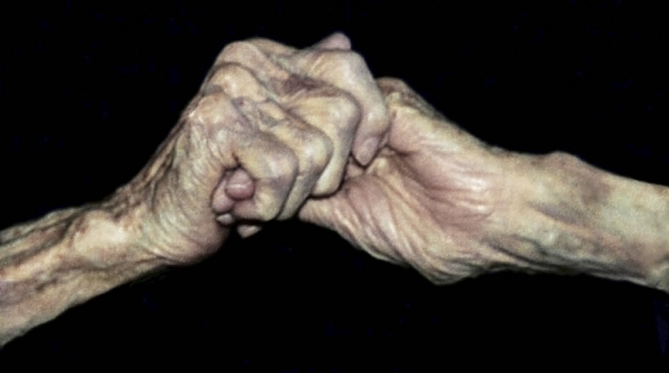
LuBAIR™ Inventory
Based in Impairment of Emotional Regulatory Circuits
Fretful/Trepidation Expressions
4. CLINGY OR "LATCHING ON", WRINGING OF HANDS, RUBBING FACE/BODY

Slide 149
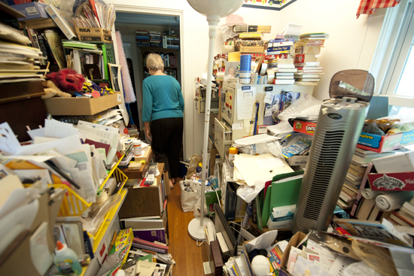
LuBAIR™ Inventory
Based in Impairment of Emotional Regulatory Circuits
Fretful/Trepidation Expressions
5. HOARDING OR COLLECTING

Slide 150
LuBAIR™ Inventory
Based in Impairment of Emotional Regulatory Circuits
Fretful/Trepidation Expressions
Purpose of Expressions
Presence of unmet ‘security’ needs

Slide 151
LuBAIR™ Inventory
Based in Impairment of Emotional Regulatory Circuits
Fretful/Trepidation Expressions
Meaning of Expressions
“Please help me feel ‘safe’
Notes:
Please help me feel ‘safe’ and ‘secure’

Slide 152
BREAK
Notes:
Ideally, this break should occur at around 2:30 at the latest.
10-15 mins break

Slide 153
LuBAIR™ Inventory
Based in Impairment of Self-Regulatory Circuits
Oppositional Expressions
Physically Responsive Expressions
Sexual Expressions

Slide 154
Self Monitoring and Regulatory Circuits
LuBAIR™ Inventory
Based in Impairment of Self-Regulatory Circuits
Oppositional Expressions

Slide 155
LuBAIR™ Inventory
Based in Impairment of Self-Regulatory Circuits
Oppositional Expressions
Basis in Developmental Psychology
Basis in parent–child interactions
Verbal and non-verbal expressions of “no” are expressions of:
Emergence of self-identity
Self-regulation
Independence

Slide 156
LuBAIR™ Inventory
Based in Impairment of Self-Regulatory Circuits
Oppositional Expressions
Role-reversal in PwD
Governed by developmental sophistication and severity of cognitive impairment
Notes:
This slide is unclear to me

Slide 157
LuBAIR™ Inventory
Based in Impairment of Self-Regulatory Circuits
Oppositional Expressions
Compliance:
Follow instruction in designated time
Non-Compliance:
Refusal to initiate or complete instructions in ‘designated time’
Basis of Oppositional Expressions

Slide 158
LuBAIR™ Inventory
Based in Impairment of Self-Regulatory Circuits
Oppositional Expressions
1. NEGOTIATING AROUND CARE AND OTHER NEEDS
It’s time to take your medicine.
I don’t need to take all that! Just give me the red ones.
You need to take all of it.
Fine – I’ll take it if you let me leave!

Slide 159
2. WORKING AGAINST THE CARE PROVIDER Simple Non-Compliance (e.g., pulling pants up during incontinent care, buttoning up shirt when needing to undress, etc.)
Full video found at https://www.youtube.com/watch?v=hahvUXwTXE4
Notes:
VIDEO
Click the video ONCE to play it (a second click will stop it)

Slide 160
LuBAIR™ Inventory
Based in Impairment of Self-Regulatory Circuits
Oppositional Expressions
3. EVASIVE TO DIRECTIONS FROM CARE PROVIDER (e.g., ignoring, etc.) Passive non-compliance

Slide 161
LuBAIR™ Inventory
Based in Impairment of Self-Regulatory Circuits
Oppositional Expressions
4. RESISTIVE TO CARE, MEDICATION, OR MEALS Direct Defiance (e.g., pursing lips at meals, clamping/crossing legs closed, tightening arms, resisting rolling/turning, etc.)
Full video found at https://www.youtube.com/watch?v=sl3Dc1kERto
Notes:
VIDEO
Click the video ONCE to play it (a second click will stop it)

Slide 162
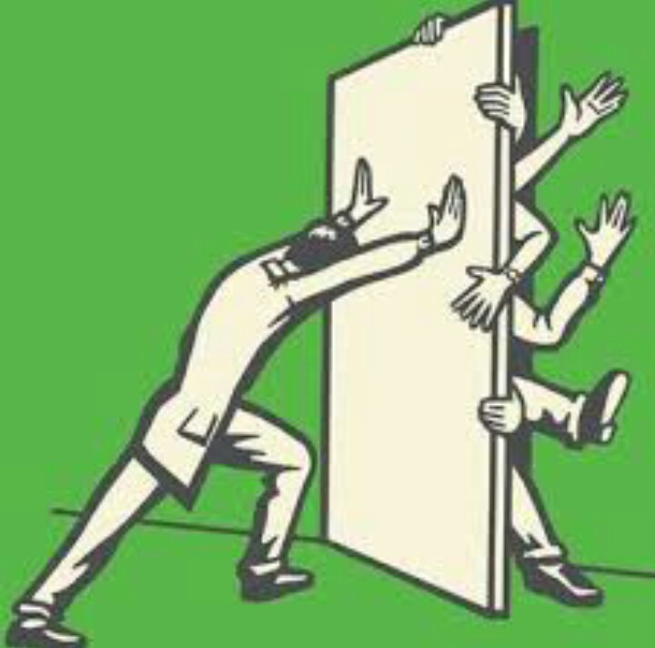
LuBAIR™ Inventory
Based in Impairment of Self-Regulatory Circuits
Oppositional Expressions
5. BARRICADING AND TERRITORIALISM OF SPACE OR BELONGINGS Direct Defiance

Slide 163
LuBAIR™ Inventory
Based in Impairment of Self-Regulatory Circuits
Oppositional Expressions
Purpose of Expression
Attempts to preserve dignity, autonomy, and self-regulation
Notes:
Preserved sense of ‘autonomy’ and ‘self-regulation’
NOTE:
If this is how the caregiver is interpreting the expression, doesn’t the current phrasing make more sense?

Slide 164
LuBAIR™ Inventory
Based in Impairment of Self-Regulatory Circuits
Oppositional Expressions
Meaning of Expression
“Please help support my independence”
Notes:
Please help me support my ‘independence’

Slide 165
Self Monitoring and Regulatory Circuits
LuBAIR™ Inventory
Based in Impairment of Self-Regulatory Circuits
Physically Expressions

Slide 166
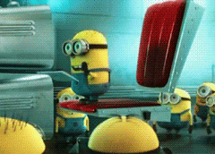
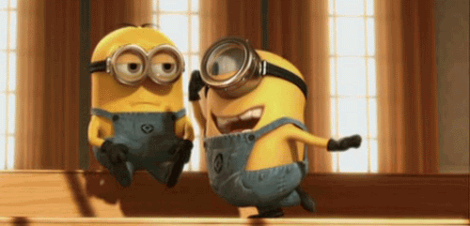
LuBAIR™ Inventory
Based in Impairment of Self-Regulatory Circuits
Physically Expressions
Classification
Instrumental Aggression
Hostile Aggression

Slide 167
LuBAIR™ Inventory
Based in Impairment of Self-Regulatory Circuits
Physically Expressions
Instrumental Aggression:
Reward-Consequence Paradigm
Individuals appreciate the difference between “right” and “wrong”
Preserved self-regulatory circuits
Criminal behavior

Slide 168
LuBAIR™ Inventory
Based in Impairment of Self-Regulatory Circuits
Physically Expressions
Hostile Aggression:
Frustration-Aggression Paradigm
Relationship between “frustration and aggression”
Perceived impediment in goal-attainment and ‘negative’ emotions
Impaired self-regulatory circuits

Slide 169
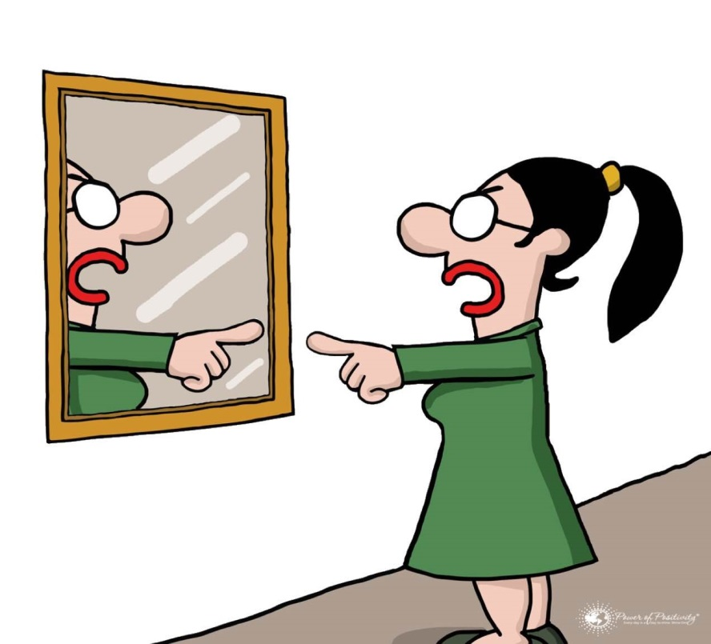
LuBAIR™ Inventory
Based in Impairment of Self-Regulatory Circuits
Physically Responsive Expressions
1. SELF-ABUSIVE

Slide 170
LuBAIR™ Inventory
Based in Impairment of Self-Regulatory Circuits
Physically Responsive Expressions
2. PULLING, PUSHING, GRABBING

Slide 171
LuBAIR™ Inventory
Based in Impairment of Self-Regulatory Circuits
Physically Responsive Expressions
3. KICKING, BITING, SCRATCHING, PUNCHING, TWISTING, HEAD BUTTING, SPITTING AT SOMEONE

Slide 172
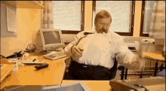
LuBAIR™ Inventory
Based in Impairment of Self-Regulatory Circuits
Physically Responsive Expressions
4. THROWING THINGS, BREAKING OBJECTS, TIPPING FURNITURE

Slide 173
LuBAIR™ Inventory
Based in Impairment of Self-Regulatory Circuits
Physically Responsive Expressions
Purpose of Expression
‘Goal attainment’ is being impeded
Notes:
THIS WHOLE SECTION NEEDS TO BE REVIEWED

Slide 174
LuBAIR™ Inventory
Based in Impairment of Self-Regulatory Circuits
Physically Responsive Expressions
Meaning of Expressions
“Please help me identify the need being impeded”

Slide 175
LuBAIR™ Inventory
Based in Impairment of Self-Regulatory Circuits
Physically Responsive Expressions
Meaning of Expressions
Which ‘need’ is being impeded?
Innate physiological needs
Security needs
Belongingness needs

Slide 176
LuBAIR™ Inventory
Based in Impairment of Self-Regulatory Circuits
Physically Responsive Expressions
Meaning of Expressions
Which ‘need’ is being impeded?
Need to avoid or cope with pain
Lack of recognition of a need

Slide 177
LuBAIR™ Inventory
Based in Impairment of Self-Regulatory Circuits
Physically Responsive Expressions
Approach to Care
Identify and understand the behavioral expressions
Determine the ‘impeded need’ which is triggering the expressions
Care Plan accordingly
Notes:
101

Slide 178
Self Monitoring and Regulatory Circuits
LuBAIR™ Inventory
Based in Impairment of Self-Regulatory Circuits
Sexual Expressions

Slide 179
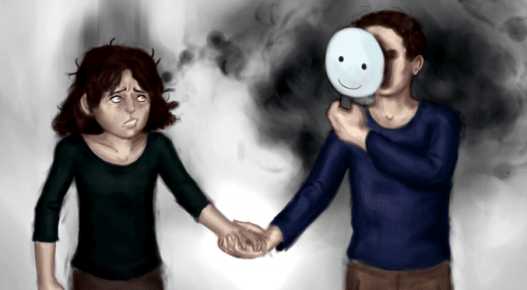
LuBAIR™ Inventory
Based in Impairment of Self-Regulatory Circuits
Sexual Expressions
The basis of these expressions can be multi-faceted:
Over-identification of Facial Visual Stimulus (Misidentification expressions)

Slide 180
LuBAIR™ Inventory
Based in Impairment of Self-Regulatory Circuits
Sexual Expressions
The basis of these expressions can be multi-faceted:
Increased drive to satiate innate physiological needs of sexuality
(goal-directed expressions)
Preserved drive for innate need for intimacy
(importuning expressions)

Slide 181
LuBAIR™ Inventory
Based in Impairment of Self-Regulatory Circuits
Sexual Expressions
The basis of these expressions can be multi-faceted:
Based in emotions of discontentment (misogynistic)
Based in satiating security needs

Slide 182
LuBAIR™ Inventory
Based in Impairment of Self-Regulatory Circuits
Sexual Expressions
The basis of these expressions can be multi-faceted:
Staff’s interpretation

Slide 183
LuBAIR™ Inventory
Based in Impairment of Self-Regulatory Circuits
Sexual Expressions
1. VERBALLY SEXUAL (e.g., comments, gestures, innuendos, etc.)

Slide 184
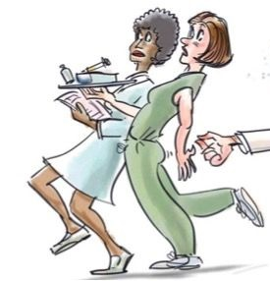
LuBAIR™ Inventory
Based in Impairment of Self-Regulatory Circuits
Sexual Expressions
2. PHYSICALLY SEXUAL (e.g., grabbing breasts, buttocks, etc.)

Slide 185
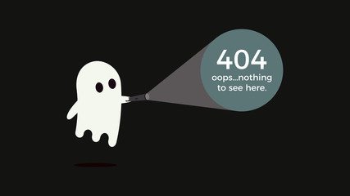
LuBAIR™ Inventory
Based in Impairment of Self-Regulatory Circuits
Sexual Expressions
3. SELF STIMULATION

Slide 186
LuBAIR™ Inventory
Based in Impairment of Self-Regulatory Circuits
Sexual Expressions
Purpose of Expressions
Don’t rush to ‘judge’ and ‘label’
Notes:
It used to say “Do not judge”
But this doesn’t make sense as the “caregiver’s interpretation of the expressions”

Slide 187
LuBAIR™ Inventory
Based in Impairment of Self-Regulatory Circuits
Sexual Expressions
Meaning of Expressions
“Please make an effort to understand my reasons”
Notes:
This is my meaning. The original said:
Based in Impairment in IPC
Over-Identification of Facial Visual Stimulus
Attribution Error
Based in Impairment in MC
Increased Drive to Satiation of IPN
Preserved Drives to INI
Based in Impairment of ERC
Emotions of Discontentment (Misogyny)
Emotions of Fear (Secure Base)

Slide 188
LuBAIR™ Inventory
Based in Impairment of Self-Regulatory Circuits
Sexual Expressions
Approach to Care
De-stigmatize
Educate staff and family
Determine the basis for expressions
Care Plan accordingly
Notes:
Original said
Individualized care plan tailored to the principles identified above

Slide 189
THANK YOU!

