Slide 1
Section # 11. Based in Impairment of Emotional Regulatory Circuits.

Slide 2
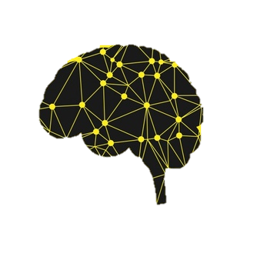
LuBAIR™ Inventory
Based in Impairment of Emotional Regulatory Circuits
Vocal Expressions
Emotional Expressions
Fretful/Trepidation Expressions

Slide 3
LuBAIR™ Inventory
Based in Impairment of Emotional Regulatory Circuits
Mood and Emotions
Distinctly different Psychological Constructs
Cannot be used interchangeably
Persistence of the same emotion for a specified duration is ‘mood’

Slide 4
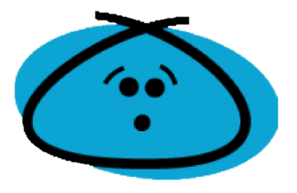
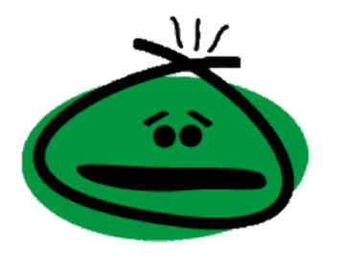
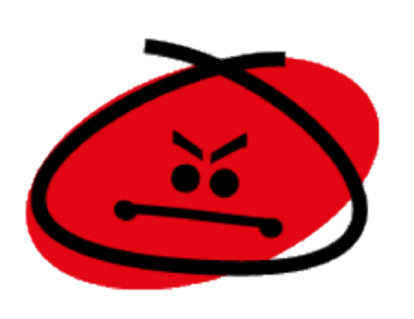
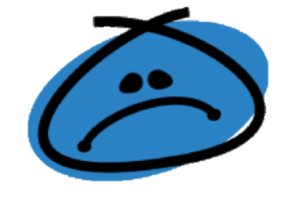
LuBAIR™ Inventory
Based in Impairment of Emotional Regulatory Circuits
Five Primary Emotions:
Joy or Happiness
Discontentment
Fear
Anger
Sadness or Melancholy
Notes:
Need a slide of sigmoid curve; discontentment at the bottom and anger at the top. Need another slide of bell curve; joy at the left end and discontentment / anger at the right end. Another slide of two intersecting circles; one has melancholy an the other is discontentment
DONE

Slide 5
LuBAIR™ Inventory
Based in Impairment of Emotional Regulatory Circuits
Anger
Discontentment
Notes:
Need a slide of sigmoid curve; discontentment at the bottom and anger at the top.

Slide 6
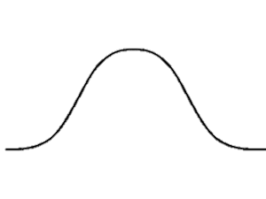
LuBAIR™ Inventory
Based in Impairment of Emotional Regulatory Circuits
Anger
Joy or Happiness
Discontentment
Notes:
Need another slide of bell curve; joy at the left end and discontentment / anger at the right end.

Slide 7
LuBAIR™ Inventory
Based in Impairment of Emotional Regulatory Circuits
Sadness or Melancholy
Discontentment
Notes:
Another slide of two intersecting circles; one has melancholy an the other is discontentment

Slide 8
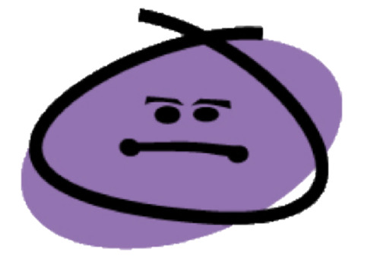
LuBAIR™ Inventory
Based in Impairment of Emotional Regulatory Circuits
Combination of emotions = secondary emotions
Optimism
Love
Awe
Disappointment
Remorse/Guilt
Contempt

