Slide 1
Section # 1 Brain and behavior.

Slide 2
Brain and Behavior
Body Circuits
Brain Circuits
Brain Functions
Notes:
Slide 5 from original PPT

Slide 3
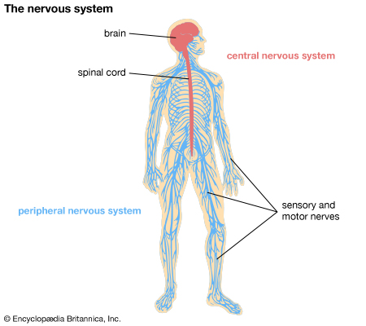
Body Circuits

Slide 4
Brain Circuits
Information Processing Circuits
Motivational Circuits
Emotional Regulatory Circuits
Self Monitoring and Regulatory Circuits

Slide 5
Brain Functions
BRAIN FUNCTIONS
Higher Cortical Intellectual Functions (HCIF)
Thinking Functions
Emotional Functions
Behavioral Functions
Notes:
Slide 6 from original PPT

Slide 6
Understanding Brain and Behavior
Brain Circuits | related to | Brain Functions
Information Processing Circuits |  | Higher Cortical Intellectual Functions (HCIF)
Motivational Circuits |  | Thinking Functions
Emotional Regulatory Circuits |  | Emotional Functions
Self-Monitoring and Regulatory Circuits |  | Behavioral Functions
Notes:
This slide does not belong here. May be later. shelf it for now.
HIDDEN
I think this slide helps to explicitly make these connections – otherwise, the listener has to make these connections themselves and may not realize that impairment of one leads to the impairment of the other (or understand why the colour scheme exists). Personally, I think this slide is necessary to make sense of how everything is connected

Slide 7
Information Processing Circuits
Higher Cortical Intellectual Functions (HCIF)
Higher Cortical Intellectual Functions (HCIF)
Executive Functions
Visuospatial
Memory
Language Functions
Praxis
Gnosia
Insight/ Judgment
Notes:
Need up and down; not side by side.
DONE
This is slide 7 from original PPT

Slide 8
Motivational Circuits
Thinking Functions
Formation of Thoughts
Thoughts
Internal and External Environment
Higher Cortical Intellectual Functions
(HCIF)
Notes:
Up and down
DONE

Slide 9
Emotional Regulatory Circuits
Emotional Functions
Generation and Regulation of Emotions
Emotions
Internal and External Environment
Motivational Circuits (Thoughts)
Higher Cortical Intellectual Functions
(HCIF)
Notes:
Up and down
DONE

Slide 10
Self-Monitoring & Regulatory Circuits
Behavioral Functions
Regulation of Social Behaviors
(Regulation of) Behavioural Functions
Internal and External Environment
Thoughts
Emotions
Higher Cortical Intellectual Functions
(HCIF)

Slide 11
Functional Model of the Brain
Information Processing Circuits
Motivational Circuits
Emotional Regulatory Circuits
Self Monitoring and Regulatory Circuits
Higher Cortical Intellectual Functions
(HCIF)
Thinking Functions
Behavioral Functions
Emotional Functions
Notes:
Slide 6 comes after this slide.
Behaviours on this slide is ok

Slide 12
Understanding Brain and Behavior
Body Circuits
Brain Circuits
Brain Functions
Peripheral Nervous System
Information Processing Circuits
Motivational Circuits
Emotional Regulatory Circuits
Self-Monitoring & Regulatory Circuits
Central Nervous System
Higher Cortical Intellectual Functions (HCIF)
Thinking Functions
Emotional Functions
Behavioral Functions
Notes:
This slide does not belong here. Needs to go after slide 13.
DONE
we need slide 5, 6 and 7 from original presentation.
DONE

Slide 13
Section # 2 Understanding brain and behavior.

Slide 14
Arousal or Alertness
Sensorium
Attention
Notes:
Need a slide before this on introducing ‘sensorium’. it’s the ‘gate-keeper’ to flow of information.
SEE PREVIOUS SLIDE
NOTE: Does it make sense to tell listeners that the sensorium is the gatekeeper before they even know what it is?

Slide 15
Arousal or Alertness
Arousal or Alertness
State of wakefulness
Psychological and physiological domain
Purpose
Reaction to stimulus
Speed of information processing

Slide 16
Attention
Attention
Behavioral and cognitive processes involved in focusing on stimulus
Purpose
Determine which “chunk” of information will be processed

Slide 17
Sensorium
Information Processing Circuits
Motivational Circuits
Emotional Regulatory Circuits
Self Monitoring and Regulatory Circuits
Higher Cortical Intellectual Functions
(HCIF)
Thinking Functions
Behavioral Functions
Emotional Functions

Slide 18
Sensorium
(gatekeeper)
Body Circuits
Brain Circuits
Brain Functions
Peripheral Nervous System
Information Processing Circuits
Motivational Circuits
Emotional Regulatory Circuits
Self-Monitoring & Regulatory Circuits
Central Nervous System
Higher Cortical Intellectual Functions (HCIF)
Thinking Functions
Emotional Functions
Behavioral Functions

Slide 19
Brain Circuits for Normal Brain Function
Regulation of Sensorium
Information Processing Circuits
Motivational Circuits
Emotional Regulatory Circuits
Self-Monitoring & Regulatory Circuits
Notes:
Need to remove this slide from here and move it down as slide 34.
DONE

Slide 20
Approach to Classification
Impairment in Regulation of Sensorium
Disorganized Expressions
Impairment in Information Processing Circuits
Misidentification Expressions
Sensorium
Information Processing Circuits

Slide 21
Approach to Classification
Impairment in Motivational Circuits
Goal Directed Expressions
Apathy Expressions
Motor Expressions
Importuning Expressions
Motivational Circuits

Slide 22
Approach to Classification
Impairment in Emotional Regulatory Circuits
Vocal Expressions
Emotional Expressions
Fretful/Trepidation Expressions
Emotional Regulatory Circuits

Slide 23
Approach to Classification
Impairment in Self-Monitoring & Regulatory Circuits
Oppositional Expressions
Physically Responsive Expressions
Sexual Expressions
Self Monitoring and Regulatory Circuits

Slide 24
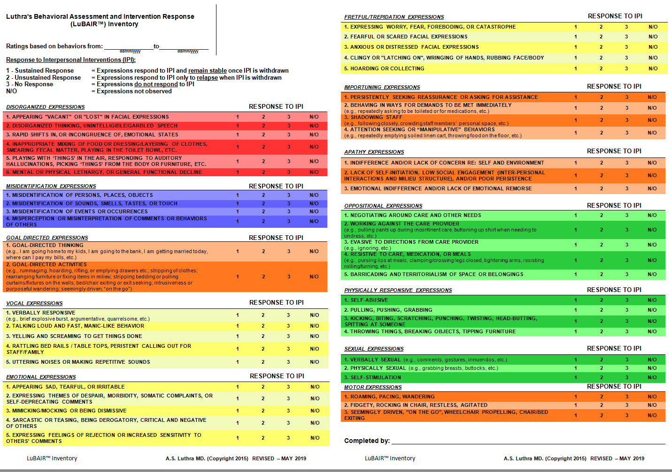
Luthra’s Behavioral Assessment and Intervention Response (LuBAIR™) Inventory

